Slide 1
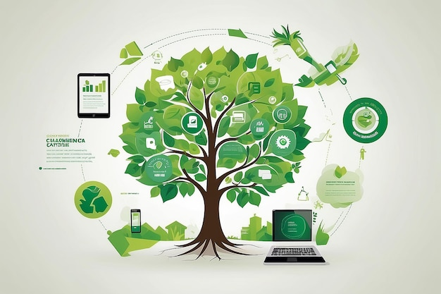


C3 Leadership, change and communication
Module 2
Digital Marketing for Sustainability
www.ecosmartproject.eu

Slide 2
Cluster 3 – Leadership, change and communication | Module 2 - Digital Marketing for Sustainability
Why this module matters to your business
Communicating sustainability effectively requires more than making claims. Hospitality businesses need authentic stories, credible evidence and communication channels that build trust with customers, employees and wider stakeholders.
01
02
03
Tell authentic sustainability stories
Build trust through transparency
Use digital channels effectively
Learn how to communicate real sustainability actions in ways that connect with customers and reflect your business values.
Use evidence, data, certifications and visible actions to strengthen credibility and avoid greenwashing.
Understand how websites, social media and customer communications can support sustainability messaging and customer engagement.
Meet the businesses you will learn from in this module
La Papa (Ireland), McNicholl Caravans (Ireland), Coco Hotel (Denmark)
Develop routines that help teams use evidence consistently, monitor progress, and improve performance over time.

Slide 3

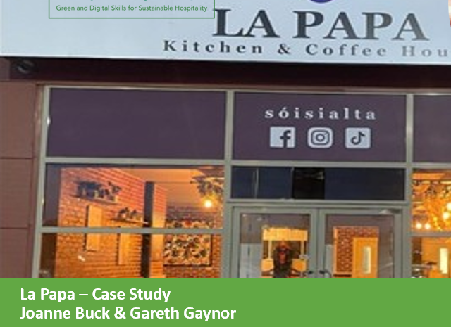
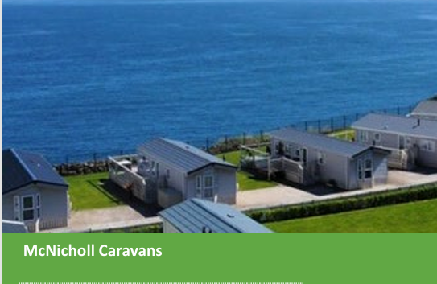

Cluster 3 – Leadership, change and communication | Module 2 - Digital Marketing for Sustainability
Where this module fits
Role :The programme's core resource for leadership, change management and strategic action, helping hospitality SMEs guide teams through green and digital transformation with confidence.
Comes after / assumes familiarity with
C2 M1 (digital tools)
C1 M1 (operations reality behind the claims)
Extends or connects to
C3 M1 (leadership positioning)
C1 M3 (guest journey)

Slide 4
Learning Objectives
By the end of this module, you will:
Understand why digital marketing is essential for communicating sustainability in your SME
Recognise key trends in ESG communication & conscious consumer behaviour
Translate sustainability actions into clear, authentic brand stories
Select and use digital tools & platforms to amplify your sustainability message
Apply entrepreneurial thinking to identify new opportunities and business value
Communicate ESG claims ethically and avoid greenwashing
Support teams in developing confident, responsible digital communication skills

Slide 5
Shared Glossary
Seven terms used across the programme. Same definitions in every module.
Term
Canonical definition
Full treatment in
Greenwashing
Making sustainability claims that are exaggerated, unverifiable, or unsupported – intentionally or by omission.
C3 M2
ESG
Environmental, Social & Governance – the three pillars used to assess a business's non-financial performance and its broader impact.
C3 M1
Nudge
A small change in how a choice is presented (a default, a reminder, the physical set-up) that shifts behaviour without restricting choice.
C1 M3
Twin transition
Advancing digital transformation and the green transition together so that each reinforces the other in SMEs.
C3 M1
KPI
Key Performance Indicator – a measurable value that shows how effectively a business is achieving a defined objective.
C2 M2
Circular economy
An approach designed to keep materials and products in use for as long as possible through reducing, reusing, repairing, refurbishing and recycling – so that waste becomes a resource.
C1 M2
Guest journey
The full sequence of a guest's interactions with a business, from awareness through booking, stay and post-stay engagement – used to design sustainability and digital touchpoints coherently.
C1 M3

Slide 6
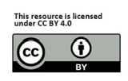
Contents
01
Introduction
Why digital marketing matters now, and how it can support sustainability
02
Understanding the Landscape
Sustainability and ESG communication & conscious consumers and decision making online
03
Strategic Storytelling
Turning sustainability and ESG actions into authentic brand stories
04
Digital Tools & Platforms
05
Entrepreneurial Thinking
inking sustainability, marketing, innovation, and new business value
06
Communication Ethics & Trust
Evidence based claims, greenwashing risk, and responsible use of AI

Slide 7
Introduction
01

Slide 8
Introduction
The marketing mix has moved online fast. Digital marketing is now where people discover, compare, and decide. Search, maps, reviews, short video, booking platforms, and email shape demand long before a guest speaks to your team. This module shows how to use digital marketing to advance sustainability, and how to make your digital marketing itself more sustainable.
AI is accelerating this shift. Guests use AI assisted search and recommendations, and purchasing through these channels is now part of everyday customer behaviour. Businesses are using AI to create content, answer questions, translate, and personalise offers. This brings speed and scale, plus new risks for trust and accuracy.
Sustainability sits inside this reality.

Slide 9
The Rise of the Conscious Customer
Customers don’t just buy a product or service…they buy into your values.
How guest expectations are shaping hospitality. Consumers want:
Transparency about environmental practices
Honest communication, no exaggeration
Visible proof of sustainability (photos, data, stories)
Meaningful local, community-connected experiences
Operators who share their values
Trends:
76% of travellers want more sustainable options (Source)
Younger guests expect authenticity and digital access to information (Source)
Experiences that feel personalised, authentic, not performative
See also ›
C3 M1
- Leading Green and Digital Change

Slide 10

Digital Marketing for Sustainability has two skill sets
01
02
You learn to make your sustainability actions visible and credible online.
You learn to run your digital marketing in a lower waste, lower impact way.
See also ›
C3 M1
- Leading Green and Digital Change

Slide 11
01.
Why digital marketing is vital for communicating sustainability
Hospitality marketing is now an always on system: search, maps, reviews, online travel agents, website, social, email, messaging.
Consumers move between channels in minutes, and each channel influences the next.
It is a living set of signals that is checked every day.
Sustainability only influences choice when it is visible and consistent, with a clear core message and proof.
This is why your sustainability story needs a simple structure you can reuse everywhere: action, proof, and what it means for the consumer.
If you don’t tell your sustainability story, someone else will or customers will assume there isn’t one.
See also ›
C2 M1
- AI in Hospitality

Slide 12
Guests Experience Journeys, Not Departments
Search
Maps
Reviews
Online Travel Agents
Social
Media
Messaging
Find Needs
Local Discovery
Builds Trush
Compare & Book
Proof of Reality
Fast Replies
See Next Slide

Slide 13
What “always on” means in practice
Hospitality marketing is always on because your digital presence is your shopfront: open 24/7, checked daily, and judged in seconds. There are multiple elements. As you review each digital marketing channel, think about your own online listing and pages.
Search: guests type needs, near me, family friendly, EV charging, local food. You need clear pages that match those searches.
Maps: Google Maps is a decision screen. Photos, categories, attributes, opening hours, and questions and answers shape trust.
Reviews: your reputation is constantly updated. How you reply is part of marketing, especially on sustainability questions.
Online Travel Agents: (e.g. platforms like booking.com) guests compare quickly. They scan photos, policies, and key points, then decide based on clarity and confidence.
Website: it is your source of truth. It must confirm what other channels promise and make booking easy.
Social: this is your proof of reality. It shows atmosphere, people, and authenticity.
Email: this converts and retains. Pre arrival emails guide choices, post stay emails drive reviews and repeat visits.
Messaging: fast replies win bookings. It is also where practical sustainability questions can show up, parking, refill points, linen policy, accessibility.

Slide 14
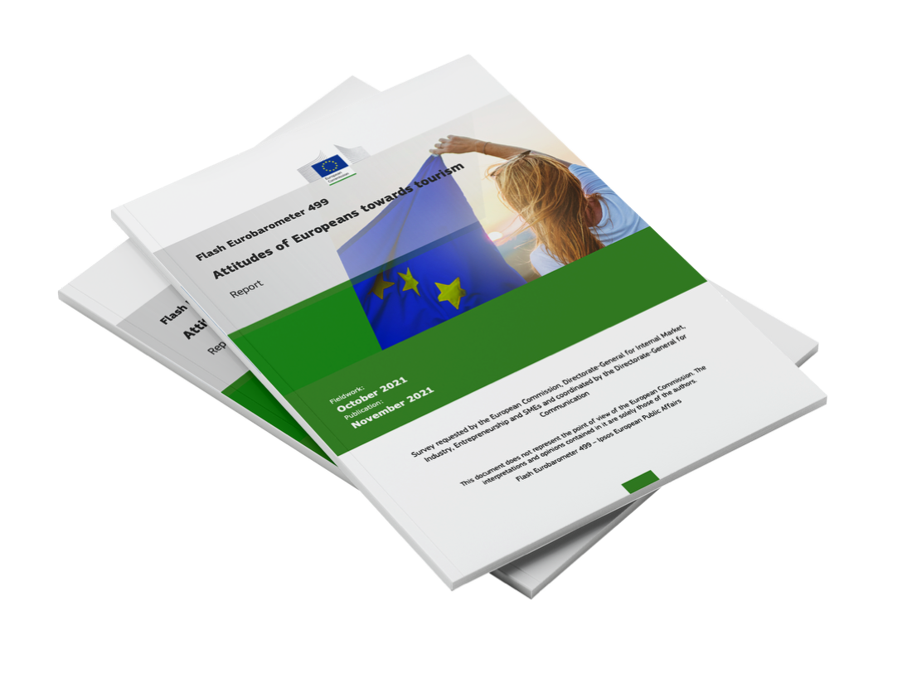
Consumers Care About Sustainability
CLICK TO VIEW
82% prepared to change habits for more sustainable tourism.
EU Flash Eurobarometer, Attitudes of Europeans towards Tourism: https://www.ipsos.com/sites/default/files/ct/news/documents/2021-12/EU-attitudes-tourism-report.pdf
82%

Slide 15
Put Sustainability
Where Choices Happen:
Consumers Care About Sustainability
⁰¹
Examples: Weak midweek RevPAR, high waste at Sunday brunch
What does this
mean for you ?
It means sustainability and ESG can influence demand, yet only when guests can see clear signals during their normal booking journey. For you, that translates into key and practical digital marketing moves.
Use Proof, Not Promises:
⁰²
Guests trust specific actions with evidence. Vague claims create doubt and risk.
Keep Wording Consistent Across Channels
⁰³
One message on your website and a different message on social media replies weakens credibility.

Slide 16
Consumers Care About Sustainability
⁰¹
⁰²
⁰³
Treat sustainability content as operational
Use eco labels
and recognisable signals
AI raises the standard:
It needs an owner, a monthly update routine, and a simple approval step.
Where you have them and explain what they mean in plain language.
It can spread weak claims fast. Anything sustainability related needs a human fact check and a proof link.
Exercise - What you should do next, simple and fast:..:
Run a 30 second guest scan of Google Maps, one OTA listing, and your website. Can a guest find one clear sustainability action and proof quickly.
Build a Proof Pack: 6 actions, 6 proof points, 12 photos, one short sustainability web page, and 10 approved lines for staff and review replies.
Use one repeatable sentence structure everywhere: Action + Proof + Guest meaning

Slide 17

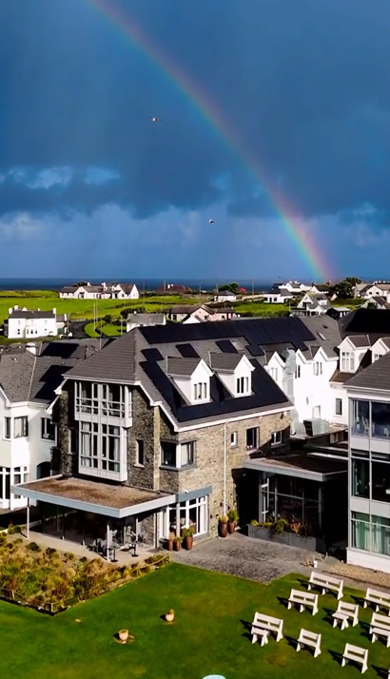
Who does this well ?
Let’s visit Armada Hotel, Ireland
Armada do a smart thing on their “Our Values” page: they publish a scannable list of 20 practical actions, so guests can see real changes quickly
They turn sustainability into guest experience and memorable stories. Discover Ireland highlights how Armada connect sustainability to a guest experience hook and to wellbeing, for example a wet hair discount in the coffee shop, discounts for reusable cups and a Wellbeing Manager 8 Eco-Friendly Places to Stay in Ireland
Independent reinforcement of sustainability shows up in Irish media and national tourism content. How to have a sustainable holiday in Clare – The Irish Times
Pic: Instagram
READ: Our Values | Armada Hotel

Slide 18
Who does this well ?
Let’s visit Armada Hotel, Ireland
They link food sustainability to a tangible asset with local Armada Farm supplying produce and a product story (e.g. seaweed as a fertiliser) that guests can repeat. You can download their Local Supplier Expenditure Policy from their website. The hotel targets at least 50% of non labour supplier spend with businesses within 80 km of the hotel.
They use place, community, and culture as part of the sustainability message The Irish Times describes sustainability as visible on site and connected to local systems (solar panels, local food, removing single use plastic, refill stations), plus community and staff wellbeing as part of the overall story.
They lead with trusted signals, then explain what it means. They position B Corp as a credibility marker and explain it in plain language across ESG pillars (governance, workers, community, environment, customers), including their impact assessment score and ongoing goals.
READ: Our Values | Armada Hotel

Slide 19
02.
And then there is sustainable digital communications
Digital communication has an environmental footprint. It uses electricity in data centres, networks, and devices. Sustainable practice reduces unnecessary data and energy and reduces digital overload for guests and staff.
Some immediate actions:
Cut website and content emissions by reducing page weight and data transfer: lighter pages, compressed images, fewer auto loading videos, fewer trackers
Choose lower impact hosting and suppliers by selecting greener hosting options and keeping digital systems lean
Reduce inbox pollution and wasted sends through better targeting and cadence: fewer emails, smaller files, clear segments, remove inactive contacts
Run paid media with less waste by improving targeting and landing page match, and stopping low value campaigns
Use media and AI in a resource aware way: reuse core assets, avoid duplicate versions across channels, draft and repurpose with controls, verify facts, limit unnecessary generation

Slide 20
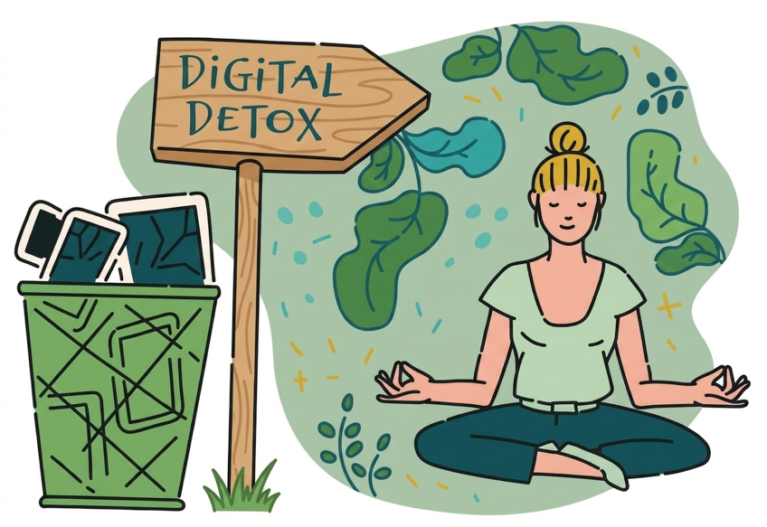
Sustainable Digital Communications and Digital Wellbeing
Sustainability is also social. Guests and staff are overloaded by constant screens, notifications, and noisy messaging. Sustainable communication gives people choice, clarity, and calmer interactions.
What you can do
Design calmer guest journeys, fewer messages, more useful messages
Offer digital detox options while keeping service quality high
Replace push with pull, make information easy to find when needed

Slide 21

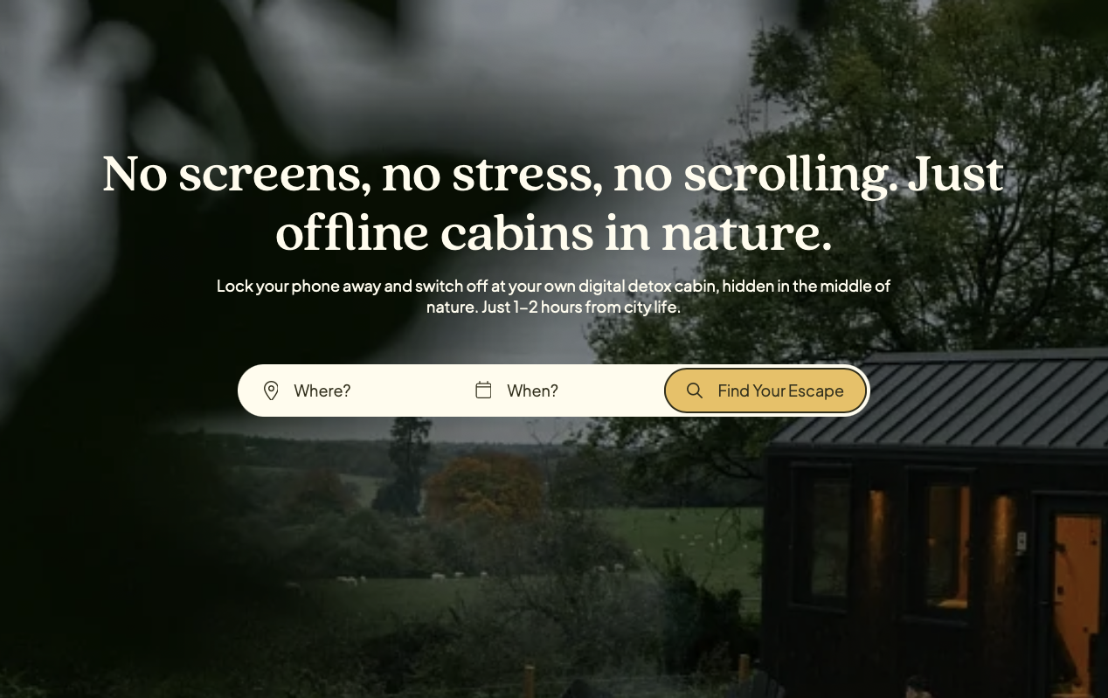
Example
CLICK TO VIEW

Slide 22
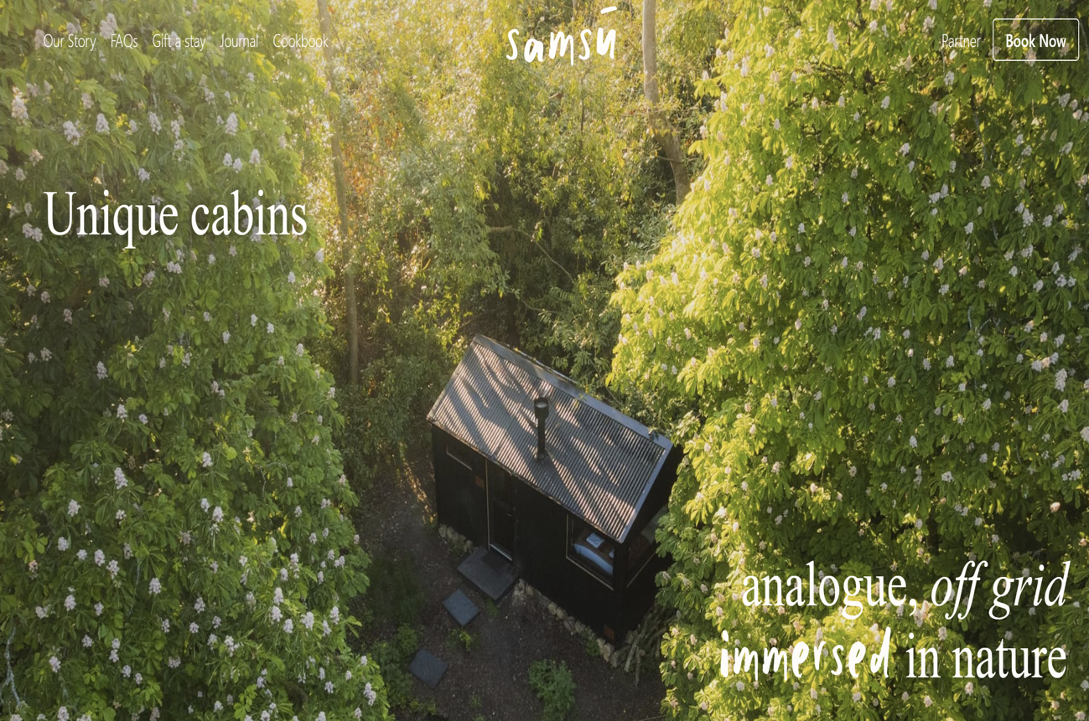
Example
CLICK TO VIEW

Slide 23
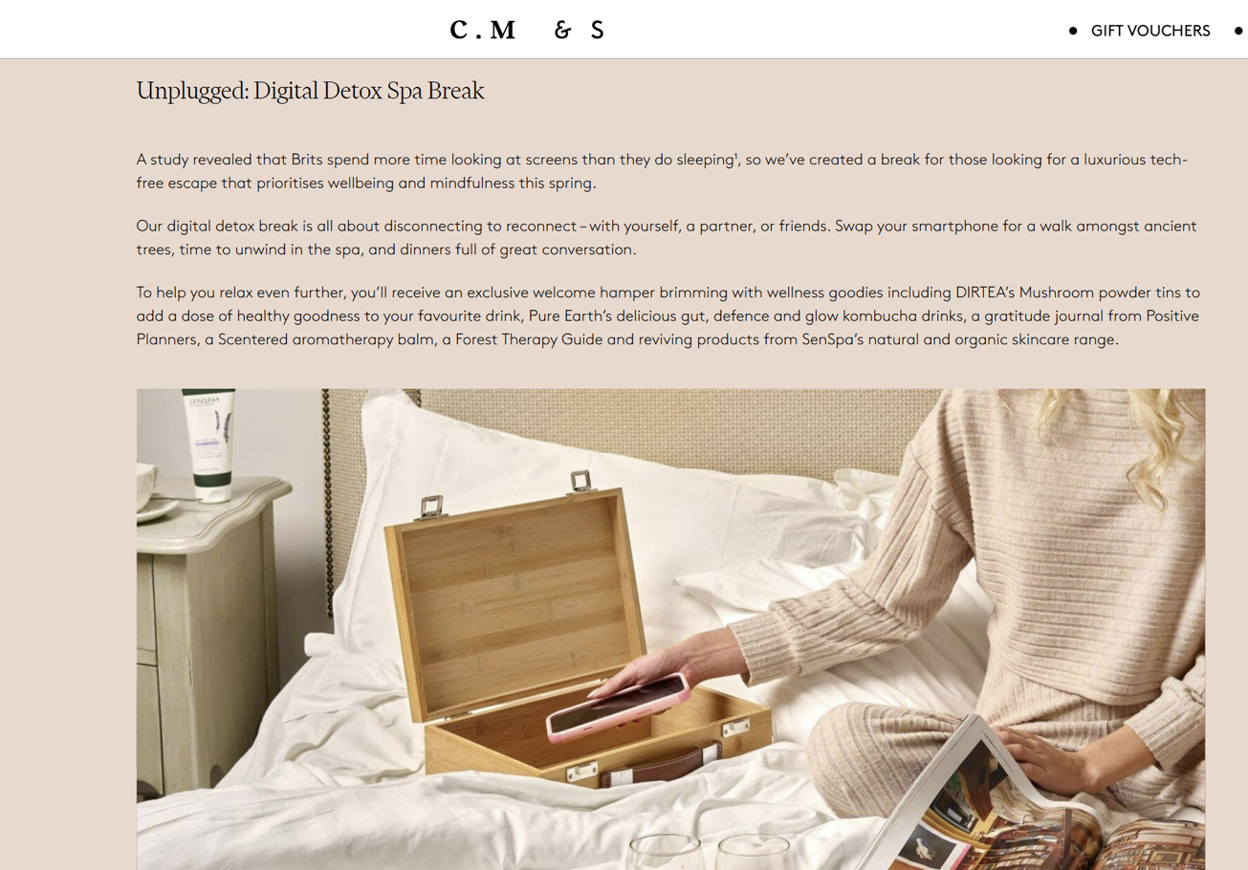
Example
CLICK TO VIEW

Slide 24

Sustainable Digital Communications and Digital Wellbeing
Practical actions
Offer a “quiet stay” option: reduced messages, fewer prompts, only essential updates
Provide one simple guest info hub: QR page that replaces multiple messages and leaflets
Set communication windows for teams: agreed response times, fewer after hours notifications
Use short, clear messages that reduce back and forth: one question, one answer, one next step

Slide 25
Understanding
the Landscape
ESG communication & Conscious consumers
02
See also ›
C3 M1
- Leading Green and Digital Change

Slide 26

ESG stands for:
Environmental
Social
Governance
How your business
reduces waste, energy use, water use, emissions & environmental impact.
How you treat staff,
support your community, promote well-being,
diversity & fair working conditions
How responsibly your business is run… transparency, ethics,
health & safety,
compliance, risk management.

Slide 27
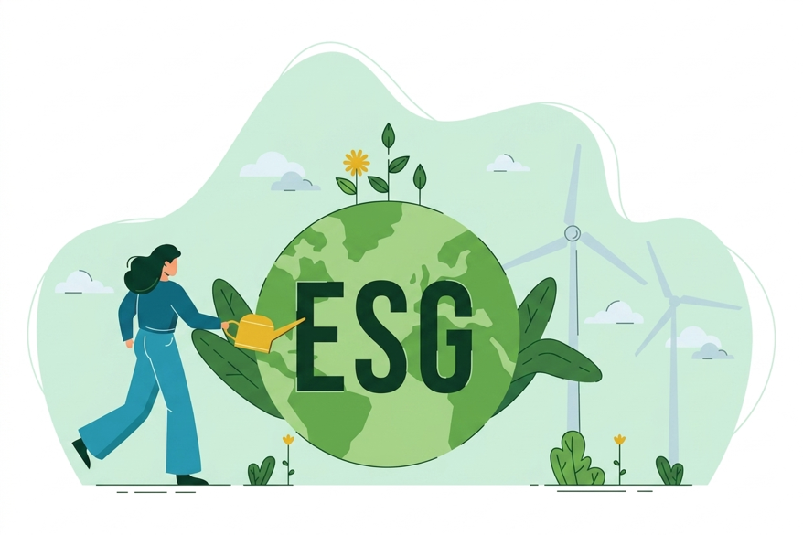
Why it matters:
Key message:
ESG is what good hospitality already does. Digital marketing simply makes it visible
ESG is the framework Europe uses to define responsible, sustainable business practices.
Hospitality SMEs already do many ESG actions, they just don’t always communicate them.

Slide 28
What is ESG Communication?
Sharing your environmental, social & governance actions clearly & honestly.
What it means:
Communicating what you do, why you do it, and what impact it has.
Highlighting sustainability actions, community engagement, staff initiatives & ethical practices
Using digital platforms to share credible, evidence-based information
Making it easy for customers to understand your values & efforts
Examples of ESG communication:
Showing how you separate waste
Sharing photos of local suppliers
Posting energy-saving improvements
Introducing your team & community involvement
Explaining your commitment to fair work and safety

Slide 29

EU Expectations: Honest, Evidence-Based Communication
Key EU rules shaping ESG communication:
Green Claims Directive: vague or unverified claims (“eco-friendly”, “green hotel”) will be restricted
CSRD: larger companies must report ESG data, pushing SMEs to be more transparent
Claims must be specific, measurable, and truthful
Safe ESG communication looks like:
“We reduced energy use by 12% in 2024.”
“We source 60% of produce from local suppliers.”
CLICK TO VIEW
How to identify Greenwashing and Make Sustainable Choices

Slide 30
Why ESG Communication Matters in Hospitality
ESG communication connects your sustainability actions to the people who care about them.
For your Business
For your Team
For your customers
Builds stronger, more credible brand reputation
Differentiates you from less transparent competitors
Attracts conscious customers & boosts repeat bookings
Creates pride & purpose around sustainability actions
Improves confidence & knowledge
Encourages involvement & innovation
Supports recruitment & retention
Helps them make informed choices
Builds emotional connection & trust
Strengthens perceived value
Drives positive behaviours, reviews & loyalty

Slide 31
Strategic
Storytelling
Turning ESG actions into authentic brand stories
03
See also ›
C3 M1
- Leading Green and Digital Change

Slide 32

What Is Strategic Storytelling in Sustainability?
Not fiction. Not marketing spin. It’s structured, honest communication in the form of strategic storytelling
Turns real ESG actions into clear, engaging narratives
It helps guests understand your journey, what you do, why it matters, and how it creates impact
Stories to build emotional connection → connection builds trust → trust drives bookings
Hospitality thrives on stories: people, places, communities, experiences
Storytelling bridges the gap between daily actions and digital visibility

Slide 33
What Makes a Sustainability Story Authentic?
Transparency is more
powerful than perfection.
Three elements:
Truth → Context → Proof
Truth: real actions, real results, real efforts…not exaggerations
Context: why you chose this action (local issue, guest need, team idea)
Proof: a photo, data point, quote, example or before/after
Avoid:
Vague claims (“eco-friendly”, “green hotel”)
Overpromising (“100% zero waste”)
Borrowed stock photos (create distrust)
Use:
Real staff
Real suppliers
Real daily practices

Slide 34
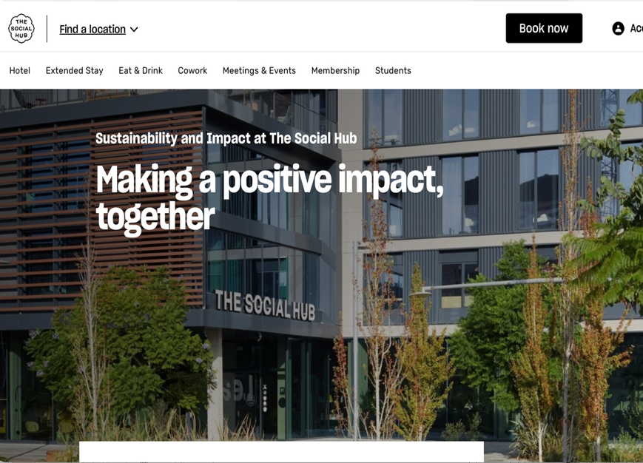
An Example of Effective
Digital Storytelling…
A really interesting business model, what started as a student hotel is a now a hotel for all, a community hub, a co-workspace and everything in between, with multiple sites across Europe.
They built a dedicated impact hub on their website that acts as a single place for their sustainability and ESG story, with clear navigation to evidence. Sustainability and Impact at The Social Hub - The Social Hub
They tell the story with numbers and narrative together: their Impact Report leads with a “year in numbers” section and a clear “our sustainability story” narrative, so it feels real and concrete.
They translate ESG into visible programmes guests and partners can understand, for example internal ambassadors, community activity, and measurable initiatives, presented as part of the brand story.
CLICK TO VIEW

Slide 35
An Example of Effective
Digital Storytelling…
They built a dedicated impact hub on their website that acts as a single place for their sustainability and ESG story, with clear navigation to evidence. Sustainability and Impact at The Social Hub - The Social Hub
They tell the story with numbers and narrative together: their Impact Report leads with a “year in numbers” section and a clear “our sustainability story” narrative, so it feels real and concrete.
They translate ESG into visible programmes guests and partners can understand, for example internal ambassadors, community activity, and measurable initiatives, presented as part of the brand story.

Slide 36
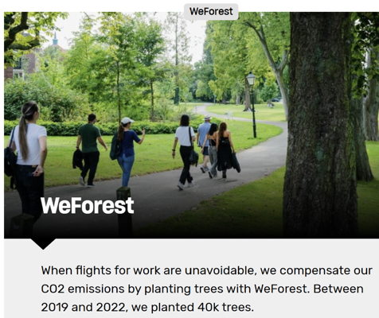
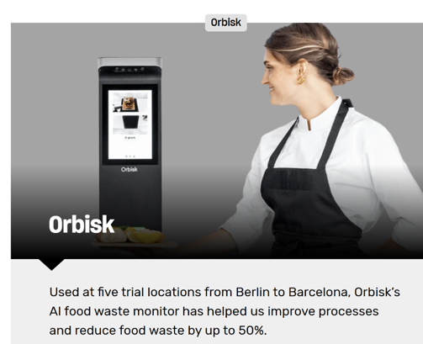
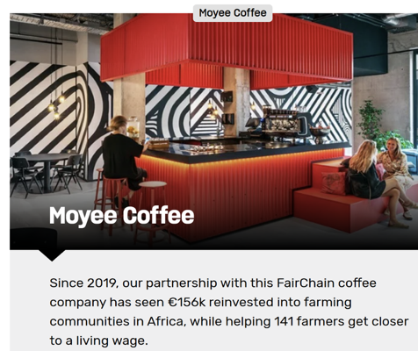
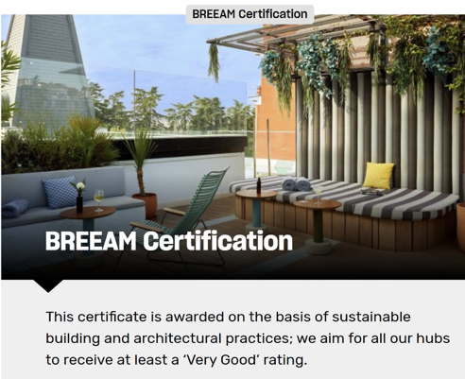
Every detail is shared, even the toilet paper sourcing!
Read their IMPACT REPORT, it is full of inspiration
13463 The Social Hub - Impact Report FY23-24_def

Slide 37
A Simple Story Structure for Hospitality SMEs
A 4-part formula that works well…
Problem or Insight - What sustainability challenge are you addressing? (e.g., food waste, energy waste, local sourcing needs)
Action You Took - Describe the specific steps your business implemented.
Impact or Result - Show the outcome with a number, photo, quote or small example.
Invitation - Invite guests or partners to be part of the solution. (“Join us by…”, “We welcome your ideas…”, “Learn more on…”)
Example:..
We noticed large amounts of breakfast waste every weekend →
So, we redesigned our buffet + trained our team on portion planning →
Food waste dropped by 22% →
You can help by choosing smaller portions and returning for seconds.”

Slide 38
Types of ESG Stories You Can Tell
See also ›
C1 M2
- Circular Economy and Resource Efficiency
There is more to sustainability than recycling.
Environmental Stories
Social
Stories
Governance Stories
Reducing food waste
Energy-saving changes
Water stewardship
Local sourcing
Biodiversity or green space initiatives
Staff training & well-being
Community partnerships
Diversity & inclusion
Local employment
Supporting local artisans
Responsible procurement
Safety & ethics
Transparency initiatives
Fair pricing & honest communication
Every daily action can become a story if you bring it to life

Slide 39
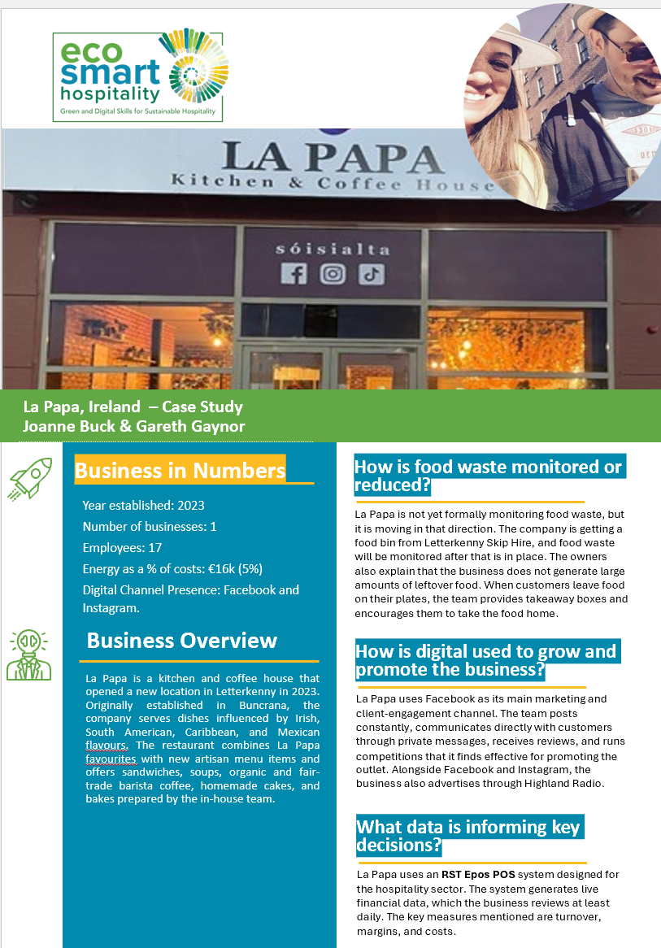
La Papa
La Papa demonstrates how small hospitality businesses can build strong customer relationships through authentic communication and consistent digital engagement. Rather than relying on large marketing budgets, the business uses Facebook, Instagram, TikTok and Google to maintain regular contact with customers, promote new offerings and encourage interaction.
The business combines digital communication with real operational actions. Local sourcing plays an important role, particularly through its relationship with Ballyholey Farm, which supplies fresh produce. This provides genuine sustainability stories that can be shared with customers through social media and day-to-day conversations.
La Papa also demonstrates the importance of two-way communication. Reviews, private messages, competitions and social media engagement provide valuable feedback while helping customers feel connected to the business. This creates stronger relationships and encourages repeat visits.
Key Learning: The most effective sustainability stories are grounded in real business practices and communicated consistently through channels customers already use.

Slide 40
Digital Tools
& Platforms
Using digital technologies to amplify impact
04

Slide 41
Why Digital Tools Matter for Sustainability Marketing
If sustainability happens offline and you don’t share it online, the impact is lost.
Digital Marketing Tools can help create…. Visibility • Consistency • Credibility
Digital marketing tools make sustainability visible to guests before they arrive and in real-time
They help you & your business communicate real actions with low cost & high reach
Tools allow quick updates (stories, photos, metrics, improvements)
They help build trust through transparency & regular communication
Digital platforms extend the impact of ESG stories far beyond the premises
Businesses gain visibility equal to larger competitors through creativity, not budget

Slide 42
Bringing Your Stories to Life Digitally
Best channels:..
Instagram Stories/Reels
TikTok (for younger audiences)
Google Business Profile posts
Website sustainability page
Digital menus (QR codes linking to stories)
In the last section, we discussed the benefits of storytelling for building team support and how digital tools can assist in everyday practices. Digital tools and a smartphone are also very effective for turning operational actions into visible stories.
Effective formats for SMEs:
Short videos (30–60 seconds) showing real actions
Before/after photos (e.g., waste reduction, menu redesign)
Staff stories (“Meet Maria: our sustainability champion”)
Supplier features (local food, community links)
Behind-the-scenes tours (waste sorting, composting, prep)
Mini data points (“20% less waste this month!”)
See also ›
C3 M1
- Leading Green and Digital Change

Slide 43
Core Digital Platforms for Hospitality SMEs
TIP:
Choose platforms your guests actually use. Consistency matters more than quantity.
Social Media Platforms
Website & SEO
Instagram → visuals, short videos, behind-the-scenes sustainability
TikTok → quick storytelling, staff content, process videos
Facebook → community partnerships, local stories
YouTube Shorts → longer sustainability update
Sustainability landing page
Supplier stories, community actions, energy/waste improvements
SEO keywords like “sustainable hotel”, “eco-friendly restaurant”, “local sourcing”
Google Business Profile
Email Newsletters
Add sustainability updates
Post photos of real ESG practices
Improve ranking for conscious consumers
Share impact updates,
Seasonal menus
Regular improvements
g

Slide 44
Digital Tools That Support Sustainable Storytelling…
Content
Creation Tools
Operational
Tools that
Create Content
Social Media Management Tools
Canva → simple designs, icons, story templates
CapCut → quick video editing for Reels/ TikTok
Adobe Express → branded content with minimal skills
Digital waste apps → create impactful visuals
Energy dashboards → provide proof needed
QR menus → link to sustainability stories
Feedback tools → capture positive green comments
Celebrate progress publicly
Share before/after examples
Highlight evident improvements
Recognise staff who contribute to change
Reinforce the WHY

Slide 45
Matching the Right Tool to the Right Message
See also ›
C1 M1
- Integrating Sustainability in Daily Operations
Different sustainability actions require different content formats. It is important to choose the platform that tells the story best. Review and plan your approach.
ESG Action.. | Best Digital Tool.. | Why..
Reducing food waste | Instagram Reels / TikTok | Visual process → builds trust
Local supplier partnership | Website / Carousel | Space to tell deeper stories
Staff well-being | Instagram / LinkedIn | Human interest content
Energy-saving upgrade | Google Business Update | Shows credibility to searchers
Community involvement | Facebook / Email | Longer storytelling + reach
New sustainable menu | Instagram Stories | Fast, visual, engaging

Slide 46
Learner/Leader Exercise:
Create Your 60-Second Sustainability Story
Step 1 - Choose a Real ESG Action (Pick one sustainability action your business (or a learner’s placement site) is already doing)
Step 2 - Use the 4-Part Story Framework
Step 3 - Turn it into a 60-Second Story
Combine the four parts into a short-spoken story or a caption that could be used as:
an Instagram Reel script
a Google Business update
a TikTok voiceover
a website sustainability highlight
This exercise aims to help you translate simple ESG practices into clear, authentic narratives
See also ›
C3 M1
- Leading Green and Digital Change

Slide 47
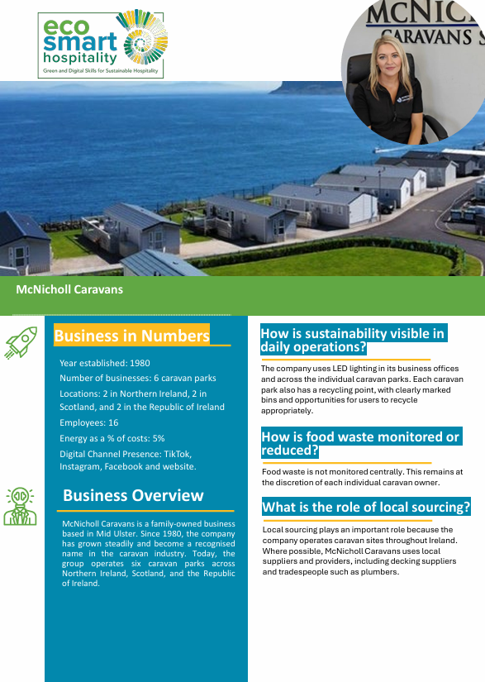
McNicholl Caravans
McNicholl Caravans demonstrates how digital communication can strengthen customer relationships and support business growth. The family-owned business has transformed the way it communicates with customers, moving from traditional postal communication to digital channels including email, social media, podcasts and video content.
A particularly effective approach is the use of walk-through videos, which allow potential customers to experience caravans virtually before making enquiries or visiting a site. The company uses TikTok, Instagram, Facebook and its website to communicate with current and prospective customers, creating a more engaging and accessible customer experience.
The business also demonstrates how branding can be linked to organisational values. Family ownership, trust, openness and customer care are consistently reflected in communications, helping strengthen credibility and customer loyalty.
Key Learning: Effective digital marketing combines useful content, strong customer communication and authentic business values to build long-term trust.

Slide 48
Entrepreneurial
Thinking
Linking marketing, innovation & new business value
05

Slide 49

What Is Entrepreneurial Thinking?
Entrepreneurial thinking is the ability to spot opportunities, solve problems creatively, and turn good ideas into practical actions that add value.
It means being curious, proactive and willing to test small improvements, not waiting for perfect conditions or big budgets. Entrepreneurial thinking is about seeing possibilities and acting on them.

Slide 50

Entrepreneurial Opportunities Created by Sustainability
Every type of hospitality business can create new value through ESG
Sustainability creates opportunities for new products, services & guest experiences
Digital visibility makes even small actions more valuable
Each hospitality segment has unique “innovation hotspots”
Guests increasingly choose businesses with strong values & authentic stories
ESG action → differentiation → new revenue streams

Slide 51
Creating Value in Your Business…
Sustainability opens different entrepreneurial doors depending on your hospitality sector…use your strengths.
Hotels: energy-saving upgrades showcased digitally to strengthen brand trust
Boutique hotels & guesthouses: local supplier stories that enhance guest experience
Restaurants & cafés: zero-waste dishes, seasonal menus, composting stories
Self-catering: digital guides promoting eco-friendly travel & local experiences
Holiday parks & glamping: nature-based experiences & low-impact living stories
Hostels: community engagement, recycling culture, social impact narratives
Banqueting & MICE: sustainable event packages, low-waste catering
Spas & wellness: natural products, low-energy heating, wellbeing partnerships

Slide 52
Innovation Toolkit for All Hospitality SMEs
Spot, test & scale ideas across every type of business
Observe what guests photograph or share
Let staff from each area
Learn from partners & suppliers
It reveals what they value
Of the business suggest improvements
They often spark sustainability ideas
Look at guest reviews
Use small experiments
Use digital insights
These often highlight needs & opportunities
Tailored to your business size
(Comments, trending topics) to guide innovation

Slide 53
Innovation Examples by Sector
Observe
→
Test
Improve
→
Innovation looks different in every hospitality segment, but the mindset is the same:
Hotels: trial “green stay” discounts for reduced housekeeping
Boutique hotels & guesthouses: promote hyper-local breakfast experiences
Restaurants: launch a “chef’s sustainability table” or low-carbon specials
Self-catering: offer reusable kit rentals (bags, crates, bikes)
Holiday parks & glamping: introduce nature trails, solar-powered amenities
Hostels: run community events, repair workshops, volunteer days
Banqueting & MICE: measure event carbon footprint & share results digitally
Spas & wellness: develop eco-friendly rituals or botanical treatments

Slide 54
Building an Entrepreneurial Culture Across Hospitality SMEs
In the last module we discussed leading the twin transition. Now we build on that theme to create a culture that welcomes ideas, experiments and creativity. Entrepreneurial culture thrives when everyone feels they can contribute, every role included.
Sector-Specific Indicators of Entrepreneurial Culture:
Hotels: cross-department innovation briefings
Boutique hotels: storytelling led by staff who know guests well
Restaurants: chef-driven creativity around waste & local sourcing
Self-catering: innovation in guest communication & digital guides
Holiday parks: seasonal experimentation with eco-experiences
Hostels: youth-driven, community-led sustainability projects
MICE venues: client collaboration to design low-impact events
Spas: staff-led improvements in wellness rituals & product sourcing

Slide 55
Learner/Leader Exercise:
Sector-Based Opportunity Design
Choose Your Sector (30 seconds)
Identify One Opportunity (3 minutes)
Ask yourself:
What sustainability challenge exists in this sector?
What guest needs or expectation connects to it?
Propose a Small Innovation (3 minutes) - Define:
One idea to test
One digital tool to promote it (Reels, TikTok, website, Google post)
One simple success indicator (engagement, reviews, uptake)
Share Quickly (2–3 minutes)
Explain: sector → challenge → innovation → digital proof → expected value
Hotel
Guesthouse
Restaurant
Café
Self-catering
Holiday park
Glamping
Hostel
MICE
Spa
Small sector-specific ideas + smart digital sharing = meaningful innovation.

Slide 56
Communication Ethics & Trust
Building credibility & avoiding greenwashing
06
See also ›
C3 M1
- Leading Green and Digital Change

Slide 57

Why Ethics Matter in Sustainability Communication
Trust needs to be the foundation of your brand. Make that your differentiator. Honest communication protects your reputation and strengthens guest loyalty.
Guests expect honest, transparent sustainability information
Misleading claims damage trust, reviews & long-term reputation
Ethical communication builds credibility with guests, communities & partners
EU regulations require accuracy & proof in environmental claims
Trust grows when actions match the stories you tell

Slide 58
What Is Greenwashing?
TIP: If you can’t prove it, don’t say it!!
Greenwashing is making your sustainability efforts seem better than they are. Greenwashing happens when:
Claims are vague (“eco-friendly”, “green hotel”, “sustainable stay”)
Statements can’t be proven or measured
Images imply practices you don’t actually do
Marketing exaggerates impact (“zero waste”, “carbon neutral”)
Perfect-sounding messages hide real challenges
See also ›
C1 M3
- Sustainable Customer Experience Design
Examples in hospitality:..:
Using green leaves/icons with no evidence behind them
Claiming “plastic-free” while using single-use items
Promoting local food with no sourcing verification

Slide 59

EU Requirements for Honest ESG Claims
See also ›
C3 M1
- Leading Green and Digital Change
Transparency is no longer optional, it is a requirement!
EU Green Claims Directive
CSRD
(Corporate Sustainability Reporting Directive)
For SMEs this means:
Criteria to stop companies from making misleading claims about the environmental merits of their products and services
EU rules require large companies to publish regular reports on how their activities impact people and the environment
Use real data (percentages, examples)
Keep records of actions (photos, supplier proof, invoices)
Ground every claim in evidence; steer clear of exaggeration and “aspirational language”
Environmental claims must be specific, truthful, and verifiable
No vague or absolute statements allowed
Businesses must provide accessible evidence
Larger companies require verified ESG data from partners, which impacts SMEs
Hospitality suppliers must be transparent about their actions

Slide 60
What Ethical Sustainability Communication Looks Like
Clear • Specific • Evidence-based
Good practice examples:..
“We reduced food waste by 18% this season.”
“60% of our suppliers are local (within 50 km).”
“We installed solar water heating in 2023.”
“We are working to reduce plastic use and have removed straws & stirrers.”
Avoid:..
“We are 100% sustainable.”
“Eco hotel.”
“Zero impact dining.”

Slide 61
Avoiding Greenwashing Across Hospitality Segments
Ethical communication must fit the reality of your sector & operations.
Hotels: promote optional housekeeping as “eco-friendly” when you can show measurable benefits
Boutique hotels & guesthouses: Avoid romanticising sustainability; focus on real local sourcing & community ties
Restaurants & cafés: Be clear about what’s truly local or seasonal. Don’t overstate “organic” or “zero-waste” unless fully verified
Self-catering accommodations: Be precise about energy-saving features or recycling facilities
Holiday parks & glamping: Use real photos of eco-practices (not stock forest images)
Hostels: Be transparent about community involvement & budget constraints
Banqueting & MICE: back every “sustainable events” claim with detail on catering, waste and energy practices
Spas & wellness centres: when using “natural” or “clean”, list the ingredients to back the claim

Slide 62

Real stories + real numbers = real trust
Hospitality SME proof examples:
Before/after photos
Supplier invoices
Recognised Bio or eco-certification
Energy/waste dashboard screenshots
Staff training certificates

Slide 63
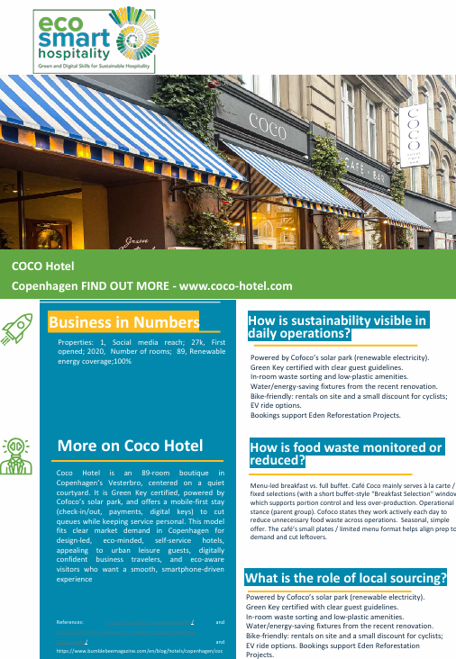
Coco Hotel
Coco Hotel demonstrates how sustainability communication can become part of the overall guest experience. The Copenhagen hotel combines Green Key certification, renewable energy, digital guest services and visible sustainability practices to create a clear and credible sustainability message.
The hotel communicates sustainability through multiple channels. Guests encounter sustainability information through the website, booking journey, digital guest experience, social media content and on-site practices such as waste sorting and renewable energy use. These actions are supported by recognised certification and transparent reporting, helping build customer trust.
Social media also plays an important role. The hotel uses stories, guest-generated content, polls, direct messaging and visual content to maintain relationships before, during and after a guest stay. Sustainability is presented as part of the overall brand experience rather than as a separate marketing message.
Key Learning: Customers are more likely to trust sustainability claims when they can see evidence through certifications, visible actions and consistent communication across multiple touchpoints.

Slide 64
Learner/Leader Exercise:
Rewrite these Claims more ethically:
“We are an eco-friendly hotel.”
“Our restaurant is 100% sustainable.”
“We use only local ingredients.”
“Zero-waste breakfast.”
“Our spa uses clean, natural products.”
“We care about the environment.”
Determine what is unclear, exaggerated or unverifiable about these claims?

Slide 65
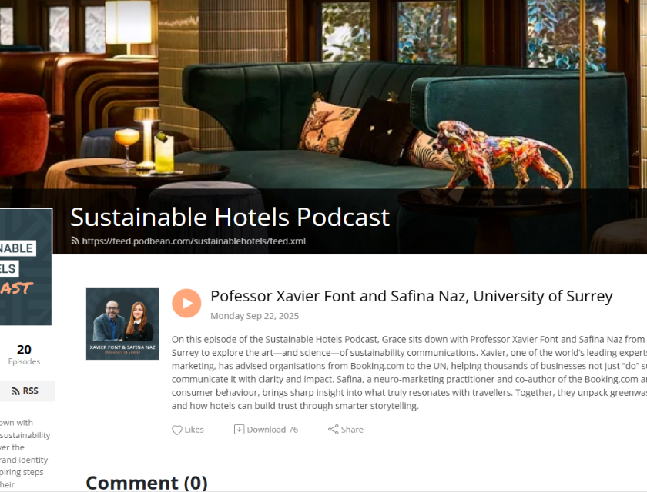
Relevant Podcasts
Professor Xavier Font and Safina Naz, University of Surrey | Sustainable Hotels Podcast
This episode explores how hospitality businesses can communicate their sustainability work in credible, meaningful ways. Professor Xavier Font, a leading expert in sustainability marketing, and Safina Naz discuss the art and science of sustainability communication, including how to avoid greenwashing
CLICK TO VIEW

Slide 66

Conclusion
This module explored how digital marketing makes your sustainability actions visible, credible and valuable to guests.
You learned to turn real ESG practices into authentic stories, use the right digital tools to amplify impact, and apply entrepreneurial thinking to create new opportunities across all hospitality sectors.
The module also reinforced the importance of ethical communication, helping you avoid greenwashing and build long-term trust with customers.
Notes:
UNESCO-UNEVOC – Green and digital skills for hospitality and tourism
https://unesdoc.unesco.org/ark:/48223/pf0000391115
European Commission – Digital skills in tourism (Digital Skills & Jobs Platform)
https://digital-skills-jobs.europa.eu/en/topics/tourism
UNWTO – Sustainable tourism and measurement (resources on energy and resource efficiency)
https://www.unwto.org/sustainable-development

Slide 67
C3 M2 · Case study pack
Download the full case studies
Every business featured in this module has a full case study. Use the links below to open each one.
La Papa – Ireland
McNicholl Caravans – Ireland
Nudges, Facebook/Instagram engagement
Digital customer engagement through multiple digital channels
Download the full case study · {{CASE_URL_LAPAPA}}
Download the full case study · {{CASE_URL_MCNICHOLL}}
Coco Hotel– Denmark
Sustainability claims supported by visible evidence.
Download the full case study · {{CASE_URL_COCO}}

Slide 68
Thank You for Engaging
We hope this module has enriched your knowledge and sharpened your practice.
Thank you for your commitment to hospitality that is intelligent, sustainable, and human centred. Carry these insights into your work, lead with ethics and empathy, and let technology serve people with care.
www.ecosmartproject.eu

