Slide 1


Cluster 3: Module 1
Leading Green & Digital Change
www. ecosmartproject.eu

Slide 2
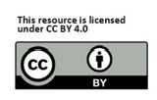
Why This Module Matters – For Your Business, Your Team and Your Guests/Customers
Hospitality is personal. Hospitality is hands-on, fast-paced and human. Every day, you welcome people into your space, create comfort, solve problems, and keep a hundred moving parts working smoothly. The work is practical. Leadership needs to feel the same.
Green and digital change is not something separate from this. It is part of running a resilient hospitality business, whether you manage a boutique hotel, a busy city restaurant, a rural guesthouse, a holiday park or a small café with seasonal staff.
This module supports you as a hospitality leader to:
• guide your team through changes without stress
• choose realistic, workable improvements that fit your scale
• strengthen your business reputation and efficiency
• build habits that reduce waste, improve consistency and make work easier for staff

Slide 3

Learning Objectives
By the end of this module, you will
understand the importance of the Green & Digital Transition for hospitality SMEs as you lead change with clarity and confidence.
learn to communicate a strong vision, support your team, and remove barriers that slow progress.
assess your ESG and digital readiness, choose realistic priorities, and create simple action plans that work.
strengthen skills in collaboration, communication and culture
build practical systems that embed sustainable and digital practices into daily operations.

Slide 4
Contents
01
Introduction & Framing
02
Where Sub Sectors are Heading– challenges, opportunities and leadership approaches
03
Your Role as a Leader of Transition– Leadership mindsets & team engagement
04
Strategy & Action – Planning & implementing ESG / Digital Steps
05
Collaboration, Communication & Culture – Motivating teams & keeping it real

Slide 5
01
Introduction & Framing

Slide 6
What Transformation Really Means for Hospitality
Transformation sounds big, but in hospitality it often starts small:
• a clearer check-in process
• a consistent waste routine
• a weekly review of energy use
• a digital log that removes guesswork
• one small menu change that reduces waste
This is transformation at hospitality scale:
making daily work smoother, more efficient and better for your team, your guests/customers and your bottom line.
The magic comes from consistency, not complexity.

Slide 7

The Most Common Challenges Hospitality Leaders Face
Based on interviews across Ireland, Spain, Türkiye, Germany and Denmark, hospitality SMEs experience barriers such as:
• lack of time to plan improvements
• staff overwhelm during busy shifts
• uncertainty about which tools actually help
• digital fear among some team members
• limited budgets for upgrades
• inconsistent routines between shifts
These challenges are normal. They do not reflect poor leadership; they reflect a fast-moving sector. This module offers leadership practices that reduce stress, not add to it.
See full research in Section 6 of Competence Framework | Eco Smart Project

Slide 8
Your Role as a Leader of Transition
Great hospitality leadership is grounded, steady and human.
Leaders of Transition:
• set a direction everyone can remember
• explain why changes matter
• build staff confidence step by step
• make space for questions
• celebrate progress
• create routines that make work easier
• model the behaviours they ask others to follow
You don’t need to be an expert in ESG or digital tools, this course gives that learning, you simply need to guide your team with clarity, kindness and consistency.

Slide 9
Reminder: What is the Twin Transition? (Green + Digital)
The Twin Transition is the combined shift toward greener operations and smarter digital practices. These two areas reinforce each other and help hospitality businesses run more efficiently, more sustainably and with more ease for staff and guests.
Green Transition in Practice - Reducing waste, saving energy and water, sourcing more responsibly, and creating operations that respect the environment and meet new regulations. These actions lower costs and strengthen guest/customer trust.
Digital Transition in Practice - Using simple digital tools, apps, and smart systems to streamline work, improve accuracy, support staff and deliver smooth guest/customer experiences. This includes anything from digital check-in to energy monitoring or staff communication tools.
Hospitality SMEs that adopt both transitions outperform those that adopt only one. Driving Sustainability Performance in Hotels Through Green Digital Transformational Leadership (2025). This study finds that when hotel managers adopt a “green-digital transformational leadership” style, meaning they explicitly combine ecological awareness (green) with digital innovation, this significantly improves sustainability outcomes on environmental, economic, and social dimensions. READ Driving Sustainability Performance in Hotels Through Green Digital Leadership and Circular Economy: The Moderating Role of Hotel Green Efficacy
Why this matters to Hospitality SMEs:

Slide 10



Hospitality Operations:
PAST
PRESENT
FUTURE
Manual systems
High energy consumption
Basic guest expectations
Growing digital adoption across booking, check-in, communication and operations
Better resource efficiency through monitoring, training and small behavioural changes
Sustainability and social responsibility becoming expected features of hospitality brands
Smart Tech intelligent hospitality systems
Carbon Neutrality
Personalised guest experiences shaped by data and seamless service

Slide 11


Ground yourself in EU Context & Strategic Importance
Europe’s policy direction is clear: the future of hospitality is green, digital & accountable.
European Green Deal – climate neutrality by 2050
Green Claims Directive – prevents unsubstantiated sustainability claims
Corporate Sustainability Reporting Directive (CSRD) – drives transparent ESG reporting
Digital Decade / Digital Compass 2030 – emphasises digital skills, digital business tools & data readiness
These policies shape what guests expect and how businesses compete. Leaders translate EU goals into simple, daily practices that work for their teams.

Slide 12
The Competitive Shift: What Happens If Leaders Don’t Lead?
Hospitality SMEs that do not invest in digital & green transitions face:
Higher operational costs
Regulatory compliance risks
Lost competitiveness
Inability to attract staff
Poor reputation among younger guests
Reduced access to financing & partnerships
27%
of hospitality SMEs have not reached a basic level of digital intensity (Digitalisation in Europe 2025)
>30%
of a hotel’s carbon footprint comes from Food & drinks (Skift)
76%
of travellers say they want to travel more sustainably (Booking.com 2023)

Slide 13

Technology & sustainability do not transform Businesses - LEADERS DO!
Leaders of Transition must:
Set the vision for digital & green innovation
Mobilise teams to take ownership
Create a culture of experimentation
Communicate purpose & progress
Integrate ESG into decision-making
Use digital tools to guide strategy
Build partnerships for long-term value
A good Leader is the BRIDGE between the two
GREEN
DIGITAL

Slide 14

Leaders don’t need to be technical experts - just facilitators of change.
Take a moment to reflect on how your leadership influences the pace and feel of change in your hospitality business.

Slide 15
Case study

Slide 16
02
Where Sub Sectors are Heading– challenges, opportunities and leadership approaches

Slide 17


Trends & practices for the future of Hospitality…
This short video outlines the importance of sustainable and digital practices for the future of Hospitality
Sustainable Practices in the Hospitality Industry - YouTube

Slide 18

The Transformation Landscape for SME Hospitality Businesses
You operate in one of the most demanding environments in Europe.
Margins are tight, recruitment is difficult, and the pace of change is overwhelming.
In this section we discuss where the sector is heading & why.
Transformation = a complete change in the appearance or character of something or someone, especially so that that thing or person is improved – Cambridge Dictionary

Slide 19
Key Forces Reshaping Hospitality SMEs:
Environmental Pressures
Digital Pressures
Social & Market Pressures
Rising cost of utilities and materials
Waste management regulations e.g. pressure on single-use items
Guests expect transparent, responsible, low-impact operations
Climate-related disruptions affecting supply chains and seasonality
Increasing expectation for seamless digital journeys: book→ stay → review
Online reputation & instant feedback culture
Digital Skills shortages - difficulty integrating old systems with new digital tools
Fragmented adoption of AI, revenue systems, IoT, etc.
Growing cyber-security requirements for guest data protection
• Increasing demand transparency and responsibility
• Labour shortages and staff wellbeing concerns
• Community expectations around sustainability
• Heightened focus on inclusive and fair employment practices
• Desire for authentic local experiences and connection
• Lower tolerance for service delays

Slide 20
The Challenges SMEs Face in Transformation
Based on the EcoSmart Hospitality research across Ireland, Spain, Türkiye, Germany & Denmark, SME leaders repeatedly highlighted the same barriers
Limited Budgets
Lack of Time
Uncertainty
for upgrades, consultancy and training
to plan or explore new tools or practices
about which solutions actually deliver a ROI
Staff Resistance
Comprehension
Overwhelm
to change and to new processes or technologies
difficulty understanding ESG regulations
from Digital choices – too many tools, unclear benefits
See full research in Section 6 of Competence Framework | Eco Smart Project

Slide 21
Challenges. Spotlight on hotels
Chronic shortages in housekeeping, kitchen and reception cause rota pressure leading to consistent service variables .
Multi-language teams with varying digital skills require structured onboarding.
Higher staff turnover leads to constant retraining and need for strong SOPs.
Large building footprints mean energy costs for HVAC, lifts, corridors and communal spaces rise sharply.
Pools, kitchens and laundry on-site are major cost centres.
Guests expect full digital journeys: online check-in, messaging, mobile key, smart room controls.
Corporate and group clients ask for ESG reporting and measurable sustainability practices.
Competition from branded lifestyle hotels pushes constant reinvestment.
Pressure = integration, better use of data, staff training, cybersecurity.

Slide 22
Hotels: Opportunities
Identify “dead hours” in rooms (midday empty rooms with AC/heating running) — often the single biggest avoidable energy leak.
Smooth out housekeeping peaks by adjusting check-out / check-in windows to match real staffing levels
Reduce breakfast waste by tracking 3 items (pastries, eggs, fruit), usually 60–70% of cost waste.
Replace the slowest check-in steps (ID capture, payment, signature) with pre-arrival tasks to shorten queues dramatically.
Use corridor temperature mapping to find hotspots/cold spots — fixes in these zones often cut energy by more than “smart systems.”
Turn quiet meeting rooms into revenue with low-effort uses: day offices, small hybrid meetings, pop-up wellness classes.
Analyse complaints for patterns (noise, WiFi, AC, breakfast delays) — solving the top two often lifts ratings noticeably.
Identify hidden bottlenecks in room turnaround: linen shortages, late room-releases from front desk.

Slide 23

Hotels: Leadership Actions
Connect sustainability + digital goals to daily tasks so staff see the link (AC off, room-status updates, waste routines).
Frame digital tools as stress reducers, not “extra work”. Show how they cut bottlenecks.
Model the core behaviours: use the digital check-in yourself, sort waste properly, note room anomalies.
Create a simple shared rhythm: daily micro-huddle, weekly green/digital win, monthly progress check.
Assign “transition champions” across departments: reception, housekeeping, breakfast.
Translate ESG into small, visible wins guests notice: refillables, linen routines, food-waste boards.
Reinforce psychological safety so staff try tools and new routines without fear of mistakes.

Slide 24
Challenges. Spotlight on boutique hotels and guesthouses
Energy pressure exists but at a different scale — fewer rooms, less communal space, less plant infrastructure.
Owners often live on-site and absorb utility increases personally
Pressure = the owner’s time = burnout, long hours, balancing check-ins, cooking, cleaning.
Retrofit decisions feel riskier because budgets are small and margins tight.
Simple fixes (heating timers, low-flow devices, zoned heating) matter more than large systems
Lighter regulatory load but still subject to new rules (short-term rental registration, safety standards, allergen information).
Owners often feel overwhelmed by changing local authority requirements. Digitisation – owners fear “over-digitising” and losing personal charm.
Sustainability is lived in daily routines: local food, small-scale waste reduction, refillables, personal hosting. Guests appreciate practical eco efforts.

Slide 25
Boutique Hotels and Guesthouses : Opportunities
Turn everyday routines into sustainability strengths. Guesthouses already run on intimate, hands-on work. This makes small sustainable habits highly visible and valued by guests .Build your eco reputation through what you already do.
Use light-touch digital tools to protect the personal hosting experience. Owners fear “over-digitising” for good reason. Use digital only where it reduces stress, clear pre-arrival info, directions, parking, breakfast times, so face-to-face time stays warm and human.
Reduce energy spend by managing the spaces guests never see. Target low-visibility spaces for timers, zoning and low-flow updates.
Create a consistent guest experience without adding workload. Guesthouses struggle with burnout, long hours, scattered routines. Build standard routines (room reset, breakfast prep, check-in rhythm) that lighten cognitive load.
Make retrofit decisions less risky through micro-investments. Take a phased, micro-step approach, one room, one zone, one fixture, building proof before larger improvements.
Use safety, allergen and waste compliance as trust signals. “We look after you and our place.”
Shift repetitive tasks to simple digital automations

Slide 26
Boutique Hotels and Guesthouses: Leadership Actions
Use small green touches that feel genuine, not staged
Cut energy use by controlling spaces guests don’t see
Send one warm pre-arrival note so you can focus on real hospitality. Share simple digital info (directions, breakfast times) to avoid repeat questions
Track key habits (waste, laundry) to guide easy improvements
Help staff succeed through small, predictable green and digital habits they can follow easily.
Highlight local, low-impact choices guests love (walks, cafés, producers)

Slide 27
Challenges. Spotlight on restaurants, cafés and bars
Volatile ingredient prices make menu profitability unpredictable and force constant recalculations. High labour costs and difficulty finding experienced chefs or baristas lead to service inconsistency during peaks.
Increased allergen, traceability and nutrition demands add administrative load to already time-pressed kitchens.
Food waste remains high across prep, plate and spoilage, directly harming margins.
Guests expect faster service flow and more digital options, especially for takeout.
Delivery platforms influence customer expectations but take large commissions, reducing already tight margins.
Equipment costs (refrigeration, extraction, dishwashers) and maintenance are rising sharply, with failures causing service disruption.
Staff burnout increases absenteeism; operators rely heavily on juniors or untrained kitchen staff.
Sustainability expectations grow: responsible sourcing, reduced packaging and visible low-waste practices influence loyalty.

Slide 28
Restaurants, Cafés and Bars : Opportunities
Refine dishes that regularly cause stress or delay so service feels smoother for staff and guests
Use innovative design (ergonomics, energy use and staff wellbeing) to reduce rush moments and energy demand in the kitchen. Improve comfort in the kitchen with small energy and ventilation adjustments
Shape low-waste habits by designing menus that work with the team’s real rhythm
Use simple digital touches only where they ease pressure such as payment flow or table communication
Strengthen team confidence through clear service patterns that reduce uncertainty
Create small, meaningful sustainability cues guests notice and staff can maintain
Stabilise peak-hour pressure through smarter drink sequencing (digital preorders and payments)
Build consistency with micro-recipes
Short, clear recipes for cocktails reduce stress for junior staff and make quality stable.
Offer low-impact drink options. Signature no-waste mocktails or local spirits

Slide 29
Restaurants, Cafés and Bars:
Leadership Actions
Shape clear service patterns so the team knows what good flow looks like and feels more in control
Practise new routines in calm moments so confidence with green and digital changes builds naturally
Co-design set up stations with staff that reduce movement, heat load and energy use
Use simple digital support only where it speeds service and reduces friction. Test with customers.
Keep roles predictable in peak times so pressure drops and teamwork strengthens
Reinforce core habits such as allergen discipline, low-waste prep and safe workflow
Celebrate improvements to build momentum

Slide 30
Challenges. Spotlight on self-catering, holiday parks & glamping
Energy costs spike due to electric heating, hot-water systems, outdoor lighting, EV charging, hot tubs or saunas.
High turnover days create intense pressure on cleaning teams; delays quickly impact guest satisfaction.
Digital expectations grow: check in, clear house manuals and reliable Wi-Fi.
Guests expect hotel-level sustainability cues (recycling, refillables, efficient heating) even in rural or rustic properties.
Seasonality affects occupancy and staffing; operators struggle to attract reliable cleaners and seasonal hosts.
Wear and tear is significant, outdoor structures, soft furnishings and facilities must withstand high guest rotation.
Poor digital communication results in negative reviews more quickly than in traditional accommodation..
Compliance and registration rules for short-term rentals continue to tighten, increasing administrative load.

Slide 31
Self-catering, holiday parks & glamping: Opportunities
Design units to “teach themselves”. Use subtle cues, layout choices and micro-instructions built into the space so guests instinctively understand how heating, waste, appliances and amenities work without staff involvement. This shifts sustainability and digital clarity from communication into design.
Create energy-aware stay patterns rather than energy-saving tips. Shape the guest rhythm through check-in timing, lighting placement, heating presets and outdoor feature activation so energy peaks smooth out naturally.
Use unit-level insights to guide micro-investments. Track which units cause repeated callouts, heavy cleaning loads or high wear. Invest only in the units where changes will shift labour cost, guest satisfaction or utility use most.
Turn your place into a self-contained low-impact micro-destination. Bundle local food, trails, activities and experiences
Build resilience through “swap-out systems”. Use modular items that can be swapped instantly instead of deep-cleaned or reset during peak changeover days.
Use digital touchpoints to reduce risk, not to add features. Introduce short digital prompts that warn about issues known to cause damage or extra work such as hot-tub covers, appliance misuse or recycling mistakes.
Shift from “cleaning after guests” to “protecting assets during the stay” Use subtle visual cues, better placements (boot racks, drying hooks, mud mats) and guest-friendly micro-routines to reduce heavy resets.
Diversify revenue through low-carbon “quiet value”. Offer slow, low-impact experiences such as stargazing kits, outdoor fire rituals, nature listening trails, self-led wellness, or craft baskets — with no staffing requirement.

Slide 32
Self-catering, Holiday Parks & Glamping : Leadership Actions
Lead through design, designing spaces that remove friction and reduce labour.
Build a culture of calm, predictable changeovers. Create a shared rhythm for turnover days where the team knows what matters most, what can flex, and how to escalate issues early.
Anchor the team around asset protection, not task completion. Help staff understand that every small cue they set protects time, facilities and budget.
Use micro-data to guide judgment. Show staff how small patterns (repeat issues in a unit, heavy wear areas, guide smarter decisions and improvements.
Position sustainability as an ease-creator, not an add-on. Frame green habits as time savers and stress reducers , fewer bin mistakes, less laundry overload, less heating waste in empty spaces.
6. Give seasonal and part-time staff clear confidence anchors
Offer two or three simple principles they can always rely on when overwhelmed such as protect the unit, remove confusion for guests, check comfort before you leave.
7. Model the mindset that digital is for prevention, not complexity
Show how small digital touches (alerts, prompts, notes) reduce incidents and callouts without replacing hospitality or adding pressure.
8. Celebrate invisible wins
Notice improvements no guest sees — smoother turnovers, fewer callouts, less wear and tear — because these gains sustain morale and reinforce transition behaviours.

Slide 33
Challenges. Spotlight on hostels & budget accommodation
Laundry and cleaning costs rise due to high bed turnover; inefficiencies directly erode margins.
Housekeeping standards are harder to maintain with transient or low-skilled staff, yet reviews are unforgiving. Staff shortages lead to multi-role shifts — one receptionist may manage check-ins, events, bar service and security.
Guests expect seamless digital flow: app-based check-in, locker access, communication.
Younger travellers call out poor sustainability claims; they expect recycling systems, refill stations and low-waste kitchens.
The social atmosphere requires continuous management; noise, safety and communal behaviour can escalate quickly. Community relations need careful handling, especially in urban areas concerned about noise or anti-social behaviour.
Cyber-security and data privacy risks increase as more processes move to mobile.
Competition from hybrid hostel-hotel brands raises guest expectations around design, comfort, technology and community building.

Slide 34
Hostels & budget accommodation : Opportunities
Shape the hostel environment so social energy supports, not disrupts, operations. Small layout and signage tweaks guide guests toward respectful shared-space behaviour without staff intervention.
Use atmosphere zones to reduce conflict and noise bleed. Create clear “quiet”, “social” and “work” pockets so the hostel holds multiple guest rhythms at once with less staff mediation.
Turn sustainability into part of the hostel identity rather than a housekeeping rule. Upcycled décor, refill points and shared kitchen routines become expressions of culture that guests participate in voluntarily.
Use digital for flow, not for full automation. Simple digital touchpoints reduce queueing, allocation errors and late-night pressure on staff while keeping human connection central.
Strengthen resilience through flexible zone staffing. Assign staff to atmosphere, security or service zones depending on live patterns rather than fixed roles.
Reduce wear and tear through invisible micro-design. Strategic placement of hooks, storage, drying areas and clear pathways protects assets and reduces next-day turnaround pressure.
Position the hostel as part of the local creative ecosystem. Collaborations with musicians, artists etc..

Slide 35
Hostels and budget accommodation: Leadership Actions
Set the emotional tone of the hostel deliberately. Fairness and warmth travel through the entire space.
Reinforce the behaviour you want through space. Adjust layout, cues and room rhythms so desired behaviours happen naturally.
Guide staff in reading the room. Help teams understand how noise, crowding and energy levels affect safety, flow and guest comfort.
Make green habits part of the hostel story, not extra chores. Staff adopt habits when they feel meaningful.
Support staff in using digital tools with confidence. Demonstrate how digital streamlines pressure moments and gives them more time for real human interaction.
Empower staff to intervene early, kindly and consistently to manage noise, conflict or misuse of shared facilities without escalation.

Slide 36
Challenges. Spotlight on events, banqueting & MICE
Food waste in buffets and large functions is high and costly, requiring new planning and tracking methods.
Staff shortages force operators to rely on agency teams or last-minute hires, reducing service consistency.
Hybrid events demand reliable digital infrastructure (Wi-Fi capacity, streaming, AV integration). Large energy loads increase bills significantly.
Short setups and quick turnovers create operational stress; mistakes cascade quickly across departments.
Strict allergen and special-diet requirements increase complexity for kitchen teams.
Price sensitivity in corporate clients leads to tighter margins and stronger competition between venues.
Rising expectations for inclusive, accessible event experiences require updated systems and training.
Corporate clients request evidence of sustainability credentials.

Slide 37
Events, banqueting & MICE : Opportunities
Redesign event flow to reduce stress loads and improve efficiency. Flow mapping (movement, timing, heat, noise) allows you to re-shape setups so bottlenecks vanish and staff work in calmer, safer rhythms.
Use pre-event digital micro-briefings to synchronise teams before they even arrive. Briefing short video, visual run sheet or WhatsApp board aligns kitchen, service, AV and housekeeping without a long morning meeting.
Treat ESG as an experience asset, not a checklist. Buffet design, décor, portion cues and waste visibility become part of the client impression and staff pride.
Stabilise service quality with “modular event elements”. Repeatable modules for bar stations, buffet blocks, AV presets and reset routines reduce labour, error risk and cognitive load during turnovers.
Use atmosphere shaping to control guest behaviour and reduce incidents. Lighting, sound, movement cues and table layout reduce queuing, improve safety and keep energy manageable for staff and clients.
Identify energy spikes and redesign patterns, Many peaks come from human rhythms (simultaneous coffee service, full-room HVAC demands, AV tests). Adjusting timing smooths energy use at almost no cost.
Turn supplier partnerships into co-created event value. Local producers, florists, caterers, musicians and AV partners become part of a sustainability or community story guests remember.
Use quiet periods to build micro-flexibility into the team. Cross-capability training (AV basics for service staff, service rhythm for housekeeping) creates resilience when something breaks or a supplier arrives late.

Slide 38
Events, banqueting & MICE : Leadership Actions
Build a shared mental model of the event so teams make aligned decisions without waiting for you.
Make uncertainty discussable so staff don’t hide small risks. Leadership creates a climate where someone can say “this could unravel later” without fear.
Connect sustainability choices to identity, and not obligation.
Develop anticipatory thinking in the team. Teach staff to look one step ahead and act before pressure arrives.
Use digital tools to create collective intelligence. A great leader positions digital touchpoints as ways for teams to see the system together, timing, updates, risks.
Create cross-team empathy so collaboration becomes instinctive.

Slide 39
Challenges. Spotlight on spas, wellness & leisure
Heating pools, saunas and hydrotherapy facilities is increasingly expensive; small inefficiencies create major cost overruns.
Water use and chemical management face growing regulatory pressure and scrutiny around sustainability. Insurance costs rise for water-based/thermal facilities,
Recruiting and retaining qualified therapists is difficult; burnout and turnover are high across the sector.
Guests expect personalised wellness journeys supported by apps, digital booking and scheduling tools.
Hygiene standards must be flawless; a single review referencing cleanliness impacts bookings significantly.
Treatment rooms sit idle when scheduling is poor; operators need digital tools to optimise occupancy.
Retail sales (products, add-ons) are under pressure as guests seek ethical source.
Accessibility upgrades for older facilities require investment prioritisation and phased planning.

Slide 40
Spas, wellness & leisure : Opportunities
Shape the guest journey so wellness, sustainability and calm reinforce each other. Design lighting, flow, scent, touchpoints and timing so guests instinctively behave in ways that reduce energy load and protect the environment without noticing.
Turn energy-intensive zones into precision-controlled environments. Pools, saunas, steam rooms and hydro areas can be run on demand curves rather than fixed schedules, aligning heat, airflow and filtration with actual guest rhythms.
Build experiential value with low-impact micro-rituals. Short, sensory rituals such as grounding moments, breath cues or guided stillness elevate the experience without extra energy, equipment or staffing.
Use treatment data to balance therapist load and guest flow. Look for patterns in session types, durations or pairing and adjust availability.
Transform quiet zones into self-guided wellness experiences. Spaces such as relaxation rooms, gardens, thermal corridors or lounges can provide high-value “self-care stations” that require no therapist time.
Build a sustainability narrative that feels premium, not frugal. Use eco products, local botanicals, natural materials and low-waste rituals to signal quality and authenticity.
Extend wellness beyond the treatment room through simple digital guidance. Short digital prompts before and after sessions help guests deepen the effect of the treatment and reduce demand for additional high-energy facilities.
Lengthen the lifecycle of assets with invisible micro-design. Smart placement of towels, mats, dryers, robes and storage reduces cleaning intensity, protects materials and improves guest flow.
.

Slide 41
Spas, wellness & leisure : : Leadership Actions
Turn sustainability into an expression of luxury
Shape a slow leadership presence that regulates the entire space
Use environmental cues (Lighting, scent, sound and layout) to lead the guest journey without words
Remove the fear of “getting it wrong” during the green transition. Leaders model experimentation, small shifts in water cycles, heating rhythms or product use, and treat missteps as learning, not failures.
Foster rituals and short end-of-shift reflections to prevent emotional carryover, which directly impacts guest experience and staff retention.
Use digital only where it deepens calm or clarifies expectations

Slide 42
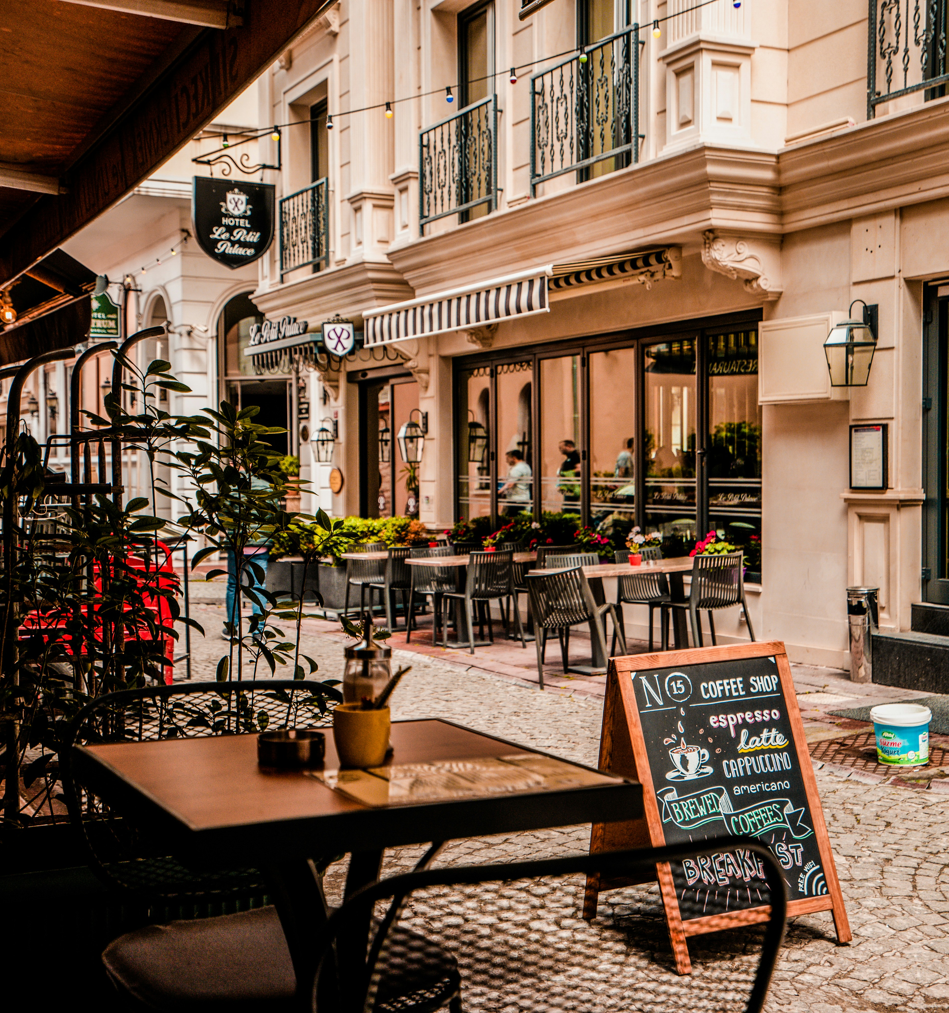
Leading Change…
Save
Improve
Attract
Retain
Grow
You are expected to run daily operations and plan for the future.
Transformation is about making smart decisions that unlock long-term environmental benefits, cost savings, and improved guest experiences.
As a hospitality LEADER, there is an opportunity for you to turn everyday operational tasks into sustainable, digital improvements.
You don’t need complex systems. 5

Slide 43

Opportunities for SMEs: Small Steps, Big Wins
High-impact opportunities for SMEs:
Energy monitoring tools can cut bills by 10-20% source
Digital check-in reduces staff pressure & improves flow
AI demand forecasting optimises staffing & menu planning
Waste-tracking apps reduce food costs
Green practices (refillables, local sourcing, linen reuse) increase guest trust
Visible sustainability actions drive more repeat bookings

Slide 44

Learner Exercise:
Discuss and share real operational challenges within your Hospitality Micro or SME.
Together, suggest solutions to these challenges (think small wins rather than large investments)
Do you know any other SMEs already making changes? What are they doing? Discuss

Slide 45
03
Leading the Change

Slide 46

"Leadership arises through genuine participation in the spectrum of living, in being who you imagine yourself to be. Knowing what is meaningful is foundational to being a leader and to being an engaged person. Leadership is a way of living; it’s a lived response."
Leanne Meyer

Slide 47
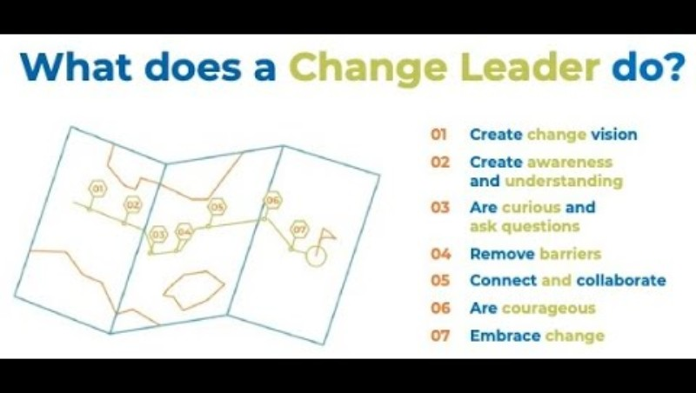
What is Change Leadership?
This short video from the Change Management Institute outlines 7 steps that are important when instigating or leading change.
Change Leadership

Slide 48

1. Creating a Change Vision & Mindset
“Leaders of Transition start with clarity, purpose & shared understanding.”
For hospitality SME leaders, a clear vision is essential for turning sustainability & digitalisation from “extra tasks” into a shared direction for the whole team.
A strong Green & Digital change vision is:
✔ Simple — easy to remember
✔ Purpose-driven — explains why it matters
✔ Practical — shows what it looks like in daily operations
✔ Shared — created with staff, not handed down
✔ Actionable — helps guide decisions
Examples:
“We aim to reduce our environmental footprint and improve our staff’s daily work using simple digital tools.”
“We want to run a hotel that wastes less, uses less energy, and gives guests a smoother digital experience.”

Slide 49
Learner/Leader Exercise:
Run a staff ‘vision brainstorm’ session during a shift change.
Ask questions like:
“What would make your daily tasks easier or more efficient?”
“What are 2 pain points you see or experience regularly (waste, delays, digital frustrations)?”
“What challenges would you prioritise?”
Staff who help shape the vision are more likely to:
Support adoption
Reduce resistance
Feel ownership over change
Suggest improvements

Slide 50
2. Communicating the WHY
“People don’t support what they don’t understand…leaders must make the ‘WHY’ impossible to miss.”
In hospitality SMEs, staff are extremely busy and often overwhelmed. If leaders want people to adopt greener behaviours or use new digital tools, they must understand why change is happening and how it impacts their daily tasks.
Staff support change when they understand:
Why the business needs this change (costs, competitiveness, guest expectations)
Why it matters to THEM personally (less work pressure, easier systems, more pride)
Why it makes the business stronger (savings, reviews, reputation, resilience)
We will discuss communication more in Section 5!!
Aligned Competence Areas:
✔ EntreComp: Mobilising Others
✔ DigComp: Communication & Collaboration
✔ GreenComp: Embodying Sustainability Values

Slide 51


Learner/Leader Exercise:
Turn Complex Sustainability & Digital Goals into Simple WHY Messages…see example.
Break down big concepts into small, relatable WHY messages:
Complex: “We need to adopt sustainable procurement strategies.”
Simple WHY message: “When we buy locally, we support our community AND reduce delivery costs.”
Complex:
“We are installing IoT sensors to measure real-time energy usage.”
“We must comply with ESG reporting guidelines.”
“We are introducing a digital scheduling system.”
This exercise will help you/leaders to communicate in clear, supportive, staff-friendly language.

Slide 52

3. Being Curious, Supportive & Approachable
“Change leaders don’t have all the answers. They ask better questions.”
Hospitality SMEs often rely on fast decisions, multitasking & close teamwork. In these environments, staff look to leaders for support, clarity & encouragement - not pressure or perfection.
Curiosity reduces digital fear
Support encourages adoption
Approachability increases feedback
Reduced Resistance
Engagement
Adoption
Staff feel safer to explore new tools when leaders explore with them
If staff feel guided, they will try new practices (waste sorting, apps, sensors).
And feedback helps leaders identify barriers and opportunities

Slide 53

4. Removing Barriers & Fear
“Leaders reduce resistance not by pushing change, but by removing what makes people afraid of it.”
Hospitality SMEs face unique constraints: limited staff, constant time pressure, and high turnover. These conditions make fear & resistance more likely whenever new sustainability practices or digital tools are introduced.
Barriers + Fears = Resistance
Resistance isn’t always laziness - it’s more likely to be a protection mechanism.

Slide 54
Detecting Common Barriers & Fears
Knowledge Barriers
Capability Barriers
Environmental Barriers
Emotional Barriers
“I don’t understand ESG / the digital tool / the new system.”
“I can’t do it…I’ll do it later”
“This tool slows me down” or “We don’t have the right equipment”.
“I’m scared of messing up or being judged.”
Give short, simple training
Break tasks into easy steps
Use visual guides
Practise during quiet times
Pair confident staff with anxious staff
Use positive reinforcement
Celebrate small wins
Demonstrate patiently
Repeat training without blame
Ensure the hardware works
Streamline workflows
Position tools for easy access
Remove unnecessary steps
Add clear signage/ instructions
Reinforce psychological safety
Normalise making mistakes during learning
Share your own learning struggles
Encourage team support
Leadership actions:

Slide 55
Barriers to Digital Tool Adoption in Hospitality SMEs
Common barriers you may see in your team:
Lack of confidence using digital devices
Fear of making mistakes
Overwhelmed with too many apps or systems (& Password fatigue)
Lack of clear instructions or training
Poor system usability (too many steps, unclear screens)
Devices are not always available during busy shifts
Habit of sticking to old, familiar routines
Concern that digital tools will slow down service
Lack of trust that the tool “will actually help”

Slide 56
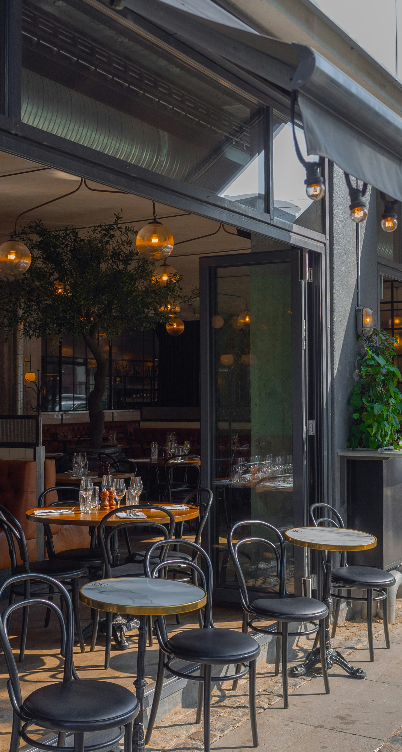
SME Examples
Digital System Anxiety (Front Desk)
01
A receptionist avoids using the new booking system.
Barrier: Fear of mistakes. Action: 10-min paired practice sessions
Printed step-by-step guide
Reinforcement: “You’re improving every day — well done.”
Waste Sorting (Kitchen)
02
A Kitchen porter mixes compostable & recycling waste.
Barrier: Confusion + Poor signage. Action: Simplify bins & labels
Create colour-coded posters
Quick on-the-spot demo during a calm moment
Energy Management (Housekeeping)
03
Housekeepers forget to switch off AC before closing rooms.
Barrier: Habits + unclear expectations. Action: Create a housekeeping checklist
Provide short refresher training
Celebrate days when compliance was high

Slide 57
5. Connecting, Equipping & Collaborating
“People commit to change when they feel supported, informed & included.”
Staff follow leaders they trust, not leaders who “announce changes.” Trust will increase willingness to try new tools or sustainable practices.
Leader Actions
Connecting:
Hold regular short, informal conversations
Ask staff for their ideas and concerns
Listen without judgement
Share success stories from the team
Show appreciation consistently
Equipping:
Clear instructions
Quick training sessions
Visual guides near workstations
Tools that actually work
Access to help when stuck
Collaborating:
Identify digital “buddies” or champions across roles
Create a small “Green & Digital Team”
Invite staff to co-design solutions
Have an open-door policy or an ideas board

Slide 58
Learner/Leader Exercise:
“Who Can Help?”
Grab a pen and paper and list:
Who needs extra support?
Who can act as a digital or sustainability champion?
What quick collaboration could improve the transition?
This simple exercise aims to help you map your team’s strengths and support needs in minutes

Slide 59
6. Showing Courage & Ongoing Commitment
“Courage starts the change. Commitment sustains it.”
As previously mentioned, Hospitality SMEs face constant pressure: high turnover, busy service periods, and limited resources. For change to last, leaders must stay committed, even when the transition gets difficult.
Courage doesn’t mean never feeling unsure…it means acting with purpose despite uncertainty.
Some tips on how to demonstrate courageous behaviour:
Admit when you don’t have all the answers
Make decisions guided by values, not convenience
Stand firm when resistance appears
Try new solutions even if they may fail
Encourage experimentation and learning

Slide 60
Committed and Consistent Leadership…
Showing Commitment
Leading by Example
Keeping Energy High
Reinforce the vision consistently
Maintain routines through staff changes
Review progress regularly
Follow up so improvements stick
Hold yourself accountable too
Using digital tools yourself
Sorting waste correctly
Turning off unused equipment
Asking for feedback regularly
Showing calm when problems occur
Celebrate progress publicly
Share before/after examples
Highlight evident improvements
Recognise staff who contribute to change
Reinforce the WHY

Slide 61
7. Normalising Disruption & Change
“Change becomes easier when it becomes expected.”
Hospitality SMEs experience constant movement: new staff, seasonal peaks, changing guest expectations. Leaders must help teams see change as the normal rhythm of the business, not a threat
To normalise change, SME leaders must:
Treat change as a natural, ongoing process – this reduces fear
Use small, frequent improvements and then it becomes part of the culture
Stay calm during a disruption – calm creates stability
Celebrate learning, not just success – failure is also learning
Reinforce routines until they become habits
Support staff emotionally & consistently to build resilience and reduce resistance

Slide 62
Case study

Slide 63
04
Strategy & Action

Slide 64
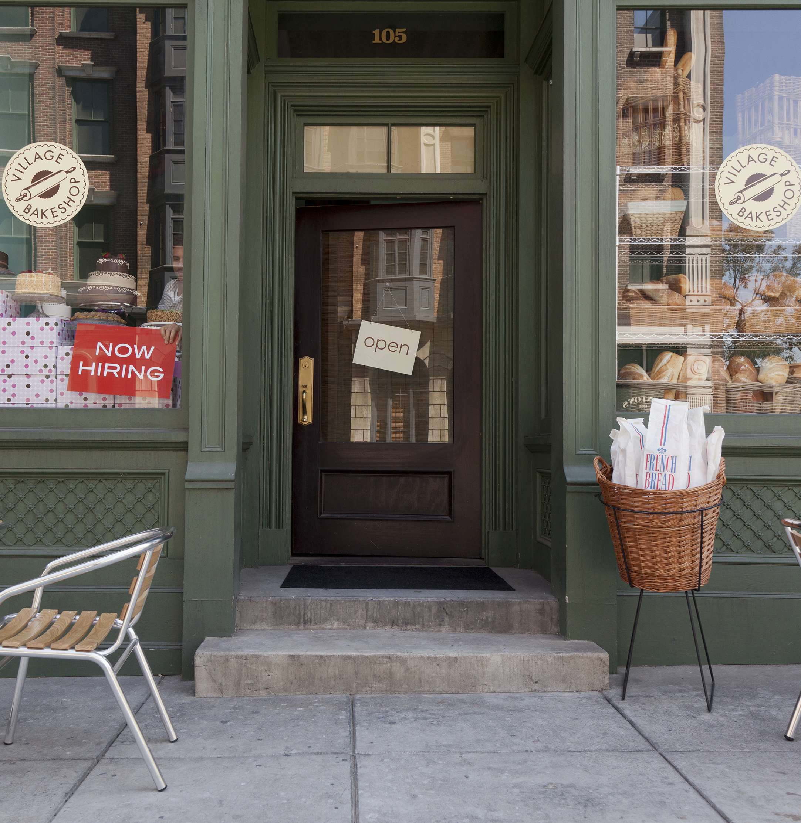
Planning & implementing strategy
A strategy is simply a roadmap for a stronger, smarter, more environmentally friendly hospitality business.
Implementation means you are intent on turning actions into habits that instil the twin transition into your business.
Vision
Priorities
RESULTS
Actions
Habits
TIP: You can’t plan improvements until you see your starting point.

Slide 65
Leading ESG & Digital: Readiness Checklist, Identifying your starting point
ESG Readiness
Do we measure waste, energy or water?
Do we follow sustainability routines consistently?
Do we source responsibly (local & sustainable)?
Do staff know our sustainability goals?
Do we track any ESG progress visibly?
Digital Readiness
Are we using basic digital tools (PMS, POS, apps)?
Are our processes digital or paper-based?
Do staff need digital skills support?
Do our systems connect well, or are they fragmented?
Do we track digital performance (e.g., check-in rates)?
Do we have a plan to improve or update digital tools?
Rate each question:
Yes – fully in place
Partly – some progress, not consistent
No – not yet started

Slide 66
Selecting your Priorities
It is recommended to focus on a small number (3-5) of high-impact actions.
Possible ESG Priority Areas | Possible Digital Priority Areas
Reduce food waste | Digital housekeeping checklists
Reduce energy consumption | Digital reservations & check-in or food ordering
Improve waste sorting | Energy monitoring sensors
Introduce more local & sustainable sourcing | Staff scheduling apps
Improve staff wellbeing & safety | Inventory & ordering automation
Communicate sustainability to guests | Guest messaging tools
TIP: choose priorities based on readiness, not ambition

Slide 67




Creating a 4-Step Action Plan
Define the Goal
Assign Ownership
Create 3–5 Simple Actions
Measure Something Small, Consistently
“Reduce food waste by 20%.”
“Introduce digital check-in / ordering for 80% of guests.”
“Cut energy use in guest rooms by 10%.”
Who leads this? (kitchen, reception, housekeeping, manager)
Who supports?
Who monitors success?
Train staff on portion control
Use digital waste logs
Install smart plugs
Create a digital inventory sheet
Introduce 2-minute digital training bursts
kWh per room
kg of food waste per day
number of digital check-ins
staff feedback
number of guest comments

Slide 68

Implementing Change – to make it stick…
Make it Visible
Make it Routine
Make it Supported
Make it Adaptive
Put KPIs on a small “Green & Digital Dashboard”
Share weekly wins
Use stickers, icons, colour coding
Change what isn’t working
Keep what is
Adjust actions monthly
Encourage staff ideas
Daily micro-huddles
Weekly review moment
Monthly progress check
Refresh training
Encourage questions
Provide extra help when needed
Celebrate effort, not perfection

Slide 69
05
Collaboration, Communication & Culture

Slide 70

Collaboration
Effective collaboration is the lifeblood of high-performing teams, particularly in a dynamic sector like Hospitality. At its core, it requires:
Understanding of team dynamics and individual roles & strengths/weaknesses
Building trust, where transparency & accountability are key
An inclusive environment
Conflict resolution and consensus building
Mastering these fundamentals not only enhances team productivity & innovation but also drives positive organisational outcomes, preparing you to excel as a leader.
INTERESTING READ:
New Study Finds That Collaboration Drives Workplace Performance (forbes.com)

Slide 71




Communication Skill for Leaders…
For leaders in the Hospitality sector, communication skills are particularly crucial due to the customer-facing and service-oriented nature of the industry.
Here are 4 important focus points of good communication:
Advanced Communication Techniques
Strategic Storytelling & Public Engagement
Conflict Resolution & Service Excellence
Cultural Intelligence & Inclusivity
Combining verbal and non-verbal skills, active listening, and emotional intelligence to create positive customer interactions and a cohesive team environment.
Harnessing the power of storytelling for branding and motivating staff, along with effective public speaking to engage and influence a range of audiences.
Employing conflict management strategies to resolve customer complaints and internal disputes, maintaining high standards of service quality and team harmony.
Developing multicultural communication skills to lead diverse teams & serve a global customer base, fosters an inclusive & welcoming atmosphere.

Slide 72


1. Active Listening
Developing active listening and empathetic engagement involves training or practicing to fully concentrate, understand, respond, and remember what is being said. This can be achieved through exercises that focus on attentive listening without interruption, interpreting non-verbal cues, and responding with empathy and understanding. This can build trust and effective engagement.
The Art of Listening | Simon Sinek (youtube.com)

Slide 73

2. Strategic Storytelling
Develop your art of storytelling. Emphasising the WHY via stories can motivate staff & connect them emotionally with your collective act of change.
Sharing success stories and relaying customer testimonials in team meetings can inspire your team and reinforce the message and actions.
Storytelling can make complex information accessible and create interest or engagement.
In this short video, we learn:
The benefits of powerful storytelling
How to improve basic storytelling skills
How to use storytelling to build relationships
The Power of Storytelling | eLearning Course - YouTube

Slide 74

Conflict Management & Multicultural Communication
To avoid conflict in the workplace, it is important to foster a culture of open communication, where you and other team members feel comfortable voicing concerns and drive for issues to be addressed constructively and proactively.
Create a diverse and inclusive leadership team that reflects the multicultural nature of your staff and your customer base, setting an example for the entire team.
Encourage the sharing of cultural experiences and perspectives within the team, fostering a deeper understanding and appreciation of diversity.

Slide 75

Communication Shapes Culture
The way leaders communicate becomes the way teams behave
Communication sets the tone for respect, trust & teamwork
Leaders create culture through what they say, repeat, and model
Clear, calm communication reduces stress in fast-paced hospitality settings
Consistent messaging builds predictability and psychological safety
Open communication encourages honesty, ideas & early problem-solving
Every conversation is a culture-building moment!

Slide 76

Setting Clear Expectations & Standards
Clear standards reduce confusion, conflict & inconsistency
SMEs need simple, visible expectations — not long manuals
Communicate what “good practice” looks like (specific behaviours)
Explain sustainability & digital expectations in plain language
Use visual SOPs & checklists to reinforce clarity
Repeat standards regularly through huddles & briefings
Examples of expectations to communicate:
Energy saving measures in rooms
Waste-sorting rules
Digital check-in procedure

Slide 77

Building Accountability Through Support
Accountability grows in a culture of clarity, fairness & follow-through
Accountability ≠ blame — it means shared responsibility
Communicate expectations early and without ambiguity
Follow up consistently (brief check-ins work best)
Give constructive feedback in private; praise in public
Use neutral, supportive language (“Let’s improve this together”)
What accountability looks like in SMEs:
Staff complete digital checklists
Actions are followed even during busy shifts
Issues are raised early, not hidden
Leaders follow the same standards they set

Slide 78
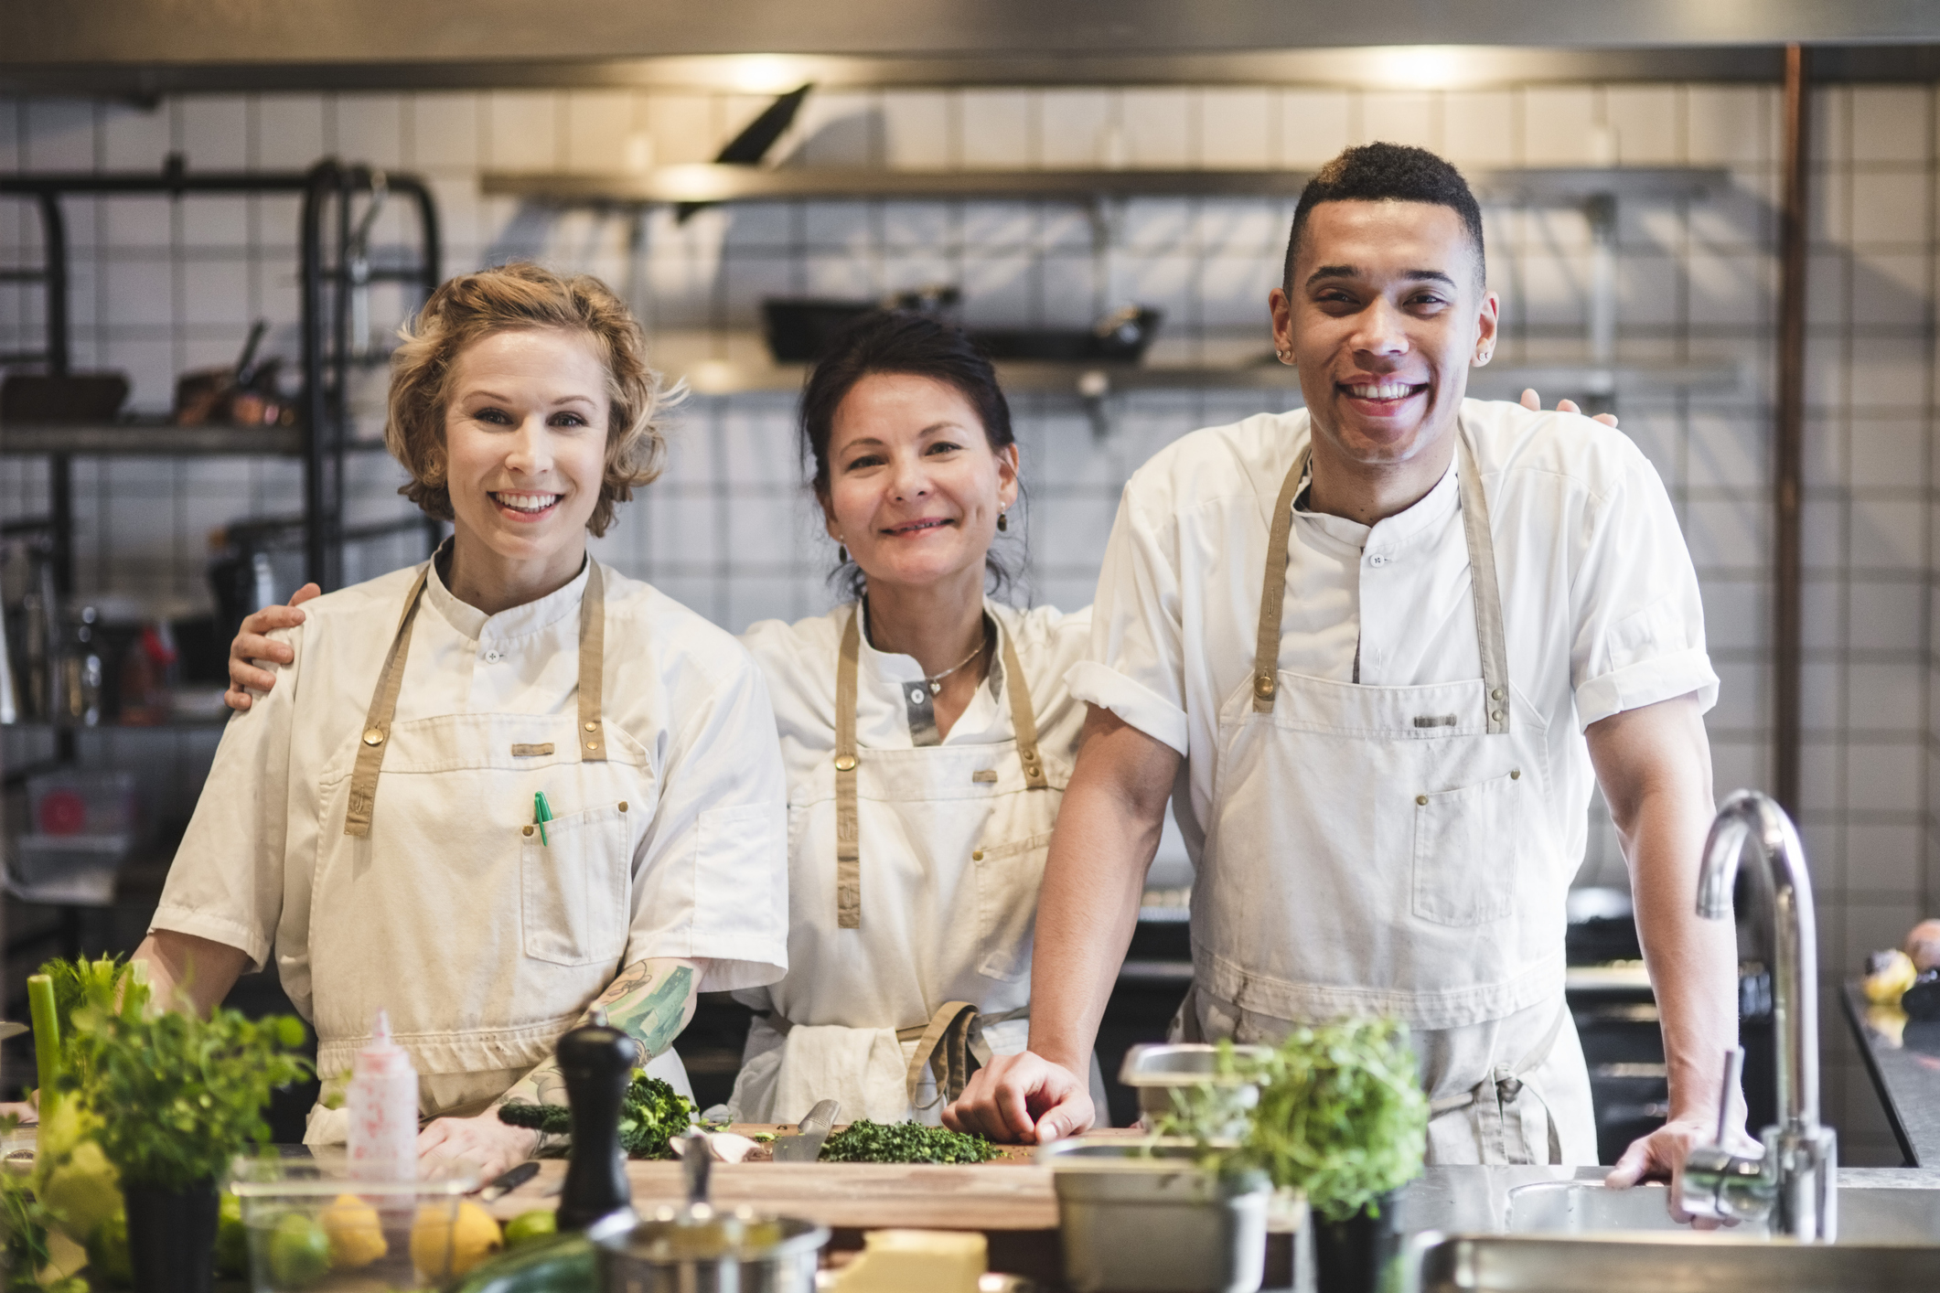
Tools That Strengthen Communication
It is important to keep everything simple, visual & consistent. Simple tools include:
Daily Micro-Huddles (1–2 mins): key priorities, quick updates
End-of-Shift Notes for FOH, kitchen, housekeeping
WhatsApp/Teams Guidelines:
one group for operations
one for emergencies
avoid overload
Staff Info Board: notices, wins, SOP updates
Visual SOPs: laminated cards, posters near workstations
Digital Logs: maintenance issues, waste data, energy checks
Why these tools matter:
Reduce miscommunication
Increase consistency across shifts
Improve cross-department flow
Help new staff adapt quickly

Slide 79





Digital Tools for Collaboration & Communication → Benefits
Enhanced Efficiency & Fewer Mistakes
More Flexibility During Busy Times
Better Team Coordination
Stronger Engagement With Guests
Reduced Costs & Smarter Resource Use
Digital tools make daily communication faster and clearer - reducing errors between shifts, speeding up guest responses, and helping teams stay aligned during busy periods.
Shared digital tools help front desk, kitchen, housekeeping and management work together more smoothly - improving handovers, noting issues in real time, and avoiding misunderstandings
Digital tools help small teams adapt quickly to changing guest needs, staff shortages or seasonal peaks - without adding extra workload. Easy to scale up as the business grows.
Digital tools make it easier to communicate with guests before, during and after their stay - boosting reviews, responding faster to requests, and tailoring experiences to guest preferences.
Digital tools help reduce unnecessary labour time, limit mistakes, cut paperwork, and optimise energy use - creating meaningful savings for smaller hospitality businesses.

Slide 80
Learner/Leader Exercise:
Using what you learned in Module 1, create your Leader of Transition Action Blueprint in 10–15 minutes.
1. Define Your WHY (Purpose)
Write one clear sentence explaining why green & digital change matters for your SME. (From Step 2)
2. Identify One ESG Priority + One Digital Priority
Choose priorities based on your readiness checklist.(From Strategy & Action)
3. Draft Your Micro-Action Plan - For each priority, define:
One simple action you can start this week
One person you need to involve
One barrier you must remove first
One measure of success
4. Outline Your Communication Message
Write a short “WHY-first” message you will use to introduce the change to your team.
5. State One Leadership Behaviour You Will Model
Choose one behaviour to practice daily (calm, curiosity, consistency, encouragement).

Slide 81
Conclusion…Becoming a Leader of Transition
As hospitality evolves, leaders create the real shift.
By completing this module, you have learned how to:
✔ Understand the drivers of the Green & Digital Transition
✔ Communicate a clear vision & purpose for change
✔ Lead your team with curiosity, support & consistency
✔ Remove barriers that prevent progress
✔ Build simple systems that make sustainability & digitalisation part of daily work
✔ Strengthen collaboration, communication & culture across your business
Small actions, repeated consistently, create transformation.
Start with one step. Lead with purpose. Bring your team with you.

Slide 82
Next up …
www. ecosmartproject.eu

