Slide 1




C2 Digital transformation in Hospitality
Image AI generated as example
Module 2:
Data Analytics in Hospitality
www.ecosmartproject.eu
EcoSmart resources licensed under CC BY 4.0

Slide 2
Cluster 2 – Digital transformation in Hospitality| Module 2 - Data Analytics in Hospitality
Why this module matters to your business
Every hospitality business generates data every day through bookings, sales, staffing, energy use, food waste, guest feedback, and operational activities. There are lots of numbers. The challenge is it is knowing which numbers matter and how to use them to support better. decision
01
02
03
Turn data into practical insights
Make informed decisions
Build a data-driven culture
Use KPIs, dashboards, and simple analysis techniques to support pricing, staffing, sustainability, and operational planning.
Develop routines that help teams use evidence consistently, monitor progress, and improve performance over time.
Understand the key numbers that drive hospitality performance and learn how to transform raw data into meaningful information..
Meet the businesses you will learn from in this module
Coco Hotel (Denmark), Hotel Luise (Germany), Sham Hanifa Group (Ireland)
Develop routines that help teams use evidence consistently, monitor progress, and improve performance over time.

Slide 3




Cluster 2 – Digital transformation in Hospitality| Module 2 - Data Analytics in Hospitality
Where this module fits
Role:The programme's core resource for transforming hospitality data into actionable insight, enabling evidence-based decisions, performance improvement, operational efficiency and more sustainable business management.
Comes after / assumes familiarity with
C2 M1 – Digital Tools for Hospitality
Extends or connects to
C1 M2 – Sustainability Performance Monitoring (energy, waste and resource KPIs)
C3 M1 – Strategic Planning and Business Performance
C3 M2 – Marketing Analytics and Customer Insights
C3 M3 – Innovation and Continuous Improvement

Slide 4
Learning Objectives
What You Will Achieve:
Unit 1 – Understand Data & KPIs: Identify key hospitality numbers (occupancy, ADR, RevPAR, food waste per cover) and where they come from
Unit 2 – Work with Spreadsheets: Use sort, filter, formulas and charts to turn raw data into clear insights
Unit 3 – Apply Data to Decisions: Compare pricing, staffing and sustainability options using real scenarios
Unit 4 – Build a Data Culture: Create simple routines that make data-informed practice normal in your team
Overall Outcome: By the end, you'll have practical data skills and a simple action plan for your business

Slide 5
Shared Glossary
Seven terms used across the programme. Same definitions in every module.
Term
Canonical definition
Full treatment in
Greenwashing
Making sustainability claims that are exaggerated, unverifiable, or unsupported – intentionally or by omission.
C3 M2
ESG
Environmental, Social & Governance – the three pillars used to assess a business's non-financial performance and its broader impact.
C3 M1
Nudge
A small change in how a choice is presented (a default, a reminder, the physical set-up) that shifts behaviour without restricting choice.
C1 M3
Twin transition
Advancing digital transformation and the green transition together so that each reinforces the other in SMEs.
C3 M1
KPI
Key Performance Indicator – a measurable value that shows how effectively a business is achieving a defined objective.
C2 M2
Circular economy
An approach designed to keep materials and products in use for as long as possible through reducing, reusing, repairing, refurbishing and recycling – so that waste becomes a resource.
C1 M2
Guest journey
The full sequence of a guest's interactions with a business, from awareness through booking, stay and post-stay engagement – used to design sustainability and digital touchpoints coherently.
C1 M3

Slide 6
Hospitality Data Foundations and KPIs
Foundations and key concepts of data in the European hospitality sector. Introduces the main types of operational data and key performance indicators that support smarter, more sustainable decisions in hotels, restaurants and cafés.
01
UNIT

Slide 7


Hospitality Data Foundations & KPIs
What numbers really matter in your business - and where do they come from?
Understanding your data is the first step to making smarter, more sustainable decisions.
What is hospitality data? – PMS, POS, rotas, waste logs
Key KPIs – Occupancy, ADR, RevPAR, average spend, food waste per cover
Data quality – Why "garbage in, garbage out" matters
Spotting errors – Missing values, duplicates, impossible numbers

Slide 8

What is Data in Hospitality?
Hospitality data is information you can count, measure or sort in a hotel, restaurant or café. You see it every day in tables, reports and digital systems (Freedman, 2025).
EVERYDAY EXAMPLES
Arrivals & departures – Who is coming and going
Rooms or tables booked – How full are you?
Covers served – How many guests did you feed?
Daily sales ($) – What came through the till?
Rotas & staff hours – Who worked and when
When you start treating these familiar figures as data, it becomes easier to analyze them and make smarter, more sustainable decisions for your business
Data in Hospitality
See also ›
C1 M1
- ·Integrating Sustainability in Daily Operations
Notes:
Freedman, Mews (2025), Hotel business intelligence explained: what every hotelier should know. https://www.mews.com/en/blog/hotel-business-intelligence

Slide 9

Where Does the Data Come From?
Property Management System (PMS)
⁰¹
Reservations, room types, rates, length of stay (AltexSoft, 2024).
Most data is created automatically by the systems you already use every day. Together, these systems form the raw data you turn into KPIs for smarter, greener decisions.
^{Point of Sale System (POS)}
⁰²
Transaction time, items purchased, amount paid, payment method (Chowbus, 2024; Square, 2025)
^{Staff & Sustainability Records}
⁰³
Rotas, hours worked, food waste logs, energy use (WWF Hotel Kitchen, 2017; EPA Ireland, 2021)
Notes:
AltexSoft – hotel PMS overview
https://www.altexsoft.com/blog/hotel-property-management-systems-products-and-features/
Chowbus – POS data meaning
https://www.chowbus.com/blog/what-is-pos-data
Square – what is a POS system
https://squareup.com/gb/en/the-bottom-line/operating-your-business/what-pos-system
WWF / Hotel Kitchen – food-waste toolkit for hotels
https://www.worldwildlife.org/publications/hotel-kitchen-fighting-food-waste-in-hotels/
Zero Waste Scotland – “Your business is food, don’t throw it away” toolkit
https://www.zerowastescotland.org.uk/resources/your-business-food-dont-throw-it-away

Slide 10


Coco Hotel
Coco Hotel demonstrates how hospitality businesses can use data from multiple sources to improve performance, guest experiences and sustainability outcomes. The Copenhagen boutique hotel combines operational, financial, customer and environmental information to support everyday decision-making.
Through its mobile-first guest experience, Coco Hotel generates valuable data on booking behaviour, digital check-in usage, guest preferences and service interactions. Management combines this information with occupancy, revenue and sustainability metrics to gain a more complete picture of business performance.
The hotel focuses on a small number of meaningful indicators rather than large volumes of reports. Website conversion rates, booking windows, occupancy, ADR, RevPAR, guest feedback trends and sustainability measures help managers identify opportunities, respond to changing demand and improve operational efficiency.
Key Learning: Effective data management begins by understanding what information is already available and how it can be used to support better decisions.

Slide 11

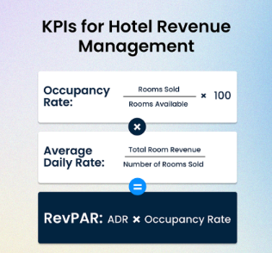
Core KPIs: The Numbers That Matter
A small set of key indicators gives you a quick picture of how your business is performing.
THE BIG THREE FOR ROOMS:
Occupancy Rate
Rooms sold ÷ Rooms available × 100 - How full are you?
Average Daily Rate (ADR)
Room revenue ÷ Rooms sold -What do guests pay on average?
Revenue per Available Room (RevPAR)
Room revenue ÷ Rooms available How well are you converting space into revenue?
(STR, 2024; OTA Insight, 2023)
KPIs for Hotel Revenue Management
See also ›
C1 M1
- Integrating Sustainability in Daily Operations
Notes:
STR – Hotel key performance indicators
https://str.com/data-insights/resources/hotel-key-performance-indicators
OTA Insight – Most important hotel KPIs
https://www.otainsight.com/resources/blog/revenue-management/hotel-kpis
SevenRooms – Restaurant metrics and average check
https://sevenrooms.com/en/blog/restaurant-metrics-average-check/
HospitalityNet – Labour cost and payroll KPIs in hotels
https://www.hospitalitynet.org/opinion/4111384.html

Slide 12

Beyond Rooms: F&B and Staffing KPIs
Hotels and restaurants also track key numbers for food, beverage and people.
FOOD & BEVERAGE KPIs:
Average Spend per Cover
Total F&B revenue ÷ Number of covers served
What does each guest typically spend? (SevenRooms, 2024)
STAFFING KPIs:
Labour Cost Percentage
Total staff costs ÷ Total sales × 100
How much of your revenue goes to wages? (HospitalityNet, 2022)
Together with room KPIs, these numbers guide both financial and sustainability decisions across Europe.
Notes:
STR – Hotel key performance indicators
https://str.com/data-insights/resources/hotel-key-performance-indicators
OTA Insight – Most important hotel KPIs
https://www.otainsight.com/resources/blog/revenue-management/hotel-kpis
SevenRooms – Restaurant metrics and average check
https://sevenrooms.com/en/blog/restaurant-metrics-average-check/
HospitalityNet – Labour cost and payroll KPIs in hotels
https://www.hospitalitynet.org/opinion/4111384.html

Slide 13

Sustainability KPI’s
Green KPI: Food Waste per Cover
A practical green KPI that measures how much food your kitchen wastes per guest served.
FORMULA:
Food Waste per Cover = Total food waste (grams) ÷ Number of covers served
EUROPEAN BENCHMARKS:
2019 Baseline: ~143 grams per cover
2021 Average: ~108 grams per cover
Reduction: More than 20% lower (International Food Waste Coalition IFWC, 2022)
Hotels tracking this KPI report 20–25% reductions through menu changes, buffet redesigns and better stock control (HospitalityNet, 2023; The PLEDGE on Food Waste).
See also ›
C1 M2
- Circular Economy and Resource Efficiency
Notes:
EPA Ireland – Food waste in hotels (food waste per cover benchmark)
https://www.epa.ie/media/epa-2020/monitoring-amp-assessment/circular-economy/Food-waste-in-Hotels--Daily-v3.pdf
Savour Food – Hotels function food-waste benchmark
https://savourfood.ie/wp-content/uploads/2023/01/Hotels-Function.pdf
International Food Waste Coalition – European hospitality and food service sector reports 20% reduction in food waste
https://internationalfoodwastecoalition.org/european-hospitality-and-food-service-sector-reports-20-reduction-in-food-waste/
International Food Waste Coalition – Food waste measurement and reporting methodology
https://internationalfoodwastecoalition.org/wp-content/uploads/2023/06/IFWC-methodology-Final.pdf
HospitalityNet / The PLEDGE on Food Waste – hotel food-waste reduction case study
https://www.hospitalitynet.org/news/4125394.html

Slide 14
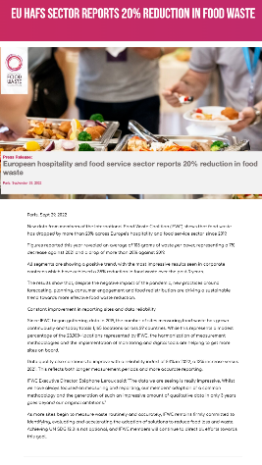
Further Reading - Food Waste per Cover in European Hospitality
International Food Waste Coalition. (2022). European hospitality and food service sector reports 20% reduction in food waste.
EU HaFS sector reports 20% reduction in food waste | IFWC - WRAP EU
This article presents real data from hotels and contract caterers across Europe. It shows how average food waste fell from around 143 grams per cover in 2019 to about 108 grams per cover in 2021, a reduction of more than 20%, when sites measured waste carefully and changed menus, forecasting and service. When you read it, note how often the results are expressed as grams per cover and think about how your own workplace could track the same KPI
CLICK TO VIEW
Notes:
EU HaFS sector reports 20% reduction in food waste | IFWC - WRAP EU

Slide 15
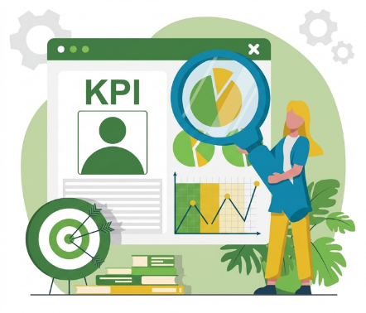
KPIs in Real European Hotel Reports
Across Europe, hotel benchmarking reports use the same KPIs you are learning in this unit.
STR Europe Hotel Performance Updates
Shows occupancy, ADR and RevPAR for major European cities and regions over time.
Savills Market Reports - Summarizes thousands of bookings and daily records into clear trends
HOW HOTELIERS USE THEM:
When occupancy + ADR increase → Revenue managers may raise rates or invest in digital marketing
When RevPAR drops → Review pricing, distribution channels or promotions (STR, 2024; Savills, 2024).
See also ›
C2 M1
- AI in Hospitality
Notes:
STR – Europe hotel performance insights
https://str.com/data-insights/news/press-releases/europe-hotel-performance
Savills – European hotel market and performance reports
https://www.savills.com/research_articles/255800/ (search within for “European hotel” or “European hospitality” spotlight)

Slide 16
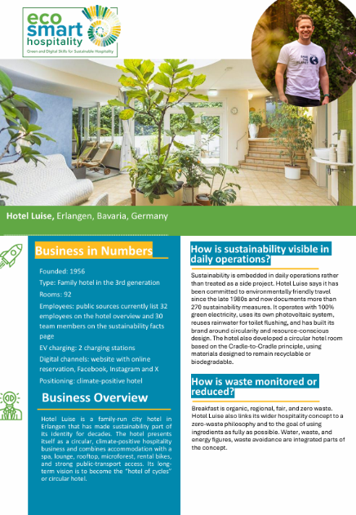
Hotel Luise
Hotel Luise demonstrates how hospitality businesses can transform operational data into meaningful KPIs that support continuous improvement.
The hotel has developed a strong reputation for measuring and monitoring environmental performance across energy, water, waste and resource consumption. Rather than focusing on raw data alone, management uses carefully selected indicators that allow progress to be tracked over time and compared against targets and industry benchmarks.
This structured approach helps staff understand performance, identify inefficiencies and prioritise actions that deliver measurable results. Data is therefore used not simply for reporting but as a practical management tool that supports strategic and operational decision-making.
Key Learning: KPIs convert complex operational data into simple measures that support monitoring, communication and improvement.

Slide 17
From Raw Data to Clear Key Numbers
Raw data — bookings, covers, receipts — sits as long lists until it is grouped. Hotel analytics and business-intelligence tools are designed to group and summarise these records into key performance indicators, or KPIs, that are easier to understand (Mews, 2025; STR, 2024).
EXAMPLE: Raw Data
Summarized into KPIs
Occupancy: 80% | ADR: €100 | RevPAR: €80
Why this Matters:
80% occupancy tells a clear story
€20 per cover is instantly meaningful
Date.. | Number of Rooms.. | Rooms Sold.. | Rooms Revenue..
01 May | 50 Rooms | 40 Sold | €4,000
02 May | 50 Rooms | 42 Sold | €4,200
03 May | 50 Rooms | 38 Sold | €3,800
Notes:
Mews – Hotel business intelligence explained
https://www.mews.com/en/blog/hotel-business-intelligence
STR – Hotel key performance indicators
https://str.com/data-insights/resources/hotel-key-performance-indicators

Slide 18

Why Data Quality Matters
THE GOLDEN RULE: "Garbage in, garbage out"
If the numbers going into your system are incomplete or wrong, the reports and decisions that come out will also be wrong.
Common Data Problems:
Missing values – Blank cells where numbers should be
Duplicate entries – Same date or booking appears twice
Impossible results – Occupancy above 100%, negative covers
Gaps in dates – Days missing from the sequence
Why it Matters:
If your occupancy, ADR, RevPAR or food waste KPIs are based on bad data, they will give a false picture of performance (HospitalityNet, 2023; Alvarez & Marsal, 2022; Attune IT, 2024)
Notes:
HospitalityNet – “Debunking the myths about AI-driven hotel revenue management”
https://www.hospitalitynet.org/opinion/4118687.html
hoteliQ – “Is your hotel ready for business intelligence?”
https://www.hoteliq.io/hospitality-expertise/is-your-hotel-ready-for-business-intelligence
Alvarez & Marsal – Staying Power: Hotel Workforce Optimization (data quality and “garbage in, garbage out”)
https://www.alvarezandmarsal.com/sites/default/files/2022-09/410822_CPI_THL%20Thought%20Leadership%20Series%20-%20Article%202_Sept%202022_0.pdf
Attune IT – “Data analytics in hospitality: from ‘garbage in, garbage out’ to smart decisions”
https://attuneit.ai/blog/hospitality-data-analytics

Slide 19


Reviewing a Small Hotel Dataset
KEY PRINCIPLE:
"Garbage in, garbage out" applies to every report. Learning to question data quality is a key skill for modern hospitality staff (Johansson, 2024).
Now apply these ideas to a short table of figures from a small hotel.
WHAT YOU'LL DO:
Scan the table – Look for missing information, unrealistic values, repeated dates
Discuss in pairs – Would you trust this data for pricing or staffing decisions?
List your checks – What further checks would you ask for?
Notes:
Demand Calendar – Data Dilemma: Is the Hospitality Industry Lagging Behind?
https://www.demandcalendar.com/blog/data-dilemma-is-the-hospitality-industry-lagging-behind

Slide 20
Hotel Data - Example Table
Date.. | Rooms Available.. | Rooms Sold.. | Occupancy %..
01 May | 50 | 40 | 80
02 May | 50 | 42 | 84
03 May | 50
04 May | 50 | 51 | 102
05 May | 50 | 35 | 70
07 May | 50 | 39 | 78
07 May | 50 | 39 | 78
08 May | 50 | 20 | 40
This table is a small extract from a hotel occupancy report. Each row shows one day, with the number of rooms available, the number of rooms sold and the occupancy percentage.
Take a moment to read through the dates and figures carefully and decide whether anything looks strange, missing or impossible. You will use this table in the next activity on checking data quality.

Slide 21
Checking The Hotel Data
CONCLUSION:
Because of these problems, this table should not be used for pricing or staffing decisions until the data have been checked and corrected.
KEY SKILL:
This is the kind of quick check you should make whenever you work with a new table of numbers (Johansson, 2024).
WHAT WE FOUND:
03 May
No values for rooms sold or occupancy (incomplete row)
04 May
Occupancy 102% (impossible with 50 rooms – data error)
Missing Day
No line for 06 May (date gap in report)
07 May
Appears twice with same figures (duplicate entry)

Slide 22
Unit 1 Summary - What You Learned:
⁰¹
What hospitality data is – Information you can count, measure or sort from PMS, POS, rotas and waste logs
ECOSMART CONNECTION:
Better use of data supports smarter resource use and improved guest experience (Mews, 2025; STR, 2024; UNESCO-UNEVOC, 2024)
⁰²
Key KPIs – Occupancy %, ADR, RevPAR, average spend per cover, food waste per cover
⁰³
Real-world application – European hotel reports use these same KPIs to shape pricing and operations
⁰⁴
Data quality matters – "Garbage in, garbage out" – missing values, duplicates, impossible numbers
⁰⁵
Error checking – Practice spotting issues in real hotel data tables
Notes:
Mews – Hotel business intelligence explained
https://www.mews.com/en/blog/hotel-business-intelligence
STR – Hotel key performance indicators
https://str.com/data-insights/resources/hotel-key-performance-indicators
UNESCO-UNEVOC – Green and digital skills for hospitality and tourism
https://unevoc.unesco.org/home/BILT%2BExpert%2Bgroup%2Breport%3A%2BGreen%2Band%2Bdigital%2Bskills%2Bfor%2Bhospitality%2Band%2Btourism

Slide 23
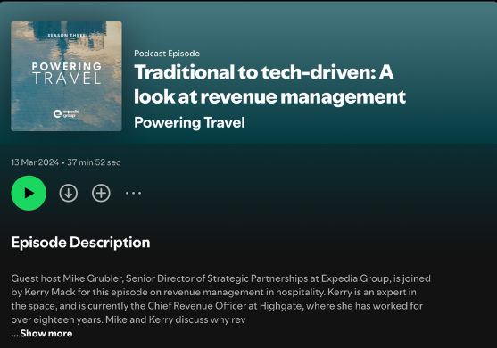
Further Listening: Data-Driven Revenue in Hospitality
Expedia Group. (2023). Traditional to Tech-Driven: A Look at Revenue Management. Powering Travel by Expedia Group.
https://open.Spotify.com/episode/1nxut1HJcLcCrIUUgsdKyO
This podcast episode discusses how hotels use data and KPIs such as occupancy, Average Daily Rate and RevPAR to set prices and manage demand. It offers a practical look at how revenue teams move from instinct-based decisions to data-informed strategies in modern hospitality
CLICK TO VIEW

Slide 24
Working with Hospitality Data in Spreadsheets
In this unit you move from concepts to systematic data work. You use spreadsheets to structure hospitality datasets, apply core calculations and present results clearly. By turning long tables of figures into key numbers and visuals, you strengthen the digital skills needed for evidence-based and sustainable decisions in Eco Smart Hospitality.
02
UNIT

Slide 25
Working with hospitality datasets
KEY INSIGHT:
Spreadsheet skills turn raw data into actionable insights for your business (UNESCO-UNEVOC, 2024).
SPREADSHEETS ARE A STANDARD
TOOL FOR ANALYZING:
PMS and POS exports
Daily revenue reports
Rota and staff data
Sustainability logs
WHAT YOU'LL LEARN:
Read the structure – Understand what each field represents
Prepare the data – Clean and organize for KPI calculations
Connect to Unit 1 – Calculate KPIs you already know: occupancy, ADR, RevPAR, average spend per cover
See also ›
C2 M1
- AI in Hospitality
Notes:
UNESCO-UNEVOC (2024), Green and digital skills for hospitality and tourism;
UK Department for Education (2019), Essential Digital Skills Framework.
https://unesdoc.unesco.org/ark:/48223/pf0000391115
https://www.gov.uk/government/publications/essential-digital-skills-framework

Slide 26
Activity: Exploring A Room-Nights Dataset
Activity: exploring a room-nights dataset
You receive a small room-nights dataset exported from a Property Management System for a 14-day period.
THE DATASET INCLUDES:
Date – When the stay occurred
Rooms Available – Total rooms in the property
Rooms Sold – Rooms occupied each night
Room Revenue (€) – Total revenue from rooms
ADR – Average Daily Rate (already calculated)
YOUR TASK:
Identify what each column represents
Check whether dates run in order with no gaps
Highlight which columns you would use to calculate: Occupancy %, ADR (verify the calculation), RevPAR
Explain why you chose those specific columns for each KPI (Adapted from Mews, 2025).
Explain why you chose those specific columns for each KPI (Adapted from Mews, 2025).
You receive a small room-nights dataset exported from a Property Management System for a 14-day period.
THE DATASET INCLUDES:
Date – When the stay occurred
Rooms Available – Total rooms in the property
Rooms Sold – Rooms occupied each night
Room Revenue (€) – Total revenue from rooms
ADR – Average Daily Rate (already calculated)
YOUR TASK:
Identify what each column represents
Check whether dates run in order with no gaps
Highlight which columns you would use to calculate: Occupancy %, ADR (verify the calculation), RevPAR
Notes:
STR – Understanding your STR reports: basics
https://str.com/data-insights-blog/understanding-your-str-reports-basics
STR – What is RevPAR?
https://str.com/data-insights-blog/what-is-revpar

Slide 27
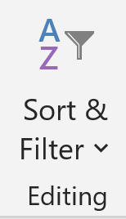
Sorting and Filtering For Insight
Sorting and filtering for insight
Sort and filter functions let you move quickly from a full dataset to the subset that matters for your question.
SORTING:
Sort by date – Review performance week by week
Sort by revenue – Identify top-performing days, dishes or room types
FILTERING:
Filter by day – Show only Fridays and Saturdays
Filter by outlet – Focus on breakfast service only
Filter by room type – Compare suites vs. standard rooms
Used together, sort and filter provide fast, low-tech analysis that supports pricing, staffing and sustainability decisions- without specialist software.
Used together, sort and filter provide fast, low-tech analysis that supports pricing, staffing and sustainability decisions- without specialist software
Sort and filter functions let you move quickly from a full dataset to the subset that matters for your question.
SORTING:
Sort by date – Review performance week by week
Sort by revenue – Identify top-performing days, dishes or room types
FILTERING:
Filter by day – Show only Fridays and Saturdays
Filter by outlet – Focus on breakfast service only
Filter by room type – Compare suites vs. standard rooms

Slide 28
Core calculations: totals, averages and percentages
THE THREE KEY FORMULAS:..
TOTAL =SUM(range)
Example: Total rooms sold over 14 days
AVERAGE =AVERAGE(range)
Example: Average rooms sold per day
PERCENTAGE = (Part ÷ Whole) × 100
Example: Occupancy % = Rooms sold ÷ Rooms available × 100 (Mews, 2025; STR, 2024)
Most hospitality KPIs are built from a small set of basic calculations.
KPIs YOU CAN NOW CALCULATE
KPI.. | FORMULA..
Occupancy % | Rooms sold ÷ Rooms available × 100
ADR | Room revenue ÷ Rooms sold
RevPAR | Room revenue ÷ Rooms available
Notes:
AltexSoft – RevPAR, occupancy rate and ADR: hotel metrics
https://www.altexsoft.com/blog/revpar-occupancy-rate-adr-hotel-metrics/
Mews – Hotel industry KPIs
https://www.mews.com/en/blog/hotel-industry-kpis

Slide 29
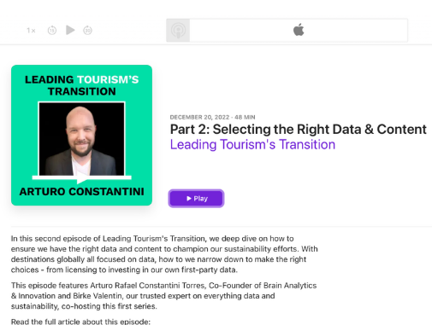
Further Listening: Becoming a Data-Driven Tourism Destination
Part 2: Selecting the Right Da… - Leading Tourism's Transition - Apple Podcasts
This episode explores how European destinations choose which data to focus on, how they keep information manageable, and what organisational changes are needed to become truly data-driven. The speakers discuss practical examples of using visitor, booking and digital behaviour data, and show collaboration between teams with data shared beyond any single specialist unit
CLICK TO VIEW

Slide 30
Activity: calculating KPIs in a spreadsheet
This exercise consolidates your understanding of how familiar KPIs are produced from simple spreadsheet operations.
Step 1: Use a total formula to check that the number of rooms available is constant across the period.
Step 2: Calculate daily occupancy %, ADR and RevPAR in three new columns.
Step 3: Compute the 7-day average for each KPI.
Step 4: Finally, compare the days with the highest and lowest RevPAR and discuss what could explain the difference.
You now apply these calculations to a short dataset containing rooms available, rooms sold and room revenue for one week.
Date.. | Rooms Available.. | Rooms Sold.. | Revenue..
01 May | 50 | 35 | €3,500
02 May | 50 | 32 | €3,200
03 May | 50 | 38 | €3,800
04 May | 50 | 42 | €4,200
05 May | 50 | 48 | €4,800
06 May | 50 | 52 | €5,200
07 May | 50 | 40 | €4,000
Notes:
STR – Hotel key performance indicators
https://str.com/data-insights/resources/hotel-key-performance-indicators
MavREV – Hotel revenue management KPIs and metrics
https://mavrev.co.uk/advice/hotel-revenue-management-kpis-and-metrics-for-measuring-succ/

Slide 31

Data Quality Checks In Practice
Embedding these checks into your workflow reduces the risk of "garbage in, garbage out" and supports trustworthy KPIs (HospitalityNet, 2023; Attune IT, 2024).
Before relying on any analysis, carry out quick data-quality checks.
YOUR CHECKLIST:
Sort by date – Confirm no days are missing
Check blank cells – Look for empty values in critical columns (rooms sold, total revenue)
Scan for impossible values – Occupancy above 100%, negative covers
Look for duplicates – Same date and figures appearing twice
WHAT TO DO IF YOU FIND ERRORS:
Correct them – Check against original PMS or POS report
Exclude the row – Remove bad data from your calculation
Notes:
HospitalityNet – How to calculate and improve 12 hotel performance metrics
https://www.hospitalitynet.org/news/4126420.html

Slide 32

Visualising KPIs with Simple Charts
European data guides highlight visualization as essential for making data usable in day-to-day decisions (European Tourism Data Guides)
Charts provide a compact way to communicate patterns in hospitality data.
WHAT YOU CAN CREATE:
Line Chart – Show trends over time (e.g., occupancy % by day)
Column Chart – Compare categories (e.g., ADR by room type)
BEST PRACTICES:
Clear title – What does the chart show?
Labeled axes – What are the units? (€, %, grams)
Consistent scale – Easy to read at a glance
EXAMPLE:
A chart showing food waste falling from 140g to 108g per cover or occupancy rising from 65% to 80% can be understood in seconds.
See also ›
C2 M1
- AI in Hospitality
Notes:
EU Smart Tourism Destinations – EU guide on data for tourism destinations
https://smarttourismdestinations.eu/wp-content/uploads/2022/07/Smart-Tourism-Destinations_EU-guide_v1_EN.pdf

Slide 33
Short Worksheet: Working with Hotel Data
Date.. | Rooms Available.. | Rooms Sold.. | Revenue..
01 May | 50 | 35 | €3,500
02 May | 50 | 32 | €3,200
03 May | 50 | 38 | €3,800
04 May | 50 | 42 | €4,200
05 May | 50 | 48 | €4,800
06 May | 50 | 52 | €5,200
07 May | 50 | 40 | €4,000
Notes:
STR – Hotel key performance indicators
https://str.com/data-insights/resources/hotel-key-performance-indicators
MavREV – Hotel revenue management KPIs and metrics
https://mavrev.co.uk/advice/hotel-revenue-management-kpis-and-metrics-for-measuring-succ/

Slide 34
Your task
Enter the data
Copy the table into a spreadsheet.
Check the data
  Are the dates in order with no gaps?
  Is Rooms available the same each day?
Calculate KPIs
Add three new columns and calculate for each day:
  Occupancy % = Rooms sold ÷ Rooms available × 100
  ADR (€) = Room revenue (€) ÷ Rooms sold
  RevPAR (€) = Room revenue (€) ÷ Rooms available
Answer three questions
  On which date is occupancy % highest?
  On which date is RevPAR (€) highest?
  What is the 7-day average occupancy %?
Create one chart
Make a simple line chart showing Occupancy % by Date, with a clear title and axis labels.
Your Task
⁰¹
Enter the data - Copy the table into a spreadsheet.
⁰²
Check the data
Are the dates in order with no gaps?
Is Rooms available the same each day?
Calculate KPIs
Add three new columns and calculate for each day:
Occupancy % = Rooms sold ÷ Rooms available × 100
ADR (€) = Room revenue (€) ÷ Rooms sold
RevPAR (€) = Room revenue (€) ÷ Rooms available
⁰³
Answer three questions
On which date is occupancy % highest?
On which date is RevPAR (€) highest?
What is the 7-day average occupancy %?
⁰⁴
⁰⁵
Create one chart - Make a simple line chart showing Occupancy % by Date, with a clear title and axis labels.

Slide 35
Unit 2 Summary
WHAT YOU LEARNED:
Spreadsheet Skills – Navigate, sort, filter and organize hospitality datasets
Core Calculations – Totals, averages, percentages for KPIs like occupancy %, ADR, RevPAR
Data Quality Checks – Find missing values, outliers, duplicates before analyzing
Visualization – Create clear line and column charts to communicate trends
Connect to Unit 1 – Turn raw data into the KPIs you learned earlier
ECOSMART CONNECTION:
These spreadsheet skills form the technical foundation for using data to support pricing, staffing and sustainability decisions.
Together, these competences form the technical foundation for Unit 3, where you will use data-driven scenarios to compare pricing, staffing and environmental options and evaluate their impact on Eco Smart Hospitality operations.

Slide 36



Further Reading: Digital Skills And Spreadsheets
For further context, you are invited to read selected pages from the UK Essential Digital Skills Framework and the UNESCO-UNEVOC report Green and digital skills for hospitality and tourism.
CLICK TO VIEW
CLICK TO VIEW
Both documents identify the ability to use spreadsheets to organise, analyse and present data as a key workplace competence in tourism and hospitality. As you read, note one example where spreadsheet skills are linked to service quality or sustainability in the sector.

Slide 37
Using Data for Pricing, Staffing and Sustainability
In this unit you use the KPIs and spreadsheet skills from Units 1 and 2 to support real decisions in hospitality. You work with scenarios that link occupancy, revenue, labour hours and food waste, and you compare options for prices, rotas and sustainability actions. The focus is on interpreting data, weighing trade-offs and explaining your recommendations clearly to colleagues and managers.
03
UNIT

Slide 38
Reading Patterns in KPIs
Hotel reports use time series of occupancy %, ADR and RevPAR to show how performance changes by day of week and season.
These three KPIs are widely recognised as the core top-line indicators for hotels. In this unit you read short tables and charts for these KPIs, plus average spend per cover and grams of food waste per cover, and identify peaks, lows and “shoulder” periods.
See also ›
C3 M1
- Leading Green and Digital Change
ACTIVITY..:
Look at a 14-day chart of occupancy % and ADR. Write one sentence describing what happens at weekends and one sentence describing any notable drops or spikes.
Notes:
STR – Understanding your STR reports: basics
AltexSoft – RevPAR, ADR, and other main hotel metrics and KPIs

Slide 39
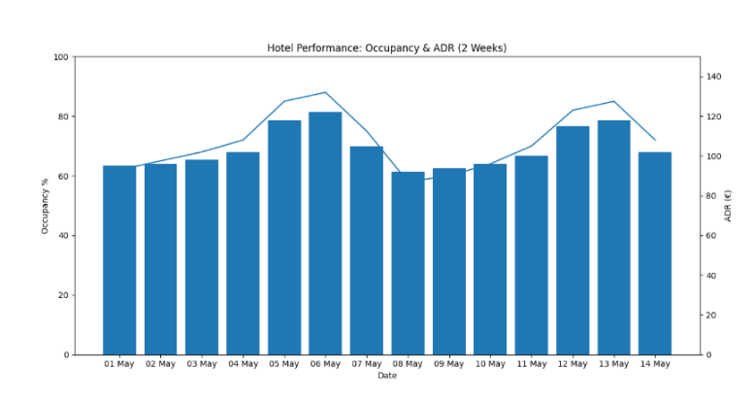
Reading Patterns in KPIs
14-day chart of occupancy % and ADR
Notes:
STR – Understanding your STR reports: basics
AltexSoft – RevPAR, ADR, and other main hotel metrics and KPIs

Slide 40
Using KPIs for Pricing Decisions
Occupancy %, ADR and RevPAR together show whether your current prices are too low, too high, or in line with demand.
WHAT THE NUMBERS TELL YOU:
Scenario.. | What It Means.. | Action..
High Occupancy + High ADR | Strong demand | Test modest rate increase
Low Occupancy + Low ADR | Weak demand | Targeted offers or packages
High Occupancy + Low ADR | Prices may be too low | Consider raising rates
Low Occupancy + High ADR | Prices may be too high | Review value proposition
ACTIVITY..:
Using last week’s dataset, increase weekend ADR by €5 in a copy of the sheet. Recalculate RevPAR (€) and total room revenue (€). In one sentence, say whether you would keep the higher weekend rate and why (Based on STR, 2024; OTA Insight, 2023).
Notes:
SiteMinder – Hotel STAR reports and key KPIs
AltexSoft – Average Daily Rate, explained

Slide 41

Using KPIs for Staffing Decisions
Linking rooms sold or covers to labour hours helps you judge whether staffing levels match demand.
KEY METRICS:
Rooms Sold per Labour Hour
= Total rooms sold ÷ Total labour hours
How productive is your team?
Labour Cost Percentage
= Total staff costs ÷ Total sales × 100
How much of revenue goes to wages?
Notes:
Lighthouse (Lighthouse by OTA Insight) – How to calculate and improve 12 hotel performance metrics

Slide 42
Using KPIs for Staffing Decisions
Day.. | Rooms Sold.. | Labour Hours..
Monday | 35 | 40
Tuesday | 32 | 38
Wednesday | 38 | 42
Thursday | 42 | 44
Friday | 48 | 50
Saturday | 52 | 55
Sunday | 40 | 45
ACTIVITY..:
Calculate rooms sold per labour hour for each day
Identify one day that looks over-staffed
Identify one day that looks under-staffed
Write one suggested rota adjustment (HospitalityNet, 2022)
Notes:
Lighthouse (Lighthouse by OTA Insight) – How to calculate and improve 12 hotel performance metrics

Slide 43
Using Data for Sustainability Decisions
KEY SUSTAINABILITY KPIs:
Food Waste per Cover = Total food waste (grams) ÷ Number of covers served
Tracks kitchen waste reduction over time
Energy per Occupied Room = Total energy use (kWh) ÷ Rooms sold
Measures efficiency improvements
EUROPEAN RESULTS:
Food Waste Reduction - Hotels tracking food waste per cover achieved 20–25% reductions through:
Menu changes
Buffet redesigns
Better stock control (IFWC, 2022; HospitalityNet, 2023)
ENERGY SAVINGS-
Monitoring kWh per occupied room before and after:
LED lighting
Improved housekeeping routines
Smart building controls (UNWTO, 2020)
See also ›
C1 M2
- Circular Economy and Resource Efficiency
Notes:
International Food Waste Coalition – European hospitality and food service sector reports 20 % reduction in food waste
https://internationalfoodwastecoalition.org/european-hospitality-and-food-service-sector-reports-20-reduction-in-food-waste/
EPA Ireland – Food waste in hotels (food waste per cover benchmark)
https://www.epa.ie/media/epa-2020/monitoring-amp-assessment/circular-economy/Food-waste-in-Hotels--Daily-v3.pdf
UNWTO – Recommendations for the Transition to a Green Travel and Tourism Economy (energy and resource KPIs)
https://www.unwto.org/sustainable-development (search within for energy/resource efficiency guidance)

Slide 44
Comparing “What If” Scenarios in Spreadsheets
Testing different options before you make a change by copying a dataset and adjusting one or two inputs.
COMMON SCENARIOS:
Pricing Scenario – Increase weekend rates by €5
Impact: Total revenue, RevPAR
Staffing Scenario – Adjust rota by ±10 hours on quiet days
Impact: Labour cost %, rooms sold per hour
Sustainability Scenario – Reduce food waste by 15%
Impact: Waste per cover (g), cost savings
ACTIVITY..:
In a copy of your KPI sheet, model two scenarios:
a €5 weekend rate increase;
a change that reduces waste by 15 % but slightly lowers covers.
For each scenario, record total revenue (€) and grams of waste per cover. In a short note, say which scenario you prefer and why.
Notes:
Lighthouse – How to calculate and improve 12 hotel performance metrics

Slide 45
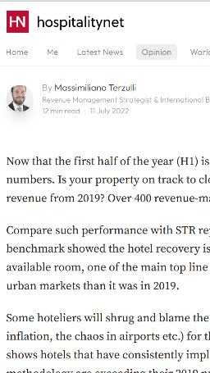
Further Reading: Data-Driven Revenue in European Hotels
https://www.hospitalitynet.org/opinion/4111430.html
This article compares hotels with active revenue-management and data-driven pricing against their peers, using performance data from European and other markets. It shows how differences in occupancy %, ADR and RevPAR can add up to 15–40 % higher room revenue when hotels monitor demand, position their prices strategically and review results regularly. A related European study found that strategic price positioning (ADR) is often a stronger driver of RevPAR than occupancy alone (Loria, 2015).
CLICK TO VIEW
Notes:
EU HaFS sector reports 20% reduction in food waste | IFWC - WRAP EU

Slide 46
Identify Two Key Issues
Group Activity: Integrated Decision Scenario
⁰¹
Examples: Weak midweek RevPAR, high waste at Sunday brunch
Your team receives a 7-day dataset that includes:
Room KPIs (occupancy, ADR, RevPAR)
Restaurant covers and average spend
Labour hours by department
Food waste per cover (grams)
Design Two "What If" Options
⁰²
In your spreadsheet, test:
Option A: Midweek package
Option B: Rota change or new portioning rule
Prepare A Recommendation
(3–4 Sentences)
⁰³
Which option you choose
The main numbers that support it
One risk or assumption managers should know (Based on IFWC, 2022; STR, 2024)
See also ›
C3 M1
- Leading Green and Digital Change
Notes:
EU Smart Tourism Destinations – EU guide on data for tourism destinations
https://smarttourismdestinations.eu/wp-content/uploads/2022/07/Smart-Tourism-Destinations_EU-guide_v1_EN.pdf
STR – Hotel key performance indicators
https://str.com/data-insights/resources/hotel-key-performance-indicators

Slide 47
Communicating Data -Informed Recommendations
Decision makers rarely need every detail from your spreadsheet. They need a clear statement of the problem, key numbers, and a concise recommendation.
THE FORMULA:
Situation – One sentence describing what's happening
Key Numbers – 2–3 numbers that tell the story
Example: "Occupancy rises from 72% to 81%" or "Waste falls from 140g to 108g per cover"
Recommendation – One clear action to take
Assumption – One thing you're assuming to be true
See also ›
C3 M2
- Digital Marketing for Sustainability
ACTIVITY..:
Using the scenario you worked on, write a short email to a fictitious General Manager including:
One sentence describing the situation
Two key numbers
One clear recommendation
One assumption
Notes:
Lighthouse – How to calculate and improve 12 hotel performance metrics

Slide 48
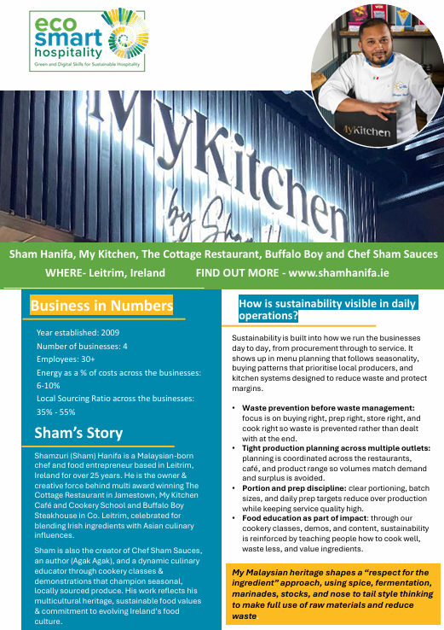
Sham Hanifa Group
Sham Hanifa Group demonstrates how hospitality managers can use data to make practical decisions that improve operational and financial performance.
Across its hospitality operations, the business uses information from reservations, sales patterns, customer demand, stock levels and food waste monitoring to support planning and resource allocation. Data helps managers anticipate demand, optimise purchasing decisions, schedule staff effectively and reduce avoidable waste.
The case highlights that successful data-driven organisations do not necessarily rely on complex technology. Instead, they consistently use relevant information to support decisions and improve business performance over time.
Key Learning: The value of data is realised when information is translated into practical actions that improve business outcomes.

Slide 49

Further viewing: Turning data into booking success in Europe
Sojern (2022). How Hoteliers Can Turn Data into Direct Booking Success: A UK&I Perspective. Webinar.
In this webinar, a European digital marketing expert shows how hotels in the UK and Ireland use data on search trends, booking windows and channel mix to adjust prices and campaigns. The session illustrates how a small set of KPIs is used to guide real decisions and keep teams focused on the signals that matter.
Viewing task: As you watch, note
one data source mentioned, and
one concrete action a hotelier takes based on that data.
Be ready to share how this relates to the pricing or scenario work in Unit 3.
CLICK TO VIEW

Slide 50
Unit 3 Summary
WHAT YOU LEARNED:
Read Patterns – Interpret time series of occupancy %, ADR, RevPAR, average spend, and food waste per cover
Pricing Decisions – Test rate changes and model impact on revenue
Staffing Decisions – Link rooms sold to labour hours, calculate labour cost %
Sustainability Decisions – Track food waste per cover and energy per occupied room
Scenario Analysis – Compare "what if" options before making changes
Communicate Recommendations – Turn analysis into short, data-informed messages
ECOSMART CONNECTION:
These skills help you use digital tools and KPIs to describe performance and to shape sustainable, well-justified decisions (IFWC, 2022; STR, 2024; UNWTO, 2020).

Slide 51
Building a Data Culture in Eco Smart Hospitality
In this unit you move from single spreadsheets or reports to how data flows across a whole hospitality workplace. You explore what a “data culture” means in hotels, restaurants and cafés, how green and digital skills fit together, and how simple routines can make data-informed practice an everyday norm. Drawing on recent European work on hospitality and tourism skills and data use, you identify concrete steps to strengthen data, collaboration and sustainability in your own context.
04
UNIT
See also ›
C3 M1
- Leading Green and Digital Change

Slide 52
What is a Data Culture in Hospitality?
A data culture is the shared behaviour, attitudes and routines that make using data part of everyday work for every role.
WHAT IT LOOKS LIKE IN PRACTICE:
Teams regularly look at KPIs – Occupancy, ADR, food waste per cover
Discuss trends openly – What's working? What's not?
Use evidence to decide – Pricing, staffing, sustainability actions
Everyone participates – every role, every shift (Revfine, 2025)
ACTIVITY..:
In 2–3 sentences, describe how decisions are usually made in your workplace. To what extent do people refer to occupancy %, average spend, labour cost % or waste per cover, and to what extent do they rely mainly on habit and experience?
Notes:
Sorour Bros – Driving Hospitality Data Culture Success
https://sorourbros.com/hospitality-data/
Revfine – Creating a Data-Driven Culture in Hotels: Why Just Getting a BI Platform Is Not Enough
https://www.revfine.com/data-driven-culture-in-hotels-requires-more-than-bi-tools/

Slide 53
Green and Digital Skills in Eco Smart Hospitality
Green and digital skills are closely linked in a modern hospitality workplace.
WHAT UNESCO-UNEVOC SAYS - Staff at all levels increasingly need to:
Handle operational data
Use basic digital tools
Understand indicators like energy per occupied room or grams of food waste per cover
WHY IT MATTERS:
These skills support the twin green and digital transition- and are part of core professional competence, not an extra task for specialists (UNESCO-UNEVOC, 2024).
ACTIVITY..:
List three data-related skills that already exist in your team (for example using spreadsheets, reading KPI dashboards, recording waste) and three skills that need to be strengthened to support Eco Smart goals in your workplace.
Notes:
UNESCO-UNEVOC – Green and digital skills for hospitality and tourism
https://unesdoc.unesco.org/ark:/48223/pf0000391115
European Commission – Digital skills in tourism (Digital Skills & Jobs Platform)
https://digital-skills-jobs.europa.eu/en/topics/tourism
UNWTO – Sustainable tourism and measurement (resources on energy and resource efficiency)
https://www.unwto.org/sustainable-development

Slide 54
Mapping Data Flows in a Hospitality Business
In a typical hotel or restaurant, data move between several core systems and teams
Bookings and stay details flow from the PMS to revenue and front-office staff; transaction data flow from the POS to finance and F&B managers; rota and HR systems track labour hours; and manual logs or meters capture energy, water and food-waste data that feed into sustainability reporting. Industry overviews show that integrating PMS, POS and other systems is essential for building a reliable, shared view of performance across departments. (Mews, 2025; AltexSoft, 2023).
See also ›
C1 M1
- Integrating Sustainability in Daily Operations
ACTIVITY..:
Choose a hotel, restaurant or café. Sketch a simple diagram showing:
where data are created (reception, restaurant, bar, kitchen, housekeeping),
which systems they go into (PMS, POS, rota/HR, waste logs),
who uses the resulting KPIs.
Mark one or two question marks where data are missing or not yet shared.
Notes:
UNESCO-UNEVOC – Green and Digital Skills for Hospitality and Tourism
EU Digital Skills & Jobs – tourism-related digital skills initiatives

Slide 55
Barriers and Enablers For Using Data
COMMON BARRIERS:
Limited time – Too busy with daily operations to analyze data
Uneven data literacy – Some staff confident, others unsure
Unclear ownership – No one person responsible for reports
Lack of trust – Numbers hard to trace back to source
KEY ENABLERS:
Visible leadership support – Managers model data use
Simple shared dashboards – Easy to access and understand
Regular cross-department meetings – Discuss KPIs together
Clear routines – Daily huddles, weekly reviews (Revfine, 2025; HospitalityNet, 2023)
See also ›
C3 M1
- Leading Green and Digital Change
ACTIVITY..:
Identify two barriers that make it hard to use data in your workplace (for example, no time to review reports, unclear KPIs, complex systems) and two existing strengths (for example, a weekly meeting, a motivated colleague, a clear waste-recording routine). Write one sentence on how you could reduce one barrier or build on one strength
Notes:
Sorour Bros – Driving Hospitality Data Culture Success
Revfine – Creating a Data-Driven Culture in Hotels

Slide 56
Simple routines and roles for KPIs
A strong data culture is built through simple, repeated routines- not one-off projects.
ROUTINE IDEAS:
Daily Huddle (5–10 min)- Review 3 key KPIs from yesterday: occupancy, ADR, waste per cover
Weekly Waste Review (15 min)- Kitchen team reviews food waste data, plans adjustments
Monthly Cross-Department Meeting (30 min)- Look at occupancy, revenue and sustainability indicators together
CLEAR ROLES:
Data Champion – Someone responsible for updating the KPI sheet
Communicator – Someone who brings main messages to the team
ACTIVITY..:
Design one realistic KPI routine for your context. For example, “Every Monday morning, the duty manager and head of department review last week’s occupancy %, RevPAR and food waste per cover for 15 minutes.” Write down who participates, which 2–3 KPIs are reviewed and how long the routine should last.
Notes:
EU Smart Tourism Destinations – Toolkit for Mastering Data
UNESCO-UNEVOC – green and digital skills recommendations for workplaces

Slide 57
Planning Eco Smart Data Actions
Planning Eco Smart data actions
European reports on tourism data and skills emphasise the value of small, practical actions that build over time.
In Eco Smart Hospitality, this might mean starting with one or two priority KPIs and one team that is ready to experiment. An action plan helps you decide what to start, who is involved and when you will review progress.
Activity:
Draft a short Eco Smart data action plan with three elements:
One KPI focus (for example food waste per cover, labour cost % or occupancy % and ADR by day of week).
One new or improved routine linked to this KPI.
One review point (for example after 4 weeks) where you will check data and decide whether to continue, adjust or extend the routine.
European reports on tourism data and skills emphasise the value of small, practical actions that build over time.
In Eco Smart Hospitality, this might mean starting with one or two priority KPIs and one team that is ready to experiment. An action plan helps you decide what to start, who is involved and when you will review progress.
ACTIVITY..:
Draft a short Eco Smart data action plan with three elements:
One KPI focus (for example food waste per cover, labour cost % or occupancy % and ADR by day of week).
One new or improved routine linked to this KPI.
One review point (for example after 4 weeks) where you will check data and decide whether to continue, adjust or extend the routine.
Notes:
UNESCO-UNEVOC – Green and Digital Skills for Hospitality and TourismEU – Study on Mastering Data for Tourism by EU Destinations

Slide 58
Unit 4 Summary
WHAT YOU LEARNED:
Data Culture Defined – Shared behaviours and routines that make data part of everyday work
Green + Digital Skills – Connected skills needed for the twin transition
Map Data Flows – Understanding where data comes from and who uses it
Barriers & Enablers – What stops data use, what helps it grow
Simple Routines – Daily huddles, weekly reviews, clear roles
Your Action Plan – Practical steps to strengthen data use in your workplace
ECOSMART CONNECTION:
Together with Units 1–3, you now have a complete pathway: understanding data and KPIs, working with them in spreadsheets, applying them to decisions, and embedding them into your team's culture (UNESCO-UNEVOC, 2024; Revfine, 2025)

Slide 59
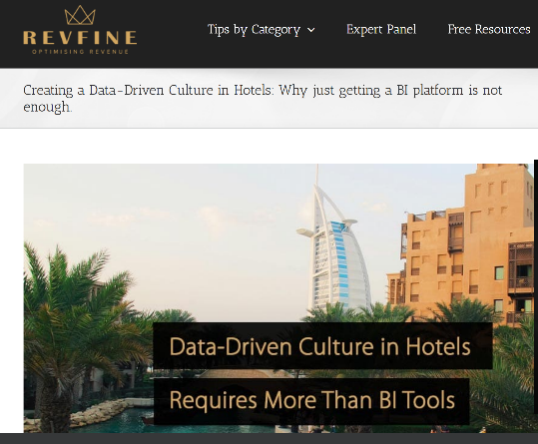
Further Reading: Creating a Data-Driven Culture in Hotels
Revfine (2025). Creating a Data-Driven Culture in Hotels: What it Takes Beyond a BI Platform.
This article discusses why many hotels still struggle to make data-informed decisions even after investing in business-intelligence tools. It explains how leadership behaviour, cross-functional collaboration and simple, shared KPIs can help turn data into action, and offers practical steps to develop a stronger data culture across revenue, operations and marketing teams.
Reading task: As you read, note one idea you could apply directly in your workplace (for example a regular KPI meeting, a shared dashboard or a clearer owner for certain reports) and be ready to share how it supports your Unit 4 action plan.
CLICK TO VIEW

Slide 60
C2 M2 · Case study pack
Download the full case studies
Every business featured in this module has a full case study. Use the links below to open each one.
Coco Hotel – Denmark
Hotel Luise – Germany
Using operational, guest and sustainability data to improve decision-making, performance monitoring and business intelligence.
Transforming energy, water and waste data into meaningful KPIs that support continuous improvement and benchmarking.
Download the full case study · {{CASE_URL_COCOHOTEL}}
Download the full case study · {{CASE_URL_HOTELLUISE}}
Sham Hanifa Group– Ireland
Using sales, reservations and operational data to support forecasting, reduce waste and improve everyday management decisions.
Download the full case study · {{CASE_URL_SHAMHANIFA}}

Slide 61
Thank You for Engaging
We hope this module has enriched your knowledge and sharpened your practice.
Thank you for your commitment to hospitality that is intelligent, sustainable, and human centred. Carry these insights into your work, lead with ethics and empathy, and let technology serve people with care.
www.ecosmartproject.eu

