Slide 1
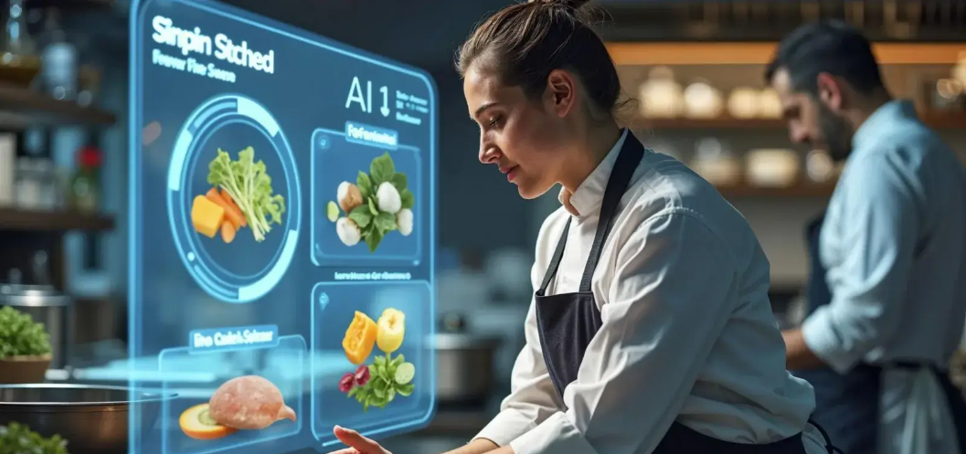



C2 Digital transformation in Hospitality
Image AI generated as example
Module 1:
Leveraging AI for efficiency & Guest experience
www.ecosmartproject.eu
EcoSmart resources licensed under CC BY 4.0

Slide 2
C2 Digital transformation in Hospitality | Module 1 - Leveraging AI for efficiency & Guest experience
Why this module matters to your business
Artificial intelligence is becoming part of everyday hospitality. Used well, it helps businesses save time, improve guest experiences, support sustainability goals, and make better operational decisions without losing the human touch that defines hospitality.
01
02
03
Focus people where they matter most
Make better decisions
Enhance guest experiences
Use AI tools to support forecasting, scheduling, pricing, communication, and operational planning with greater confidence and consistency.
Automate repetitive tasks, reduce administration, and free staff to concentrate on service, problem-solving, and guest relationships.
Create faster, more personalised, and more responsive interactions while maintaining authenticity, trust, and human connection.
Meet the businesses you will learn from in this module
Adrede (Madrid, Spain) · Heritage Flavours (Bursa, Türkiye) · Hotel Lücke (Rheine, Germany) · Casa Verde Bistro (Portugal — learner task)

Slide 3

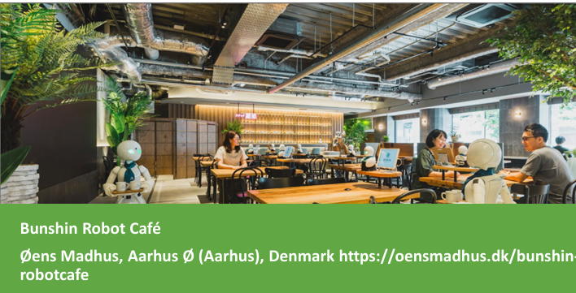

C2 Digital transformation in Hospitality | Module 1 - Leveraging AI for efficiency & Guest experience
Where this module fits
Role: Foundation module for understanding, evaluating, and applying AI tools in hospitality operations, guest experiences, and business decision-making
Extends or connects to
C2 M2 (data literacy)
C3 M1 (leading digital change)
C3 M2 (marketing AI)
This module also draws on leading international hospitality brands that are actively implementing artificial intelligence at scale. Their experiences provide practical insights into how AI is being used to improve guest communication, personalise services, optimise operations, reduce waste, support sustainability goals, and strengthen business performance. Featured examples include:
Hilton Hotels – AI-enabled guest services and operational efficiency
citizenM Hotels – AI-first hospitality, automation, and sustainability
Accor Group – ethical AI, staff engagement, and responsible innovation Scandic Hotels – smart controls supporting guest comfort and sustainability
Marriott International – predictive analytics, food waste reduction, and intelligent operations
Meliá Hotels International – intelligent building management and energy optimisation
NH Hotel Group – personalised guest communication and digital engagement

Slide 4
Learning Objectives
What You Will Achieve:
Foundations:
Define AI in practical hospitality terms
Explain how automation supports operations & sustainability
Application:
Identify where AI enhances guest personalization
Evaluate ethical implementation for your team
Action:
Analyse real case studies for lessons
Create your own AI implementation plan
Overall Outcome:
You'll leave with the confidence and practical tools to lead responsible AI adoption in your business.

Slide 5
Shared Glossary
Seven terms used across the programme. Same definitions in every module.
Term
Canonical definition
Full treatment in
Greenwashing
Making sustainability claims that are exaggerated, unverifiable, or unsupported – intentionally or by omission.
C3 M2
ESG
Environmental, Social & Governance – the three pillars used to assess a business's non-financial performance and its broader impact.
C3 M1
Nudge
A small change in how a choice is presented (a default, a reminder, the physical set-up) that shifts behaviour without restricting choice.
C1 M3
Twin transition
Advancing digital transformation and the green transition together so that each reinforces the other in SMEs.
C3 M1
KPI
Key Performance Indicator – a measurable value that shows how effectively a business is achieving a defined objective.
C2 M2
Circular economy
An approach designed to keep materials and products in use for as long as possible through reducing, reusing, repairing, refurbishing and recycling – so that waste becomes a resource.
C1 M2
Guest journey
The full sequence of a guest's interactions with a business, from awareness through booking, stay and post-stay engagement – used to design sustainability and digital touchpoints coherently.
C1 M3
EcoSmart Hospitality – WP3 · Shared glossary · identical in all 7 modules

Slide 6
Contents
01
Understanding AI in Hospitality
02
Automating Routine Operations
03
Enhancing the Guest Experience
04
Ethics, Staff, Engagement and Responsible AI use
05
Case Studies and Applied Practice

Slide 7
Understanding AI
in Hospitality
Foundations, applications, and human implications of AI in the European hospitality sector. To introduce the concept of Artificial Intelligence and examine its strategic and ethical role in sustainable hospitality
01

Slide 8
Understanding Artificial Intelligence
AI = Digital systems that perform tasks requiring human-like intelligence
⁰¹
⁰³
Learns From Data
Improves through feedback, not fixed
Recognises Patterns
Spots trends in large datasets
Unlike traditional automation, AI adapts and gets better over time.
Processes Language
Understands speech and text
Makes Predictions
Forecasts under uncertainty
⁰²
⁰⁴

Slide 9
Why Artificial Intelligence Matters in Hospitality
Daily Efficiency
⁰¹
Automates check-in, scheduling & communication → 76% time savings
on routine tasks reported
(EcoSmart Project Research, 2024)
Three ways AI transforms hospitality operations:
Sustainability & Costs
⁰²
Energy monitoring & predictive maintenance → ~20% lower energy use in hotel settings
(CBRE Hospitality Analytics, 2024)
AI strengthens both your environmental credentials and your bottom line.
Guest & Team Experience
⁰³
Frees staff for complex, empathetic service → 54% faster guest communication
(HospitalityNet Industry Report, 2024)

Slide 10
Artificial Intelligence in Action
AI is now embedded across hotel management and guest experience:
⁰¹
⁰³
Many hotels start with contained uses (digital communication, dynamic pricing), then progress to more advanced applications. (HES SO Hospitality Research, 2025)
Chatbots -
Handle routine enquiries 24/7
Predictive Models -
Adjust pricing & staffing in real-time
Sentiment Analysis
Extract themes from guest reviews
Smart Housekeeping -
Align cleaning with departures (CBRE European Hospitality Report, 2024)
⁰²
⁰⁴

Slide 11

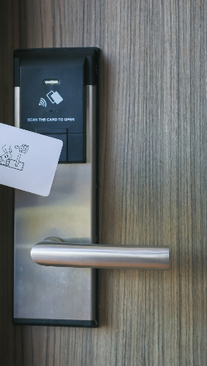
Artificial Intelligence in Leading Hospitality Brands
Hilton: "Connie" AI Concierge
IBM Watson-powered assistant in hotel lobbies
Reduces routine queries
Staff focus on personalised support
Improved guest satisfaction scores
(Hilton Corporate Innovation Report, 2024)
CitizenM: Sustainable Automation
Predictive housekeeping & energy management
Adapts to real-time occupancy
Reduces energy waste
Aligns with EcoSmart mission
(CitizenM ESG & Innovation Report, 2024)

Slide 12

Artificial Intelligence in Leading Hospitality Brands
Accor Group: Guest Sentiment Analysis
AI analyses thousands of daily reviews
Identifies recurring themes (cleanliness, service tone)
20% faster complaint resolution
Greater consistency across properties
(Accor Group Digital Transformation Report, 2024)
Marriott International: Predictive Analytics
AI-driven occupancy forecasting
Optimises staff scheduling
15% improved operational efficiency
Better guest satisfaction & cost control ( Marriott International Operations Review, 2023)
Across Europe, ~41% of hotels use AI, with 68% planning adoption soon. (HospitalityNet Industry Survey, 2025)

Slide 13
The Role of People and Technology
Human Essentials:
⁰¹
Empathy
Cultural understanding
Genuine connection
→ Creates trust and lasting loyalty
True hospitality is human. Technology should enhance, not replace, genuine connection.
Tech As Enabler:
⁰²
Handles data-heavy tasks
Provides decision support
→ Frees staff for meaningful interaction
Balance requires planning and training. Staff need to know when to use data and when to lead with empathy.
Research Insight:
⁰³
Hotels combining AI tools with trained staff achieve higher guest satisfaction and employee engagement.
See also ›
C3 M1
- Leading Green and Digital Change

Slide 14
Artificial Intelligence in Action
AI is now embedded across hotel management and guest experience:
⁰¹
⁰³
Many hotels start with contained uses (digital communication, dynamic pricing), then progress to more advanced applications. (HES SO Hospitality Research, 2025)
Chatbots -
Handle routine enquiries 24/7
Predictive Models -
Adjust pricing & staffing in real-time
Sentiment Analysis
Extract themes from guest reviews
Smart Housekeeping -
Align cleaning with departures (CBRE European Hospitality Report, 2024)
⁰²
⁰⁴

Slide 15
Reflection and Discussion
AI in Your Experience
Think of one recent encounter with AI in hospitality:
Chatbot for booking?
Digital check-in?
Dynamic pricing?
Automated messages?
Guest Perspective
The
Balance
Was it efficient?
Did it feel personal?
Clear?
Where did automation help vs. where was human touch needed
Staff Perspective
Think in 3 Dimensions:
Support better service?
Did it save time?
Create confusion?
Prepare to Share: In small groups: What tasks should stay human-led?

Slide 16
Reflection and Discussion
3-step Group Activity:
Share & Synthsise
⁰¹
Compare AI examples. What tasks suit automation vs. human touch?
→ Agree on 3 principles for responsible AI use
Apply your Insights
⁰²
Measure Success:
How will you know it works?
Faster responses
Better guest comments
Higher staff confidence
Choose one small, realistic change to test:
Chatbot handover improvement
Friendlier automated messages
Clearer data use transparency
Evidence of Learning
⁰³
Summarise your example + one key lesson about balancing digital tools with human service

Slide 17
⁰¹
⁰⁴
AI = Practical Tool: Digital systems that learn from data to help with human-like tasks
Growing in Europe: 41% of hotels use AI, 68% planning adoption (HospitalityNet European Survey, 2025)
⁰²
⁰⁵
Delivers Real Benefits
Saves time: (76% on routines), saves energy (~20%), enhances service (Industry studies reported in EcoSmart Project Research, 2024)
Essential Balance:
Success requires: Strong leadership + Good
data management + Comprehensive staff training
⁰³
Complements humans: frees staff for empathy and problem-solving.
Key Takeways
Ethical, inclusive digital transformation that preserves hospitality's human essence.

Slide 18

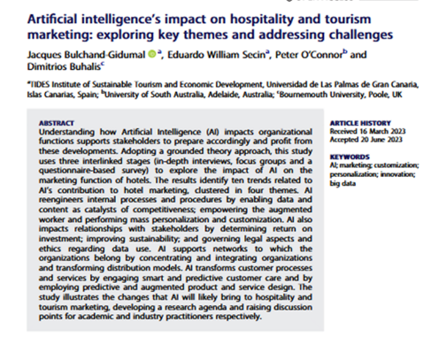
Further Reading: Artificial Intelligence in Hospitality and Tourism
Bulchand-Gidumal, J. (2024). Artificial Intelligence’s Impact on Hospitality and Tourism. Journal of Tourism Futures. Taylor & Francis Online.
This academic paper analyses how Artificial Intelligence is transforming the hospitality and tourism industries. It explores adoption trends, guest perceptions, marketing applications and operational improvements. The study provides insight into both opportunities and challenges for European businesses as they integrate AI into service delivery and guest engagement
CLICK TO VIEW

Slide 19
Automating Routine Operations
Enhancing efficiency and sustainability through artificial intelligence. To explore how artificial intelligence automates key operational processes such as scheduling, housekeeping, and inventory management, improving efficiency and sustainability while allowing staff to focus on meaningful guest interaction.
02
See also ›
C1 M2
- Circular Economy and Resource Efficiency

Slide 20
What Is Automation?
Automation refers to the use of technology to complete repetitive or predictable tasks with minimal human input.
With AI: AI-powered automation learns from data, responds to demand, and improves over time.
In Hospitality Context: Makes operations faster, more consistent, and less prone to error.
European Adoption: Nearly 50% of hotels have automated at least one routine process, most often in housekeeping or guest communication.
Pause and reflect: Which process in your organisation could be automated to save time or energy? How might this change support both staff wellbeing and guest satisfaction?

Slide 21
How Automation Transforms Daily Operations
Three Key Impacts:
Operational Efficiency
⁰¹
Connected systems manage room assignment, housekeeping, inventory, payments → 30% faster room turnaround reported
Guest Experience
⁰²
Mobile check-in, digital keys, online payments → 10% higher satisfaction vs. manual systems
Balance Achieved:
Guests gain convenience & control, while staff focus on personal service.
Pause and reflect
Identify one process in your workplace that could benefit from automation. How would this change affect energy use, time management or guest satisfaction?
Sustainability
⁰³
Smart energy systems, automated kitchen monitoring → Reduces waste and operating costs

Slide 22

Automation in European Hospitality
How leading European brands use automation to solve real operational challenges:
Premier Inn (United Kingdom)
Challenge: Long queues during peak check-in
Solution: Self check-in kiosks & mobile check-in
Result: Faster arrivals, staff free for personal welcome
(Premier Inn Digital Guest Journey Case Study, 2024)
Scandic Hotels (Nordic Region)
Challenge: Inefficient housekeeping & energy waste
Solution: Digital scheduling linked to real-time occupancy
Result: Faster room turnaround + lower energy use
(Scandic Hotels Sustainability & Operations Report, 2024)

Slide 23
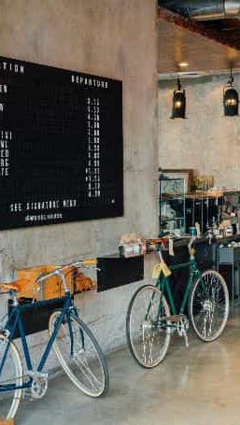
Automation in European Hospitality
Meliá Hotels International (Spain)
Priority: Energy efficiency & guest comfort
Automation: Smart building controls (lighting, HVAC)
Outcome: Lower energy use + improved comfort levels
(Meliá Hotels International Smart Buildings Initiative, 2024)
Radisson Hotel Group (Europe-wide)
Priority: Revenue accuracy & staff focus
Automation: Pricing & room availability tools
Outcome: Synchronised rates + more time for guest relations
(Radisson Hotel Group Revenue Management Review, 2024)

Slide 24

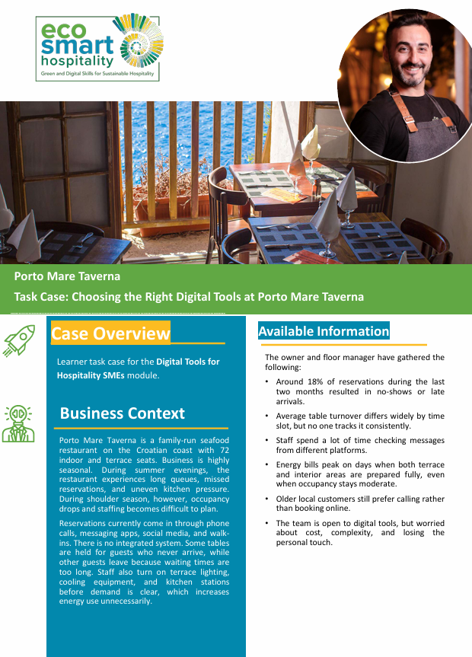
Porto Mare Taverna
Porto Mare Taverna demonstrates how digital transformation often begins by solving everyday operational challenges rather than introducing advanced technology. As a busy seasonal seafood restaurant, the business struggles with reservations arriving through multiple channels, inconsistent table management, long waiting times, and unnecessary energy use caused by preparing spaces and equipment before demand was fully understood.
Management identified that around 18% of reservations resulted in no-shows or late arrivals, while staff spent significant time monitoring messages across different platforms. The business also recognised that energy consumption increased when terrace areas, lighting, cooling systems, and kitchen stations were prepared for demand that did not always materialise.
The case encourages us to explore how relatively simple digital tools can improve reservation management, support operational planning, reduce resource waste, and provide better information for decision-making. It also highlights an important hospitality principle: technology should improve efficiency while preserving the personal service that guests value.
Key Learning: Successful digital transformation starts with clearly defined operational problems and tools that improve efficiency + guest experience.

Slide 25

Reflection and Discussion
Automation can bring speed, accuracy and sustainability, but its success depends on how people design, manage and use it. The most effective systems strengthen, the human side of hospitality.
What Worked Well?
Speed? Accuracy? Convenience?
What Created Difficulty?
Confusion? Impersonal feel? Technical issues?
How Could it be Smoother?
For both guests AND staff?
Discussion in small groups:
Which processes benefit most from automation?
Which moments require human presence?
Agree on 3 principles for responsible automation

Slide 26
⁰¹
⁰⁴
Automation is Central:
Enhances efficiency, accuracy & sustainability across European hospitality
Drives Better Outcomes: Hotels combining digital systems + human expertise report higher satisfaction
⁰²
Strengthens Human Roles: Reduces admin work, freeing staff for creativity & personal service
⁰³
ECOSMART APPROACH:
Automation as a partnership: Systems handle repetition & data, people provide empathy & ethical oversight.
Supports Environmental Goals: Smart energy & resource management through digital systems
Key Takeways

Slide 27
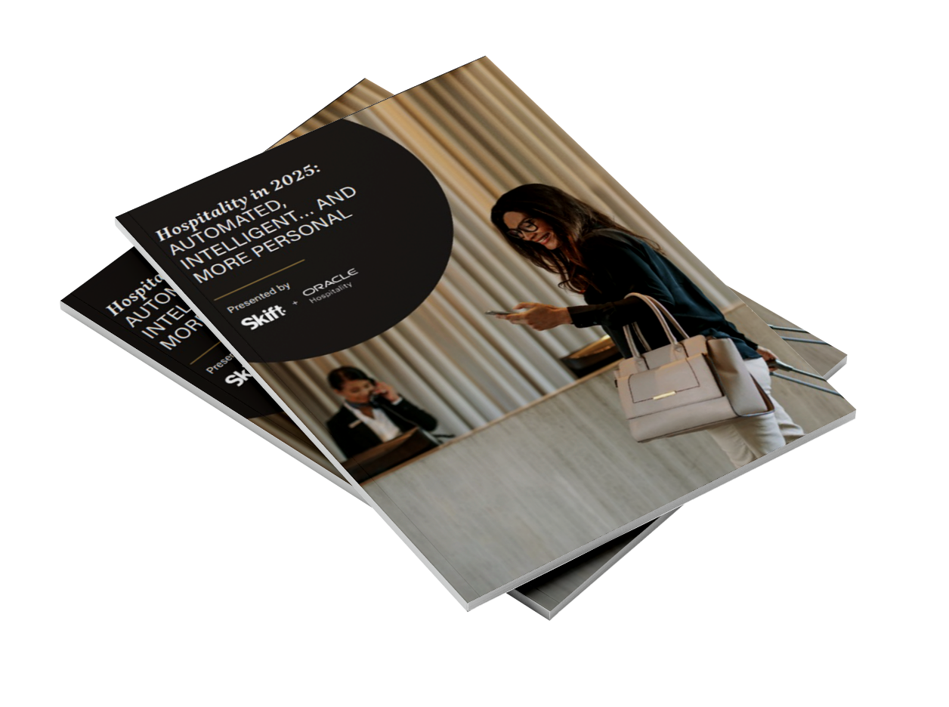
Multimedia Exploration
Skift, 2025. Hospitality in 2025: Automated, Intelligent and More Personal.
The article outlines how automation and artificial intelligence shape service, from mobile check in to voice control and data informed personalisation. It shows how technology should deepen human connection.
After reading, identify two examples that could be introduced in your workplace or region. Explain how each might enhance efficiency, sustainability or guest satisfaction.
CLICK TO VIEW

Slide 28
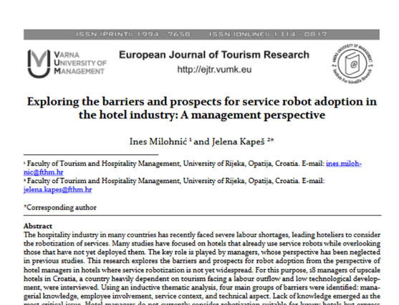
Further Reading: Automation and Service Robots in Hospitality
Milohnić, I. & Kapeš, J. (2024). Exploring the Barriers and Prospects for Service Robot Adoption in the Hotel Industry: A Management Perspective. European Journal of Tourism Research, 38, 3805.
This European study explores how hotel managers perceive automation and use of service robots within hospitality. It analyses the operational, ethical & managerial challenges that influence adoption, as well as the benefits to efficiency, consistency and guest satisfaction. The paper highlights how automation can reshape roles, improve workflow & support service quality when implemented with clear strategy & staff engagement
CLICK TO VIEW

Slide 29
Enhancing the Guest Experience
Personalising hospitality through artificial intelligence. To explore how artificial intelligence enhances guest interaction, communication, and personalisation across hospitality services, helping organisations deliver efficient yet human centred experiences.
03
See also ›
C1 M3
- ·Sustainable Customer Experience Design

Slide 30
How AI Supports Guest Interaction and Personalisation
Hospitality is still about how guests feel, but service is now shaped by people and intelligent tools working together.
What Enhancement Means:
Using AI to:
Remove delays
Personalise moments
Support staff to give warmer, more attentive service
European Values:
Accessibility
Sustainability
Respect for cultural diversity
Simple Goal:
"Use data wisely so every stay feels efficient, inclusive, and genuinely personal."

Slide 31

Enhancing the Guest Experience
AI analyses data to create tailored guest experiences.
Guest Expectations:
Today's guests expect personalised communication, customised recommendations, and timely responses.
AI Tools in Action:
Chatbots - Instant answers to common questions
Virtual Concierges - Personalised activity suggestions
Recommendation Engines - Based on past preferences
Predictive Systems - Anticipate needs before guests ask
Staff Support: Automates routine tasks so employees can focus on meaningful, human-centered engagement.

Slide 32
How AI Supports Guest Interaction and Personalisation
AI transforms how hotels understand and respond to guests-moving from generic to tailored experiences.
Personalisation Examples:
Returning guest: Preferred room temperature already set
Frequent diner: Menu suggestions reflecting past choices
Business traveler: Quick check-in and workspace ready
Family: Activity recommendations for children's ages
Data Sources:
Bookings
Reviews
On-site interactions
Past preferences
European Context:
Leading hotel groups recognise this balance between efficiency and empathy as the hallmark of high-quality guest experience.
See also ›
C1 M3
- Sustainable Customer Experience Design
Notes:
QloApps. (2025, April 25). How AI Agents are transforming hotel bookings [Image]. QloApps. Retrieved from https://qloapps.com/ai-agents-smarter-hotel-bookings/

Slide 33
How AI Agents
Are Transforming Hotel Bookings
24/7 Efficient
Customer Support
Smarter Pricing with AI
01
Personalised Hotel Recommendations
02
08
How AI Agents Are Transforming Hotel Bookings
Operational Efficiency
07
03
Faster Booking Experience
06
04
Mobile – First Simplicity
05
Safety & Fraud Prevention
Enhanced Guest Loyalty

Slide 34
European Examples of Guest-Facing AI
Room Mate Hotels, Spain
Tool: AI concierge learning from guest feedback
Function: Real-time suggestions for events, dining, transport
Benefit: Guests explore confidently; staff focus on personal welcomes
(Room Mate Hotels Guest Technology Case Study, 2024)
NH Hotel Group, Spain and Italy
Tool: Personalised pre-arrival & in-stay communication
Function: Timely messages about room readiness, local tips
Benefit: Small, thoughtful gestures feel individual and caring
(NH Hotel Group Digital Communication Strategy, 2024)
Notes:
QloApps. (2025, April 25). How AI Agents are transforming hotel bookings [Image]. QloApps. Retrieved from https://qloapps.com/ai-agents-smarter-hotel-bookings/

Slide 35
European Examples of Guest-Facing AI
Tivoli Hotels and Resorts, Portugal
Focus: Guest feedback analysis across channels
Action: Managers adjust menus, service tone, opening hours
Result: Quicker response to issues, clearer understanding of guest values
(Tivoli Hotels & Resorts Service Quality Report, 2024)
Scandic, Sweden and the Nordics
Focus: Sustainability + comfort integration
Approach: Smart controls adjust heating/lighting, staff explain purpose
Result: Builds guest trust while supporting environmental goals
(Scandic Hotels Guest Comfort & Sustainability Program, 2024)
Notes:
QloApps. (2025, April 25). How AI Agents are transforming hotel bookings [Image]. QloApps. Retrieved from https://qloapps.com/ai-agents-smarter-hotel-bookings/

Slide 36
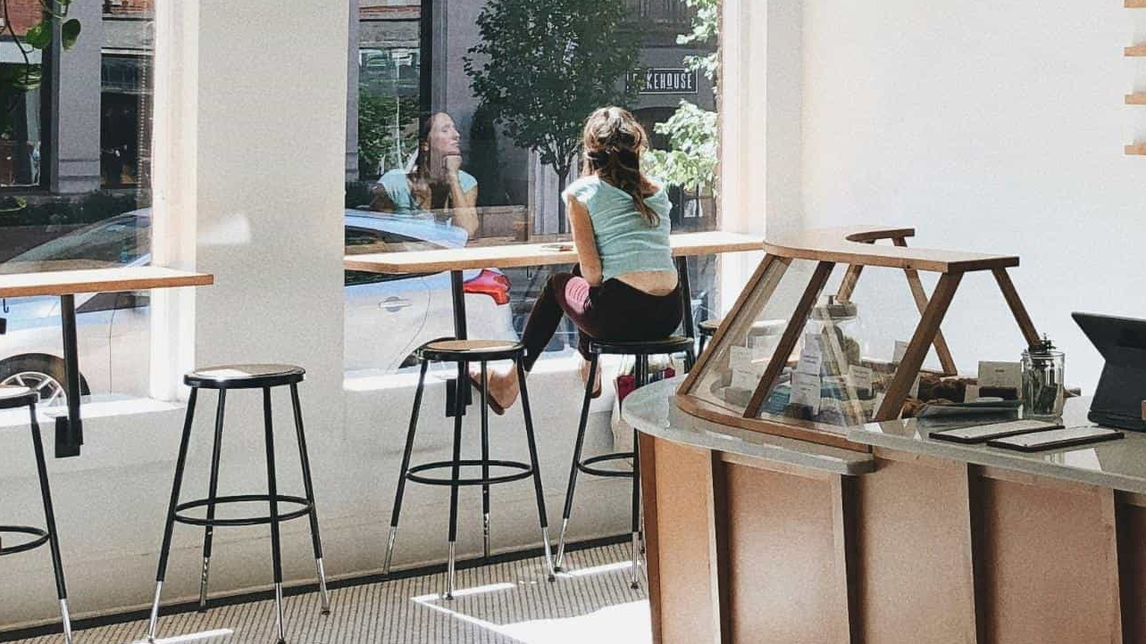
“Guests want smart service that feels effortless and personal. Technology helps us deliver it, but the warmth of a human welcome remains our strongest asset.”
Elie Maalouf, CEO, IHG Hotels & Resorts (2025)

Slide 37
The Human Touch in a Digital Experience
Technology can simplify travel, but hospitality
remains built on human connection.
What Guests Remember:
Warmth of a welcome
Thoughtful gestures
Empathy and attentiveness
Authenticity in service
Balanced Approach:
Leading European hotels combine:
Automated check-in → Staff greet by name, not handle paperwork
AI-driven insights → Guide staff to anticipate preferences
Digital efficiency + Personal presence = Lasting impression
Staff Guidance:
Teams must know when to rely on systems and when to intervene with humanity.
See also ›
C3 M1
- Leading Green and Digital Change

Slide 38
The Human Touch in a Digital Experience - Discussion Task
Scenario:
In small groups, share one example where a human action improved a digital process.
Focus Questions:
What specific behaviors made the experience feel more personal?
How did the human touch build trust?
What was the outcome for guest satisfaction?
Example Starters:
Staff helping with a confusing kiosk
Personal follow-up after automated message
Human explanation of smart room features
Warm handover from chatbot to person
Outcome:
Identify the exact moments where human presence transforms digital efficiency into genuine hospitality.

Slide 39
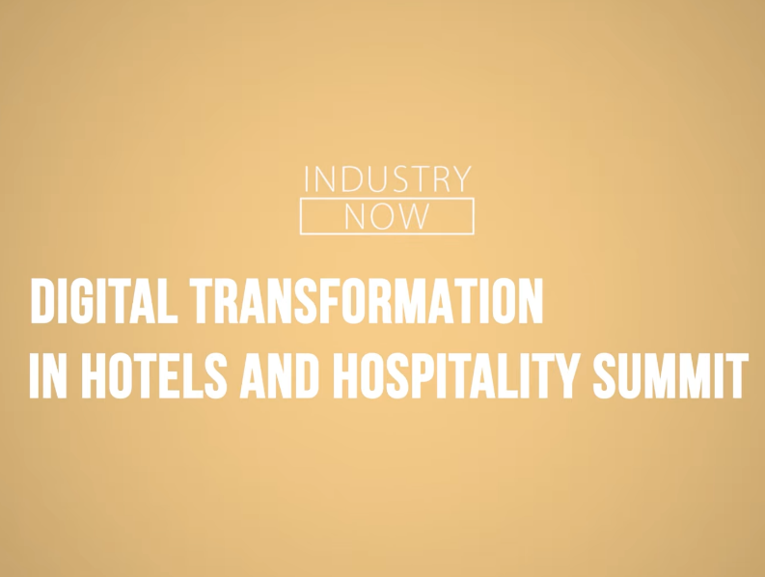
Further Learning: Human Touch in a Digital Experience
Where Tech Meets the Human Touch: How to Enable Hospitality Staff to Make a Business Impact
Hospitality Net, 2025
European leaders show how digital tools free staff to focus on empathy and judgement. The discussion offers practical examples that lift service quality, support sustainability and improve staff wellbeing while keeping hospitality warm and personal.
CLICK TO VIEW

Slide 40
Reflection and Practical Activity
Choose a Scenario
⁰¹
Arrival
Late check-out
Room issue
Local recommendations
Afterwards
Write 3 sentences on :
What worked best
Exact moment human involvement mattered most
One change to increase trust/satisfaction
Map the Steps
⁰²
Where can tech bring speed/accuracy?
Where should a person add warmth/ reassurance?
Create a Script
⁰³
One person = Digital assistant
Other person = Staff member
Use plain, friendly language

Slide 41
⁰¹
⁰⁴
AI Shapes Every Journey: From booking to departure, enhancing communication and experience
Partnership
Delivers Excellence:
Tech + Staff = Hospitality that feels both intelligent and sincere
⁰²
⁰⁵
Precision + Personalisation:
Predicts occupancy, optimises energy, tailors recommendations in real-time
Success Measure:
Hotels balancing digital
tools with genuine
interpersonal care achieve:
• Higher guest satisfaction
• Stronger loyalty
• Better staff wellbeing
⁰³
Key Takeways
Ecosmart View:
Technology and people as partners-combining efficiency with inclusivity, sustainability, and European values of care.
Empathy is Irreplaceable: Technology brings efficiency, but warmth builds trust and loyalty

Slide 42
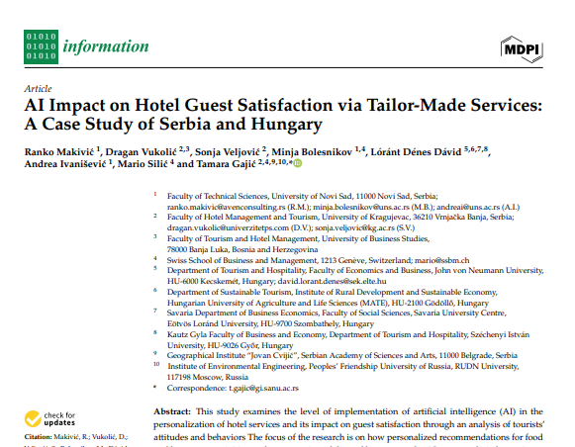
Further Reading: Artificial Intelligence and Guest Satisfaction
Makivić, R. (2024). AI Impact on Hotel Guest Satisfaction via Tailor-Made Services. Information (MDPI), 15(11), 700.
https://www.mdpi.com/2078-2489/15/11/700
This European study investigates how artificial intelligence enhances guest satisfaction through personalised service. Drawing on data from hotels in Serbia and Hungary, it analyses how trust, data security, and user experience shape guest perceptions of AI tools. The research concludes that personalised recommendations and predictive systems can improve comfort and loyalty when they are transparent, ethical, and supported by human empathy.
CLICK TO VIEW

Slide 43
Ethics, Staff Engagement, and Responsible AI Use
Building ethical awareness and inclusive practice in AI adoption. To examine the ethical, social, and workforce implications of artificial intelligence in hospitality, focusing on fairness, transparency, and staff wellbeing. The unit explores how responsible use of technology can promote trust, inclusion, and integrity within digital transformation.
04
See also ›
C3 M1
- Leading Green and Digital Change

Slide 44
Why AI Ethics Matter in Hospitality
Ethical
ensuring adherence to ethical principles
& values
ex. Ethics Guidelines
Current Reality:
AI now influences bookings, personal data, and guest communication. As systems make more decisions,
ethical awareness becomes essential.
EU Requirement:
Trustworthy AI principle requires systems to be:
Lawful
Ethical
Robust
Dual Protection:
Ethical AI use protects both:
Guests - privacy, fair treatment, transparency
Staff - meaningful roles, support, not replacement
Trustworthy AI
Lawful
complying with all applicable laws & regulations
ex. AI Act
Robust
both from a technical & social perspective
ex. Technical standards
Business Imperative:
Guests are more likely to trust hotels that use technology responsibly and communicate clearly about data use

Slide 45
Key Ethical Principles in Hospitality AI
See also ›
C3 M1
- Leading Green and Digital Change
⁰¹
⁰³
⁰⁵
Fairness
Accountability
Inclusivity
AI systems must provide equal treatment to all guests. For example, room upgrade algorithms or pricing tools should not show bias based on nationality, gender or language
Hotels must take responsibility for the outcomes of their digital systems. Human oversight is needed to correct errors and ensure decisions remain ethical.
Ethical AI should support accessibility and cultural sensitivity, ensuring all guests can interact comfortably with technology
Transparency
Privacy
Guests and staff should understand when and how AI is used. Clear communication builds confidence and prevents misunderstandings about automated decisions
Personal data collected through bookings, chatbots and loyalty programmes must be securely stored and used only for legitimate purposes.
⁰²
⁰⁴

Slide 46
Risks and Real World Challenges
Core Danger:
Technology should support staff, not replace their judgement.
⁰¹
⁰³
Bias in Algorithms
Loss of Human Connection
Systems learn from data - if data reflects inequality, outcomes can be biased
Chatbots & self-service tools can reduce personal warmth if overused
Data Protection
& Misuse
Over-Reliance on Automation
Large volumes of personal information risk breaches or unauthorized use
Weakens critical thinking & staff engagement when judgment is needed
⁰²
⁰⁴

Slide 47
Responsible AI in Practice
Case Study: ACCOR Group
One of Europe's largest hotel networks implementing AI across loyalty programs, operations, and guest communication.
Key Practices:
Employees at the Centre
Staff training to interpret AI suggestions, not follow automatically
Transparency
Guests informed when AI tools are used
GDPR Compliance
Guest data anonymised, stored securely
Sustainability Alignment
Partners with EU Digital for Sustainability initiative
Result:
Shows how responsible AI can strengthen both trust and efficiency.

Slide 48
Learning from Accor
Accor’s example shows that artificial intelligence can enhance service when guided by clear ethical principles and strong staff engagement.
What specific actions made Accor's AI use ethical and transparent?
How did staff training contribute to maintaining trust and service quality?
What policies or practices would ensure digital innovation in your setting remains fair and responsible?
Application Exercise:
identify one area in your organisation where AI could support your staff.
Design Check:
Outline how you would include:
Clear communication
Data protection
Human oversight

Slide 49
Staff Training and Engagement for Responsible AI Use
Staff training is central to building a culture of ethical and confident use of artificial intelligence in hospitality.
Why it’s Critical:
When employees understand AI systems, they can:
Use them responsibly
Recognise when human judgment is needed
Build confidence in digital transformation
European Approach:
Hotels are introducing digital literacy & ethics training covering:
Secure guest data management
Interpreting automated insights
Identifying bias in recommendations
Open dialogue channels for concerns
Responsible AI
Key Outcome:
Engaged, informed teams maintain trust in both technology and leadership.

Slide 50
Staff Training and Engagement for Responsible AI Use
Accountability
Privacy & Data Protection
Inclusivity & Human-Centered Design
01
02
03
04
05
06
Fairness
Transparency and Explainability
Safety & Security

Slide 51
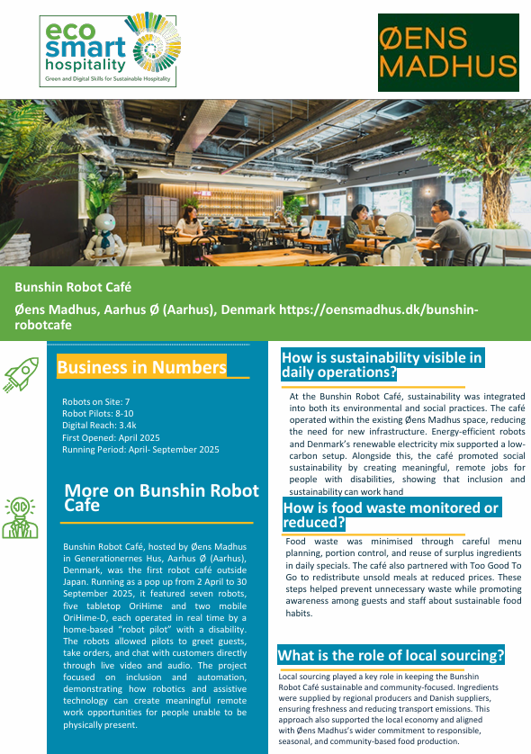
Bunshin Robot Café
Bunshin Robot Café demonstrates that artificial intelligence and robotics can be used to expand participation rather than replace people. Hosted by Øens Madhus in Aarhus, the café became the first robot café outside Japan, using remotely operated OriHime robots controlled by people with disabilities from their own homes. The robots welcomed guests, took orders, and supported customer interaction through live communication technology.
The project explored an important question for hospitality: how can technology create opportunities while preserving human connection? Rather than removing people from service delivery, the café used AI-assisted robotics to enable individuals who might otherwise be excluded from hospitality employment to participate directly in customer interactions.
Alongside its social impact, the café integrated practical sustainability measures including local sourcing, food waste reduction, energy-efficient operations, and digital monitoring systems. The result was a hospitality concept that combined innovation, inclusion, and operational sustainability.
Key Learning: The most effective use of AI in hospitality strengthens human participation, accessibility, and service quality rather than replacing meaningful human interaction.

Slide 52
Building Ethical Awareness through Training
UNWTO Course:
AI in Hospitality: Challenges & Business Opportunities
4-week structured learning path
European case studies focus
Covers privacy, bias, transparency, data protection
Certificate upon completion
Addressing the Gap:
72% of European hotels see AI as essential
But only 9% have a formal strategy
Proven Results - Early adopters report:
Faster response times
Improved GDPR alignment
Higher guest trust
Stronger EU AI Act readiness
Broader Impact:
Course embedded in hospitality schools across Italy & Belgium, building supervisor capability.
See also ›
C3 M1
- Leading Green and Digital Change

Slide 53
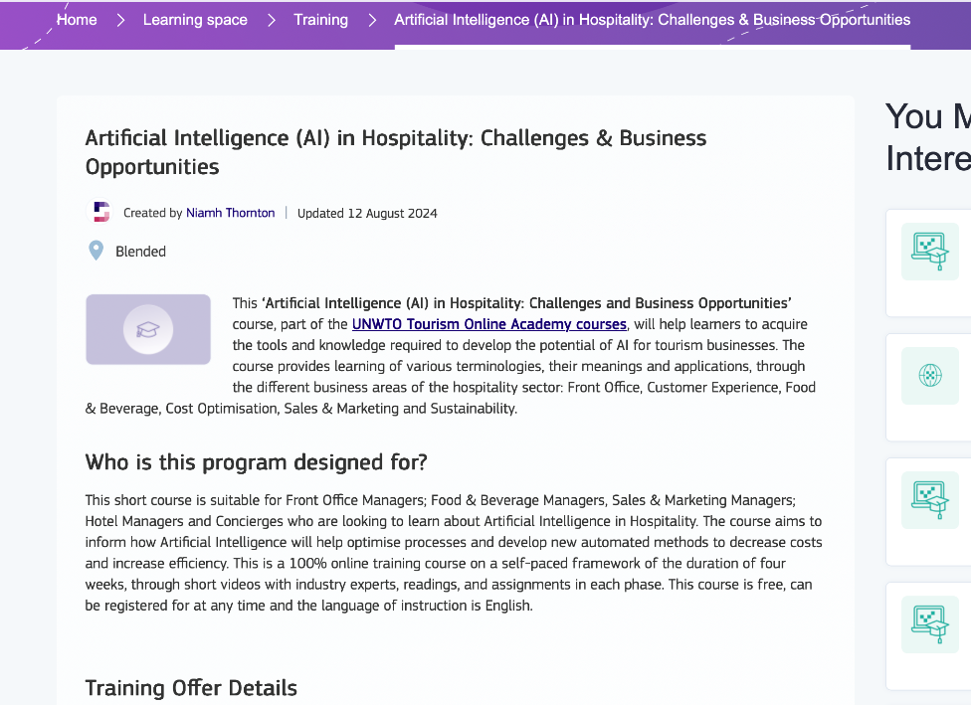
Artificial Intelligence in Hospitality: Challenges and Business Opportunities
Provider: UNWTO Tourism Online Academy, 2024
CLICK TO VIEW

Slide 54
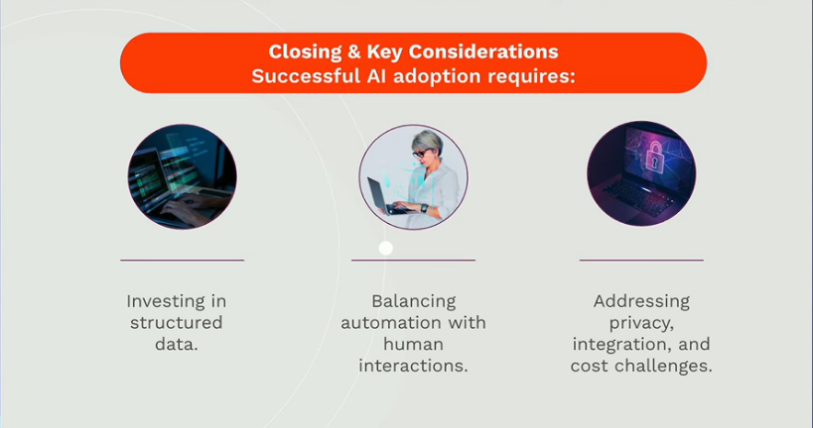
Ethical AI in Hospitality
Opportunities, Challenges, and the Road Ahead (YouTube, 2024)
https://www.youtube.com/watch?v=9BavI4Gowh8
This short video explains how hotels can integrate artificial intelligence responsibly, focusing on real-world examples of data management, automation and guest experience. Industry leaders discuss how ethics strengthen competitiveness by building trust and compliance
CLICK TO VIEW

Slide 55
⁰¹
⁰⁴
Training Closes the Gap: Structured learning turns EU policy into daily practice
European
Framework Guides:
GDPR and EU AI Act provide clear standards for responsible adoption
⁰²
Ethics Builds Trust:
Responsible AI use strengthens both compliance and guest confidence
⁰⁵
Skills Development:
Targeted training gives
staff confidence to know:
When to rely on automation
When to lead with human judgement
⁰³
Staff Enablement is Key: Technology handles routine tasks, people focus on empathy and problem-solving
Key Takeways

Slide 56
Applied Practice
Learning from real-world examples of AI in hospitality. To consolidate learning through analysis of real examples of AI use in hospitality operations and guest services. Learners examine how hotels and restaurants have adopted AI tools, identify success factors and challenges, and apply insights to design their own small scale implementation plan.
05
See also ›
C1 M3
- ·Sustainable Customer Experience Design

Slide 57

From Principles to Practice
Unit Transition:
In this final unit, you shift from theory to action.
What you’ll Explore:
How leading hospitality businesses apply AI in real-world settings, focusing on:
Efficiency
Guest satisfaction
Sustainability
Brand reputation
Your Role:
Critical reflection + Practical application = Professional readiness
Preparation:
Get ready to recognise the strategic, ethical, and operational factors that shape successful AI adoption.

Slide 58

AI in Hospitality: Practical Applications
Current Reality - AI is already transforming hospitality across:
Automation
Personalisation
Sustainability
Operations
Problem-Solving Focus:
Case studies show how technology solves real problems, drives performance, and supports people- not replaces them.
Industry Data:
*73% of hospitality executives identify AI as a top-three digital investment priority. - McKinsey 2024*
Approach:
Each example highlights purposeful implementation with clear human benefits.
See also ›
C2 M2
- Data Analytics in Hospitality

Slide 59
Hilton Hotels: Enhancing Service with AI
Scale & Strategy:
7,500+ hotels across 138 countries with 41 distinct AI use cases
Approach:
Prioritised system modernisation & cloud integration before rolling out targeted AI tools
Key Application:
Xiao Xi Chatbot (China) - 94% satisfaction, 50K+ monthly enquiries (Hilton, 2020 - China market implementation)
Winnow Food Waste System - 60%+ food waste reduction (AI Adopters Club, 2025)
Marketing AI - Doubled ROI through personalisation (AI Adopters Club, 2025)
Staff Co-design - Employees helped create digital avatars
Core Philosophy:
"Use innovation to deepen, not dilute, the personal nature of hospitality

Slide 60
Marriott International: Intelligent Operations at Scale
Marriott International has invested heavily in AI to personalise guest service, optimise pricing, and improve operational efficiency across its global portfolio.
Scale of Use:
2.5+ million service requests managed via mobile chat tools
Key Tools & Results:
ChatBotlr & RENAI - 44% of stay queries resolved automatically
Predictive Pricing - 5–10% RevPAR increase
Winnow Vision AI - 370,000+ kg food waste prevented (2024) (Winnow Solutions food waste prevention data, 2024)
Carbon Accounting AI - 5–10% emissions reduction
People-Centered Approach:
150+ AI use cases from staff-driven incubators
Piloted with end-user councils
AI upskilling via Microsoft 365 Copilot
Supports people, not replaces them

Slide 61
citizenM Hotels: AI First Hospitality with Purpose
citizenM integrates artificial intelligence across its guest journey and operations to drive efficiency, sustainability, and service quality.
Brand Philosophy:
AI-first hospitality with purpose - driving efficiency, sustainability & service quality
Guest Experience:
App (4.7/5 rating) - Contactless check-in, digital keys, full room control
AI Chatbot - Instant answers to routine questions
Operational Efficiency:
Robotic Process Automation - 30+ tasks automated (invoicing, reporting)
Predictive Housekeeping - Cleaning scheduled only when needed
Sustainability Impact:
37.8% water use drop (2019–2021)
2 million plastic bottles eliminated annually
90%+ renewable electricity

Slide 62

Trends Snapshot : Hospitality AI in 2025
68% of hotel groups use AI in at least one department (Skift Research, 2025)
23% guest retention boost from AI-driven personalisation (Accenture Travel Report, 2024)
Top Concerns: Data privacy (42%), Transparency (35%), Staff deskilling (21%) (Deloitte, 2024)
3:1 ROI on AI investments when paired with staff enablement (McKinsey, 2025)
Industry Insight:
This data grounds our case study analysis in sector-wide developments and challenges.

Slide 63
Analysing Success and Drawing Lessons from AI Implementation
Start by identifying the core problem each AI tool was designed to address, such as improving service speed, increasing guest satisfaction, or reducing costs. Evaluate success based on clear, measurable outcomes and how well the system integrated into existing workflows.
Consider usability: Could both managers and frontline staff adopt and operate the system with confidence?
Review ethics: Were data privacy, fairness, and transparency respected throughout deployment?
Assess sustainability: Is the AI solution scalable and adaptable across different types of hospitality settings, including smaller enterprises?
Discussion prompt:
Which factors contributed most to success? Think beyond technology to leadership, training, and trust.
See also ›
C3 M1
- Leading Green and Digital Change

Slide 64
This unit has demonstrated that artificial intelligence, when applied with purpose
and planning, can deliver measurable improvements in hospitality.
⁰¹
⁰⁴
Purposeful AI Delivers Results: From food waste reduction to multilingual communication- solves real operational challenges
Human-Centered Innovation: AI supports frontline teams, freeing people for higher-value work
⁰²
Success = People + Process: Driven by leadership clarity, staff engagement, ethical implementation
⁰³
Strategic Message:
“The real value of AI lies in how it enhances human connection, builds trust, and sustains quality service.”
Key Takeways
Measurable Improvements: Shorter response times, higher satisfaction, better sustainability, stronger finances

Slide 65
Artificial Intelligence in hospitality Concluding remarks
The EcoSmart module has shown how Artificial Intelligence reshapes European hospitality through efficiency, sustainability, and innovation while preserving the human quality of service
EcoSmart Achievement:
You're now prepared to analyse, design, and lead responsible AI integration that balances efficiency with care, innovation with integrity.
Final Message:
AI empowers people.
See the next slide:

Slide 66
Module Journey:
Across five units, you've moved from core concepts to applied practice:
⁰¹
⁰³
⁰⁵
Understanding AI
Foundations for SMEs
Enhancing Guest Experience
Personalisation
with human
oversight
Case Studies
& Planning
Real examples to
your action plan
Automating Operations
Efficiency & sustainability
Ethics & Responsibility
Fair, transparent, staff-centered adoption
⁰²
⁰⁴

Slide 67

Further Watching Learning AI and Food Waste Prevention
To deepen your understanding of AI’s real-world applications in hospitality, watch the short case study: Accor France: Leading the Fight Against Food Waste*
Available at: https:www.winnowsolution.com/en/videos
This video demonstrates how AI technology, powered by Winnow Solutions, is helping hotels reduce food waste while improving operational efficiency and sustainability.
Your Task:
Write a brief impact analysis (150–200 words) based on the video. Use the following questions to guide your response:
What operational or sustainability problem was AI solving?
How were staff involved in its design, training, or daily use?
What measurable results were achieved financially, environmentally, or culturally?
CLICK TO VIEW
See also ›
C1 M2
- Circular Economy and Resource Efficiency

Slide 68
C2 M1 · Case study pack
Download the full case studies
Every business featured in this module has a full case study. Use the links below to open each one.
Bunshin Robot Cafe – Aarhus, Denmark
First robot cafe outside Japan — OriHime robots operated by disabled pilots; inclusion by design.
Download the full case study · {{CASE_URL_ BUNSHIN}}
Porto Mare Taverna – Croatia
choose the right digital tools for reservations and energy at a seasonal seafood spot.
Download the full case study · {{CASE_URL_ PORTOMARE}}

Slide 69
Thank You for Engaging
We hope this module has enriched your knowledge and sharpened your practice.
Thank you for your commitment to hospitality that is intelligent, sustainable, and human centred. Carry these insights into your work, lead with ethics and empathy, and let technology serve people with care.
www.ecosmartproject.eu

