Slide 1
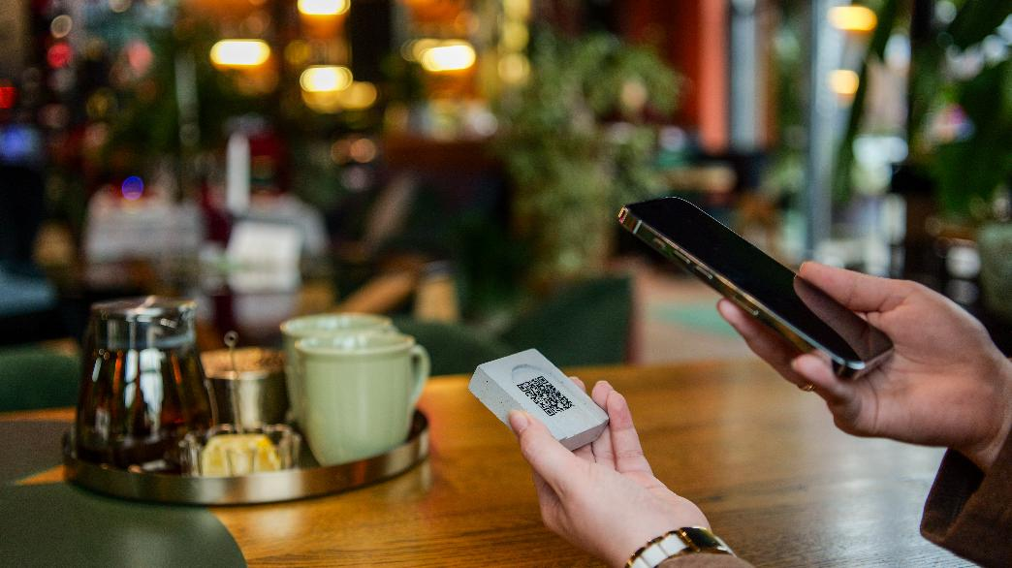



C1 Sustainability and Green Innovation
Module 3:
Sustainable Customer Experience Design
www.ecosmartproject.eu
EcoSmart resources licensed under CC BY 4.0

Slide 2

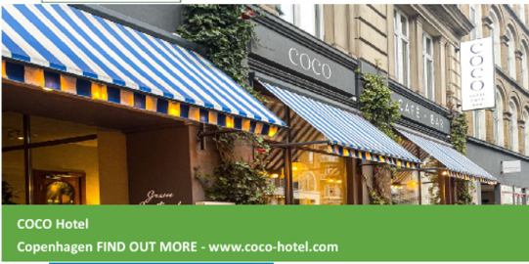
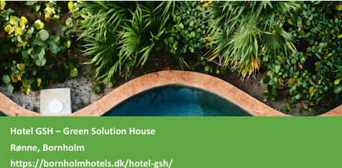
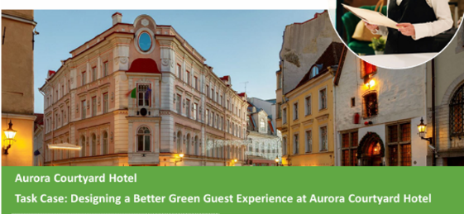
C1 M3 · Cluster 1 – Sustainability & Green Innovation
Where this module fits
Sustainable Customer Experience Design
Role: Main resource for behavioural nudges and hospitality guest- experience design.
Comes after / assumes familiarity with
C1 M1 (operations)
C1 M2 (circular economy)
Extends or connects to
C2 M2 (guest-data loops)
C3 M2 (marketing claims)

Slide 3
Why This Module Matters in Hospitality
Guests rarely describe a stay as “ESG-aligned.” They describe how it felt.
They remember whether arrival was smooth, whether the room felt thoughtful, whether food felt local and authentic, whether sustainability felt genuine and lived, and whether the business made responsible choices visible without making the guest feel guilty or restricted.
This is why sustainable customer experience design matters. It translates environmental and social values into moments that guests can see, understand, and remember.
This also reflects current market shifts. Booking.com’s 2025 traveller research reported that 84% of travellers say sustainable travel remains important, 93% want to make more sustainable travel choices, and 77% seek experiences representative of local culture.

Slide 4
Learning Objectives
By the end of this module, you will be able to:
explain what sustainable customer experience design means in hospitality
identify guest-facing touchpoints where sustainability can improve experience quality
apply sustainable design principles, eco-label awareness, responsible tourism trends, and behavioural nudges in hospitality contexts
map a guest journey and identify sustainability-enhancing touchpoints
propose two experience design ideas that support sustainability and improve satisfaction
develop a guest communication strategy using storytelling, visual cues, and clear messaging
design guest-facing sustainability touchpoints that are inclusive, credible, and culturally respectful
distinguish between meaningful sustainability communication and greenwashing

Slide 5
Shared Glossary
Seven terms used across the programme.
Term
Canonical definition
Full exploration in
Greenwashing
Making sustainability claims that are exaggerated, unverifiable, or unsupported – intentionally or by omission.
C3 M2
ESG
Environmental, Social & Governance – the three pillars used to assess a business's non-financial performance and its broader impact.
C3 M1
Nudge
A small change in how a choice is presented (a default, a reminder, the physical set-up) that shifts behaviour without restricting choice.
C1 M3
Twin transition
Advancing digital transformation and the green transition together so that each reinforces the other in SMEs.
C3 M1
KPI
Key Performance Indicator – a measurable value that shows how effectively a business is achieving a defined objective.
C2 M2
Circular economy
An approach designed to keep materials and products in use for as long as possible through reducing, reusing, repairing, refurbishing and recycling – so that waste becomes a resource.
C1 M2
Guest journey
The full sequence of a guest's interactions with a business, from awareness through booking, stay and post-stay engagement – used to design sustainability and digital touchpoints coherently.
C1 M3
EcoSmart Hospitality – WP3 · Shared glossary · identical in all 7 modules

Slide 6
Contents
01
Understanding Sustainable Customer Experience Design
02
Mapping the Guest Journey
03
Designing Sustainable Touchpoints and Nudges
04
Storytelling, Trust and Inclusive Communication
05
Applied Practice: Building a Conscious Guest Experience Concept

Slide 7
Understanding Sustainable Customer Experience Design
Why experience, sustainability, and guest value now belong together. To introduce the meaning of sustainable customer experience design and show how hospitality businesses can turn sustainability into memorable, guest-facing value.
01

Slide 8
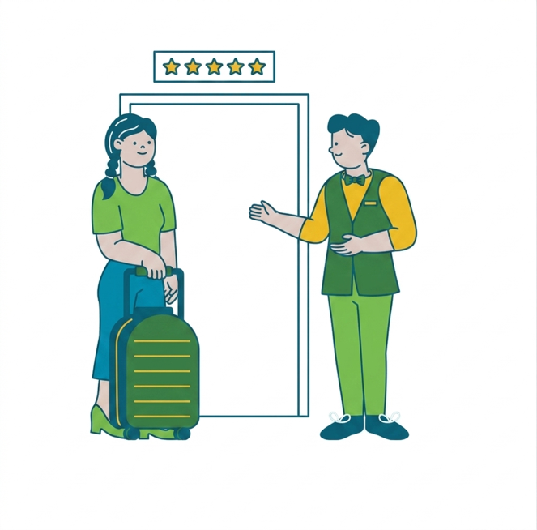
What Sustainable Customer Experience Design Means
Sustainable customer experience design shapes the interationitself so that it becomes environmentally responsible, culturally respectful, socially inclusive, and still desirable from the guest’s point of view.
In hospitality, this means sustainability should feel like:
quality
thoughtfulness
local meaning
clarity
comfort
good design
It should not feel like:
inconvenience
hidden cost-cutting
moral pressure
vague branding
Core idea:
A well-designed sustainable experience helps guests feel that responsible hospitality is also better hospitality.
See also ›
C3 M2
- Digital Marketing for Sustainability

Slide 9
Why Experience and Sustainability Belong Together
Sustainability and guest experience are often treated as separate agendas. In practice, they overlap constantly.
When a hotel uses local food well, guests often experience greater authenticity.
When room communication is clearer, guests experience less friction.
When design reduces waste elegantly, the property often feels more thoughtful and better managed.
When inclusive information is available, more guests feel welcome and confident.
What does that overlap look like ?

Slide 10
The Experience and Sustainability Overlap
Local Sourcing
Authenticity
Smart Design
Comfort
01
02
03
04
Clear Signage
Ease
Inclusive Info
Belonging
Sustainable design creates a more thoughtful, valuable guest experience.

Slide 11
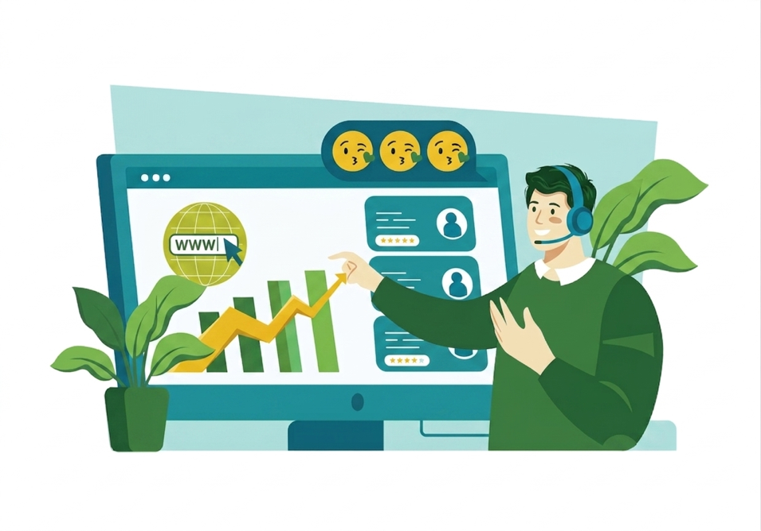
Concept: The Experience Economy
A classic management idea from Pine and Gilmore argues that businesses create increasing value as they move from commodities to goods, from goods to services, and from services to experiences.
Hospitality translation
A room is a service
A meaningful stay is an experience
A sustainable, locally rooted, emotionally coherent stay is a more distinctive experience
Guests remember moments, stories, feelings and meaning - beyond the accommodation, food or service transaction.
Customer Experience Design implication:
Sustainability becomes more powerful when it is experienced, felt and lived.

Slide 12
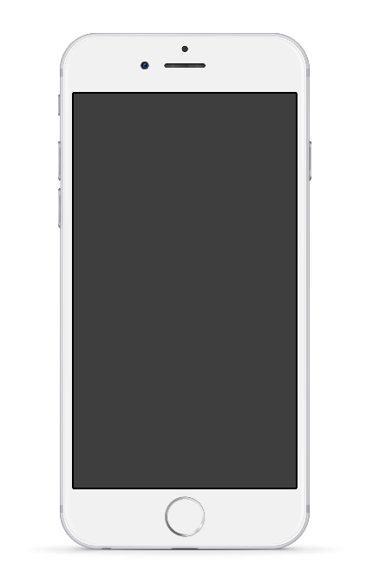
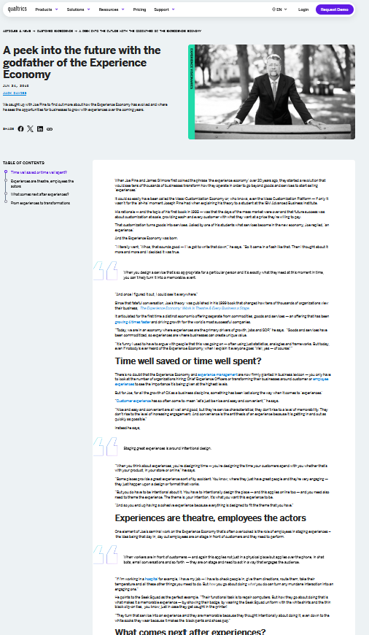
Further Reading:
A current summary of Pine and Gilmore’s “experience economy” idea is available through Qualtrics’ interview with Joe Pine
https://www.qualtrics.com/articles/customer-experience/experience-economy-godfather/
CLICK TO VIEW

Slide 13
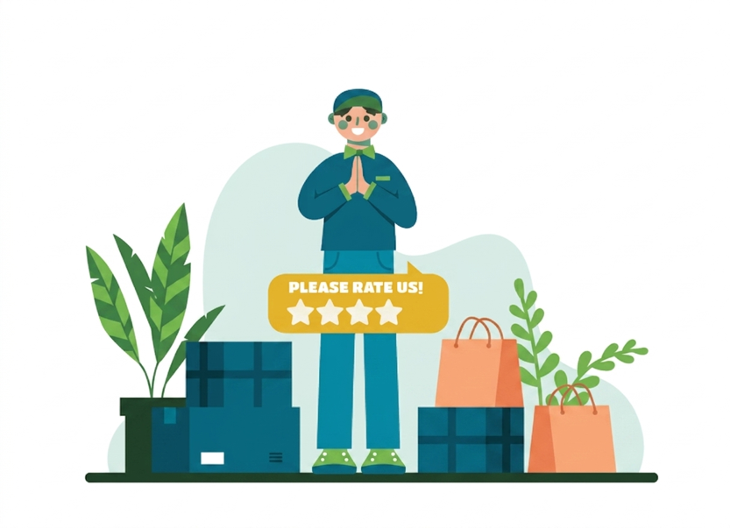
Concept: Service Design
Service design shapes experiences across the whole service system, every visible and invisible moment included.
It looks at:
people
processes
spaces
digital channels
physical evidence
backstage support
In hospitality, this means the guest experience is shaped by far more than frontline friendliness.
It also depends on:
booking confirmation
signage
check-in flow
housekeeping options
menu explanation
staff coordination
follow-up after departure
If we want sustainable guest experiences, we must design both the visible experience and the system behind it.

Slide 14
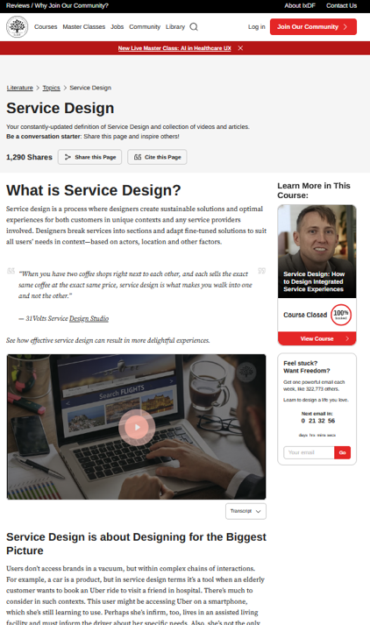
Further Reading:
Both the Interaction Design Foundation and Service Design Network describe service design as a way to create holistic, sustainable, user-centred solutions across service systems.
https://www.service-design-network.org/community-knowledge/what-is-service-design
https://ixdf.org/literature/topics/service-design
CLICK TO VIEW

Slide 15

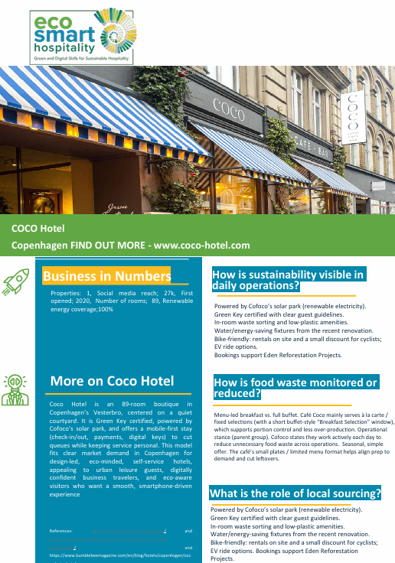
Coco Hotel, Copenhagen
Coco Hotel demonstrates how sustainability can become part of the emotional atmosphere of a stay rather than a separate environmental message. Guests encounter sustainability through design cues, convenience, and spatial experience long before they read a policy statement. The hotel combines mobile-first check-in, renewable energy, low-plastic amenities, in-room sorting, and bike-friendly mobility support within a carefully designed boutique environment.
This reflects the servicescape principle: guests interpret quality, care, and credibility through the physical and communicative environment itself. At Coco Hotel, sustainability is communicated through consistency of experience rather than heavy explanation.
Key Learning: Guests often decide whether sustainability feels authentic through atmosphere, coherence, and visible operational detail rather than through formal claims alone.

Slide 16
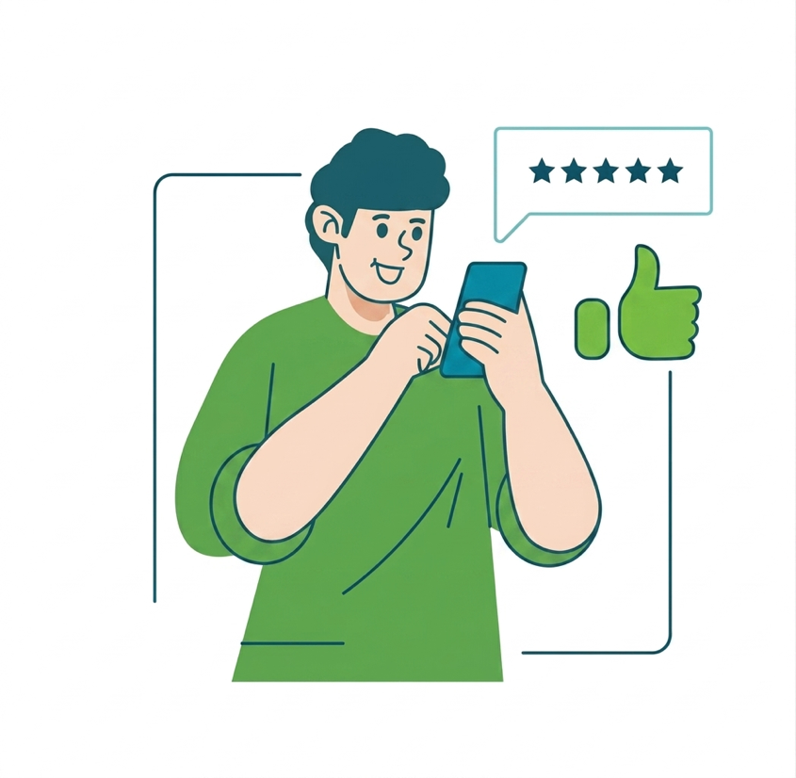
The Space Speaks Before the Staff Do
In service management, the visible environment is often discussed through the idea of the servicescape: the physical and communicative setting in which the service is experienced. Guests notice evidence before they read a sustainability policy.
They notice:
materials
lighting
cleanliness
scent
refill stations
menu presentation
uniforms
signage
digital interfaces.
These details quietly communicate whether the experience feels:
premium or cheap
caring or careless
local or generic
trustworthy or performative
Guest experience design is built as much through evidence as through explanation.

Slide 17
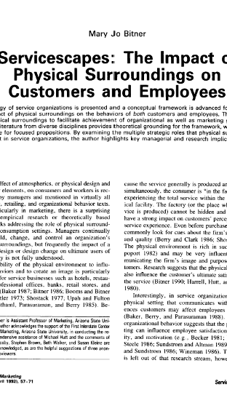
Further Reading:
Bitner, M. J. (1992). Servicescapes: The Impact of Physical Surroundings on Customers and Employees. Journal of Marketing, 56(2), 57–71.
CLICK TO VIEW

Slide 18

Guests Need to Be Active Co-creators
The best sustainable hospitality experiences are often co-created.
This means value is created by what the business provides
and by how the guest participates.
Examples:
choosing reduced housekeeping frequency
joining a local eco-activity
selecting seasonal menu items
using shared mobility options
following room-based water or energy prompts
engaging with local community stories
Important principle:
Co-creation works best when guests feel invited, informed, and respected with no sense of pressure

Slide 19
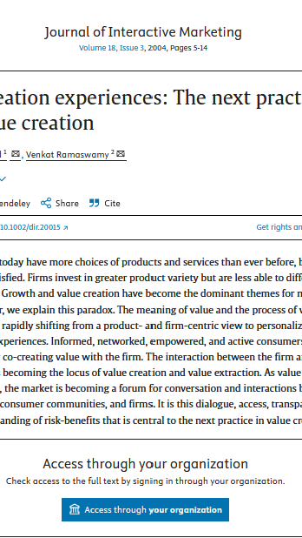
Further Reading:
Prahalad, C.K., & Ramaswamy, V. (2004). Co-creation experiences: The next practice in value creation. Journal of Interactive Marketing, 18(3), 5–14.
CLICK TO VIEW

Slide 20
EcoSmart Hospitality Examples
Rural Guesthouse
⁰¹
A guesthouse offers seasonal menus built around locally sourced ingredients and presents them with a short story about the producers.
What these examples show
sustainability can be guest-facing
communication matters
meaning matters
small design choices shape experience
Reception Eco-Challenge
Reception staff encourage guests to join a simple eco-challenge with a small reward. Example: Coco Hotel, Copenhagen Guests arriving by bicycle receive small incentives and practical support through bike-friendly services and local mobility information. Sustainability is positioned as part of an easy urban lifestyle rather than a restriction.
⁰²
⁰³
Room Communication
Hotel room signage offers guests a choice of housekeeping frequency and explains the environmental benefit clearly.

Slide 21
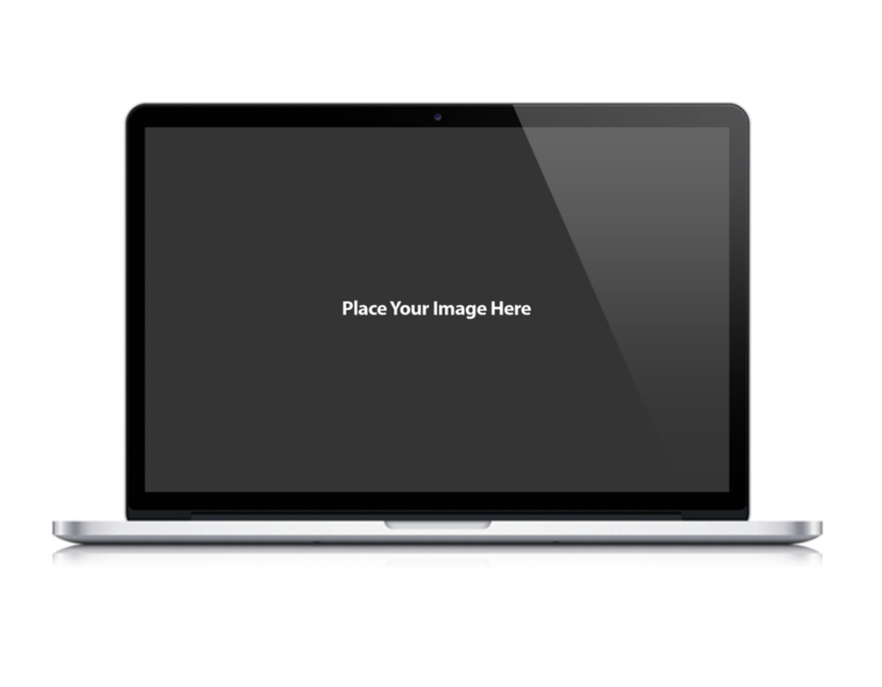
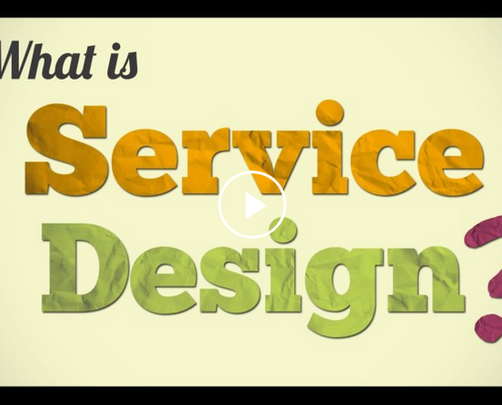
Watch: Why Service Design Makes the Difference
Watch the video and watch for:
how service design explains choice and loyalty
why people choose one service over another
how physical space, process, and communication work together
Your task - Write 3 short notes:
one idea you could apply in a hotel or restaurant
one guest touchpoint that could be redesigned
one visible cue that affects trust before staff even speak
Our next page sets out the key takeaways from
CLICK TO VIEW

Slide 22
Key Takeways so far…
⁰¹
⁰⁴
Sustainable customer experience design turns values into visible guest experience.
Guests interpret sustainability through evidence, atmosphere, language, and choice.
⁰²
Hospitality value is increasingly created through memorable and meaningful experiences.
⁰⁵
Co-created experiences feel stronger when guests are invited, not instructed.
⁰³
Key Takeways
Designing for conscious guests means designing for comfort, meaning, trust, and responsibility together.
Service design helps us look at the whole system, every interaction included.

Slide 23
Mapping the Guest Journey
Seeing sustainability through the guest’s eyes
To examine the full guest journey and identify where sustainability can enhance clarity, comfort, trust, and meaning.
02

Slide 24
Guests Experience Journeys, Not Departments
A hospitality business may be organised into sales, front office, housekeeping, F&B, marketing and maintenance. A guest experiences it as one connected journey.
That connected journey involves:
searching, booking, arriving, entering the room, eating, asking questions, moving through the space, leaving, remembering, reviewing.
A sustainability message can fail if it is only strong in one place and weak in another.
A beautiful local breakfast story loses impact if guest touchpoints feel inconsistent and the departure experience leaves no lasting sense of connection or continuity.
See the next slide:

Slide 25
Guests Experience Journeys, Not Departments
Awareness
Desire
Goals
Action
Interest
Journeys create memory. Consistency creates trust.

Slide 26
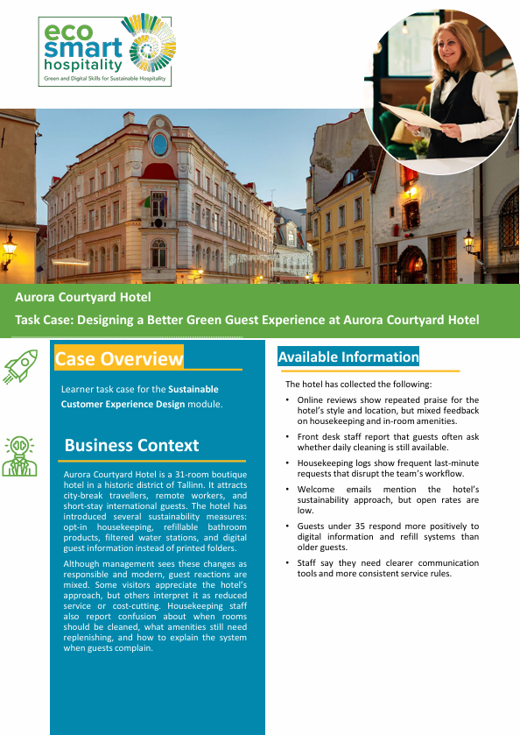
Aurora Courtyard
Aurora Courtyard Hotel introduced several sustainability measures including opt-in housekeeping, refill stations, and digital guest information. While management viewed these as responsible and modern, guest reactions became inconsistent because the experience was not fully aligned across touchpoints. Some guests appreciated the sustainability approach, while others interpreted it as reduced service or hidden cost-cutting.
The operational challenge was not the sustainability measures themselves. The challenge was inconsistency across the guest journey. Welcome emails had low engagement, reception teams answered questions differently, and housekeeping staff lacked clear guidance on service expectations and replenishment routines.
This illustrates a central principle of guest journey design: guests experience one connected service, not separate departments. If sustainability communication feels disconnected between booking, arrival, room experience, and staff interaction, trust weakens quickly.

Slide 27
What Is a Customer Journey Map?
Journey maps help teams design better experiences and reduce hidden friction.
A customer journey map is a visual way of understanding how people experience a service over time and across channels.
It helps teams identify:
stages
touchpoints
channels
actions
emotions
pain points
unmet needs
opportunities for improvement
In hospitality, journey mapping is useful because it helps
us move beyond operational assumptions and see the
service from the guest perspective.
Consideration
Engagement
Satisfaction

Slide 28
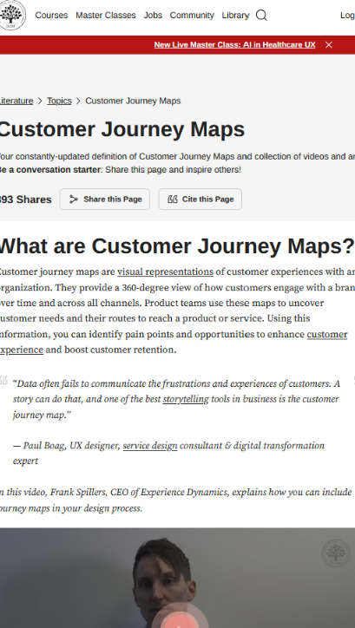
Further Reading:
The Interaction Design Foundation defines customer journey maps as visual representations of customer experiences over time and across channels, used to uncover needs, pain points, and opportunities.
https://ixdf.org/literature/topics/customer-journey-map
https://www.interaction design.org/literature/article/customer-journey-maps-walking-a-mile-in-your-customer-s-shoes
CLICK TO VIEW

Slide 29
The Main Stages of the Hospitality Guest Journey
Each stage of the Guest Journey offers opportunities to make sustainability feel easier, clearer, and more meaningful.
⁰¹
⁰³
⁰⁵
Pre-Arrival
Search,
booking, expectations, trust signals
Stay
Comfort, room
use, housekeeping, amenities, information
Departure
Closure, gratitude, memory, review
prompt
Arrival
Welcome, wayfinding,
First impressions, clarity
Dining & Activities
Food choices, local culture, mobility, discovery
Post-stay
Reflection, sharing, loyalty, advocacy
⁰²
⁰⁴
⁰⁶

Slide 30
Touchpoints, Channels, Feelings, Needs
When mapping a journey, look at four things together:
Touchpoints
01
Where the guest interacts with the business
04
Needs
02
Clarity, comfort, relevance, accessibility, trust, choice
03
Channels
Feelings
Website, email, in person, signage, app, phone, room information
Confident, confused, welcomed, rushed, curious, reassured
Sustainability works best when it supports the real need behind the moment.

Slide 31
Moments of Truth and Friction Points
Some points in the guest journey carry disproportionate influence. These are often called moments of truth.
In sustainable experience design, common moments of truth include:
booking-page credibility
arrival welcome
room communication
breakfast or menu explanation
problem handling
departure messaging
Common friction points include:
confusing sustainability claims
unclear icons or signage
opt-out systems that feel manipulative
lack of accessible alternatives
too much text at the wrong moment
Concentrate effort on the moments that shape trust and memory most.
See also ›
C3 M1
- Leading Green and Digital Change

Slide 32
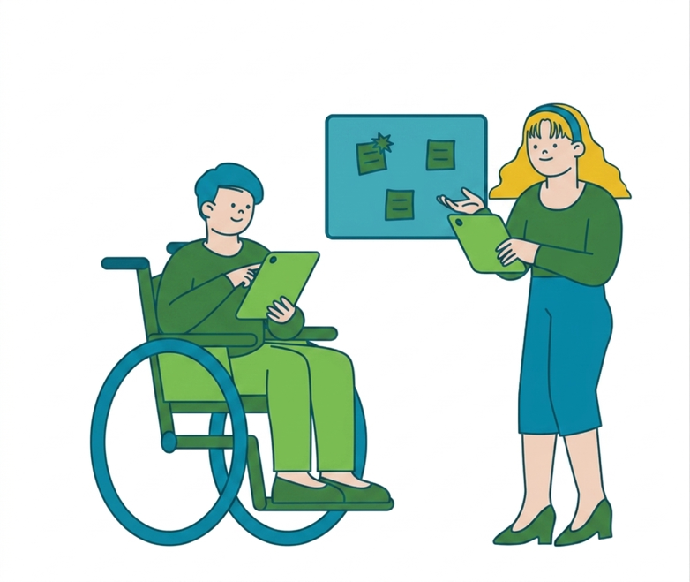
Mapping for Inclusion and Accessibility
A well-designed guest journey works for every guest including those who are less confident, less digitally fluent, with mobility needs, or from less familiar cultural backgrounds.
Questions to ask:
Is the information readable and understandable?
Is the signage accessible?
Are there non-digital alternatives where needed?
Can guests with mobility, sensory, language, or dietary needs move through the experience with dignity?
Does the communication check for assumptions and hidden barriers?
Accessible information is part of good experience design, woven through every touchpoint.

Slide 33
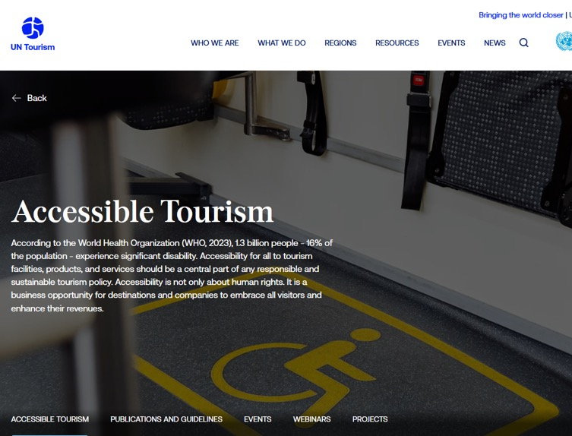
Further Reading:
“According to the World Health Organization (WHO, 2023), 1.3 billion people - 16% of the population - experience significant disability. Accessibility for all to tourism facilities, products, and services should be a central part of any responsible and sustainable tourism policy. Accessibility is not only about human rights. It is a business opportunity for destinations and companies to embrace all visitors and enhance their revenues. “
https://www.untourism.int/accessibility-tourism
See also ›
C3 M2
- Digital Marketing for Sustainability

Slide 34
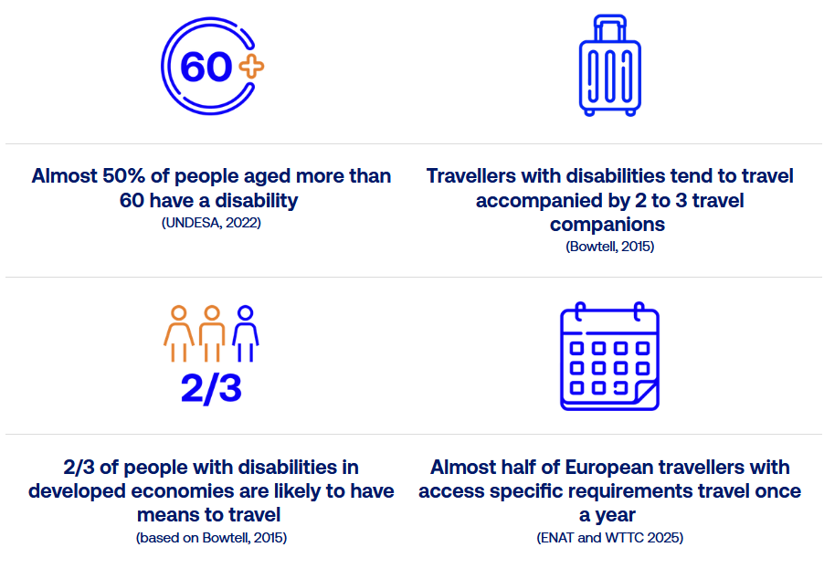
Mapping for Inclusion and Accessibility
Did you know..
https://www.untourism.int/accessibility-tourism

Slide 35
Activity: Map a Guest Journey
Define the guest and scenario.
At each stage, identify:
Output:
One key touchpoint
One guest need
One sustainability opportunity
One possible friction point
A first-draft journey map for team discussion.
01
02
03
04
05
06
Choose One Setting:
Map the six stages of the journey.
(see Slide 24)
Highlight the three most important improvement opportunities.
Boutique Hotel
B&B
Café
Resort
Rural Guesthouse
Restaurant

Slide 36
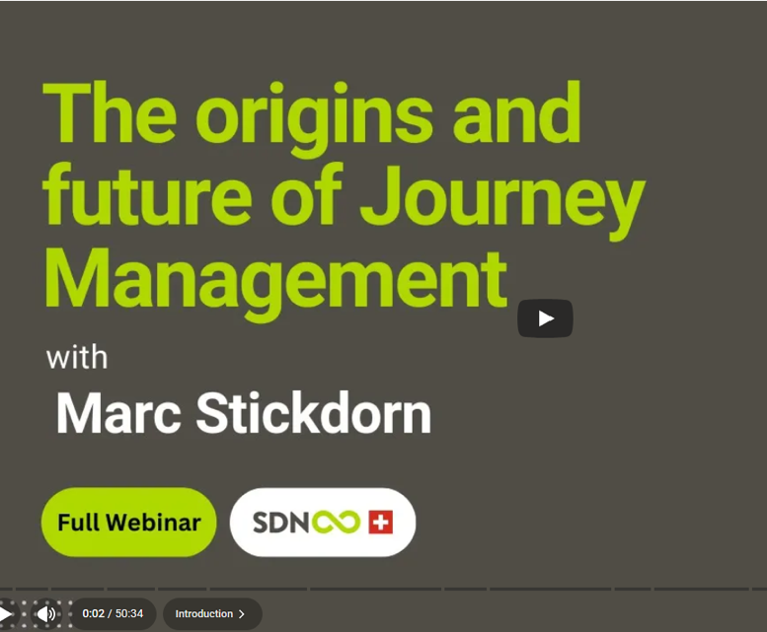
Watch: Journey Management with Marc Stickdorn
Watch the Service Design Network webinar highlights on “The origins and future of Journey Management” with Marc Stickdorn.
Watch For:
why journey maps are more than diagrams
how organisations use journey thinking to improve services
why implementation matters as much as mapping
Your task - Note:
one idea that applies to hospitality
one journey stage that is often ignored in your context
one way to use mapping beyond the classroom
CLICK TO VIEW

Slide 37
Key Takeways so far…
⁰¹
⁰⁴
Guests experience one connected journey, not separate departments.
Mapping should include feelings, needs, friction points, and accessibility.
⁰²
Journey maps help teams see experience over time and across channels.
⁰⁵
Better journeys create stronger memories and more credible sustainability.
⁰³
Sustainable design opportunities exist before, during, and after the stay.
Key Takeways
If you want to improve the experience, start by seeing it as a journey.

Slide 38
Designing Sustainable Touchpoints and Nudges
Making the better choice easier, clearer, and more appealing.
To explore how hospitality businesses can use behavioural insights and design choices to support sustainable guest behaviour while protecting comfort and trust.
03

Slide 39
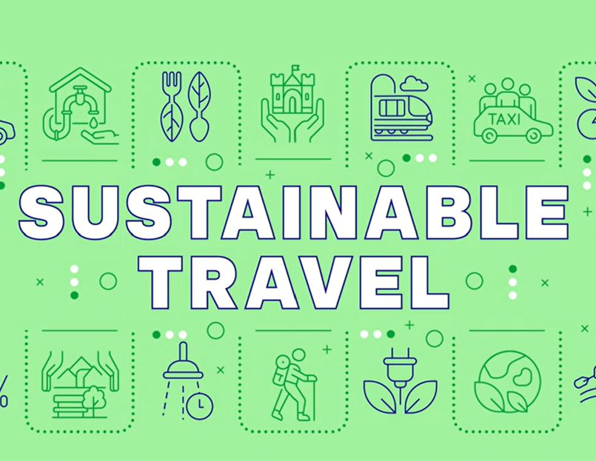
Sustainable Choices Need Good Design
Guests make decisions in real contexts: tired after travelling, distracted, in a hurry, unfamiliar with the space, focused on comfort, sometimes overwhelmed by information. This means that sustainable behaviour cannot depend only on awareness or goodwill. It must also depend on design.
A well-designed touchpoint:
Reduces friction
Makes the preferred action easier
Uses clear language
Appears at the right moment
Respects autonomy
Avoids guilt-heavy messaging
Sustainable hospitality starts with making responsible actions easy to understand and follow
See also ›
C3 M1
- Leading Green and Digital Change

Slide 40
Concept: Choice Architecture and Behavioural Nudges
Choice architecture means the way choices are organised and presented. A nudge is a small design intervention that influences behaviour while keeping freedom of choice intact.
Useful hospitality nudges include:
better defaults
clearer prompts
timely reminders
visible feedback
social norm messages
simpler option structures
Important Boundary:
A good nudge supports better decisions.
A bad nudge becomes manipulation.
Simplicity
Timing
Defaults
Choice Architecture
Norms
Prompts
Feedback

Slide 41
Concept: Choice Architecture and Behavioural Nudges
Defaults
Offer the preferred option as the standard choice where appropriate.
Prompts
Use short, visible reminders at the moment of action.
Examples
digital receipts as default
opt-in housekeeping frequency
signage near refill points
“most guests in this room type…”
eco-challenge or local reward system
Feedback
Show guests the effect of a choice in simple terms.
Social Norms
Signal what many guests already do.
Rewards
Use small, positive reinforcement where suitable.

Slide 42
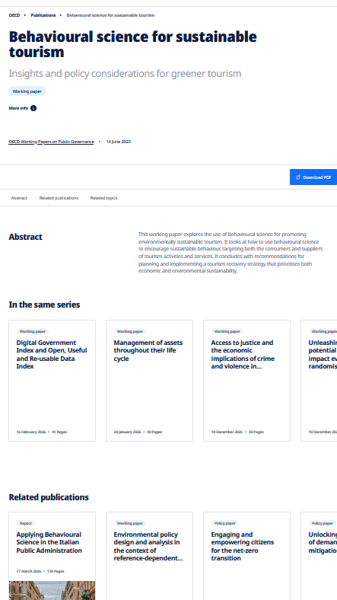
Further Reading:
OECD and EU behavioural insights resources both highlight the importance of framing, defaults, salience, and social context in greener decision-making.
https://www.oecd.org/en/publications/behavioural-science-for-sustainable-tourism_c2ec4fcf-en.html
https://knowledge4policy.ec.europa.eu/behavioural-insights/topic/behavioural-insights-climate-environment_en
See also ›
C3 M1
- Leading Green and Digital Change

Slide 43
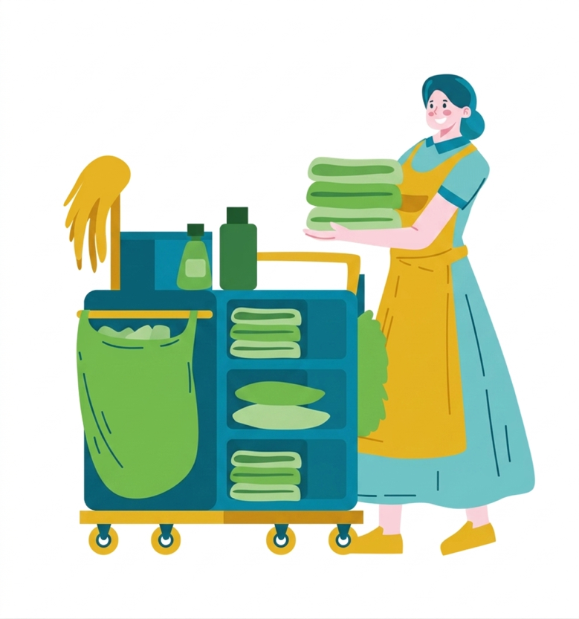

Designing the Housekeeping Choice
A housekeeping-frequency choice is more than an operational tool. It is a guest experience design challenge.
Example:
“You can choose daily housekeeping or a lighter service during your stay. Selecting a lighter service helps reduce water, energy and laundry impacts while maintaining comfort.”
Weak Version
too much text
unclear benefit
sounds like cost cutting
no positive language
difficult to opt in or out
Stronger Version
simple wording
visible choice
clear environmental benefit
reassurance on service quality
respectful tone
See also ›
C1 M2
- Circular Economy and Resource Efficiency

Slide 44
Aurora Courtyard
Aurora Courtyard Hotel discovered that housekeeping choices go beyond operational decisions. They are experience-design decisions. Guests repeatedly asked whether daily cleaning was still available because the sustainability message was interpreted differently at different points in the stay. Some guests saw the lighter housekeeping model as environmentally responsible and modern. Others experienced uncertainty about comfort standards, replenishment expectations, and service quality. Housekeeping teams also faced workflow disruption through last-minute cleaning requests and inconsistent guest understanding. The case demonstrates why sustainable service design must balance:
      clarity
      reassurance
      operational consistency
      visible guest choice
      respectful language
Guests accept behavioural nudges more easily when the experience feels intentional, transparent, and guest-centred rather than imposed.

Slide 45

Food, Locality and Experience Design
Food is one of the strongest touchpoints for making sustainability visible in a positive way.
Well-designed food experience touchpoints can communicate:
seasonality
locality
low-waste practice
producer identity
cultural authenticity
care for place
Design Examples:
short producer story cards
menu icons with clear meaning
daily specials that use seasonal abundance
staff explanation that feels warm, not scripted
visual presentation that signals freshness and intention
Guests often accept sustainability more easily when it arrives through flavour, story, and place.
See also ›
C1 M2
- Circular Economy and Resource Efficiency

Slide 46
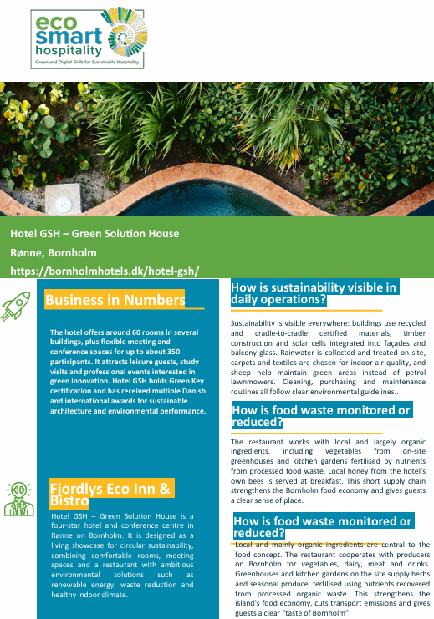
Hotel GSH, Bornholm
Hotel GSH demonstrates how food can make sustainability visible through flavour, locality, and sensory experience. The hotel uses local and largely organic ingredients, including produce from on-site gardens and greenhouses fertilised using nutrients recovered from processed food waste.
Honey produced by the hotel’s own bees is served at breakfast.
These practices reduce transport impacts and strengthen circular resource use, but they also shape how guests experience place. Sustainability becomes connected to taste, freshness, regional identity, and storytelling. Guests experience sustainability directly through the food environment and this reflects an important hospitality principle: guests often connect more strongly with sustainability when it is experienced through comfort, flavour, authenticity, and emotional meaning.
Key Learning: Food experiences can translate abstract sustainability values into memorable and emotionally meaningful guest moments.

Slide 47

Silent Sustainability vs Visible Sustainability
Some sustainability should be quietly embedded.
Some sustainability should be gently made visible.
The skill is knowing which is which.
Transport Guidance
Food Origin Explanation
Guest Choices
Refill Systems
Local Stories
Certifications Explained Simply
Efficient Systems
Backstage Waste Reduction
Better Procurement
Smart Maintenance
Lower-impact Materials

Slide 48
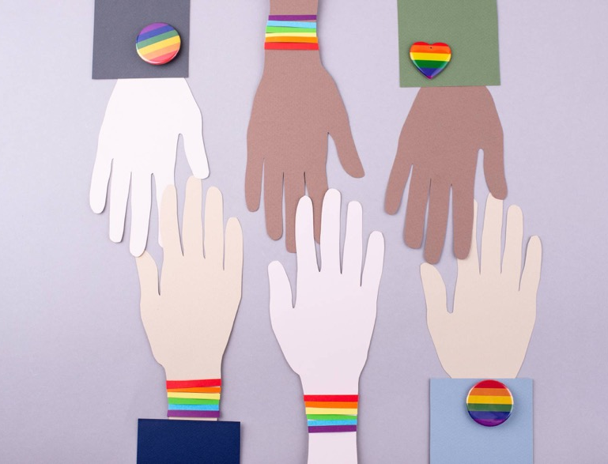
Designing Low-Friction and Inclusive Touchpoints
A good sustainable touchpoint should be:
easy to understand
easy to act on
easy to access
easy to trust
This means:
plain language
clear icons
good contrast and legibility
multilingual or culturally aware wording where relevant
alternatives for guests who prefer non-digital interaction
respectful, non-judgmental tone
Practical rule: a strong design makes the action easy for the guest to understand at a glance.

Slide 49
Silent Sustainability vs Visible Sustainability
Guests are invited to join a small sustainability challenge with a simple reward.
Room signage gives guests a clear, respectful choice about service frequency.
A breakfast buffet highlights seasonal local ingredients and explains where they come from.
03
Arrival information includes walking, cycling, and local transport options.
Eco-Challenge at Reception
Housekeeping Choice
02
04
Local Mobility Welcome Pack
Seasonal Breakfast
Discussion prompt - Which of these is:
most visible to guests?
easiest to implement?
most likely to change behaviour?
most likely to build trust?
01

Slide 50
Silent Sustainability vs Visible Sustainability
Guests are invited to join a small sustainability challenge with a simple reward.
Room signage gives guests a clear, respectful choice about service frequency.
A breakfast buffet highlights seasonal local ingredients and explains where they come from.
Eco-Challenge at Reception
03
Housekeeping Choice
Arrival information includes walking, cycling, and local transport options.
02
04
Seasonal Breakfast
Local Mobility Welcome Pack
01

Slide 51
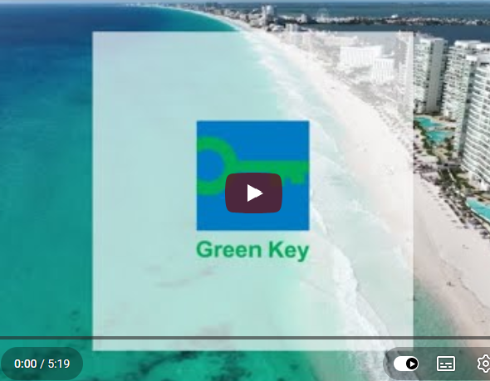
Watch: Green Key Introduction Video
Watch the short introduction video on the Green Key Programme page.
Watch for:
how certification builds guest trust
how staff information and guest information are linked
how sustainability is communicated as part of operational quality
Your task - Write a short note on:
what makes a sustainability label credible
what guests need beyond a logo
how your business could explain a certification more clearly
CLICK TO VIEW
See also ›
C3 M2
- Digital Marketing for Sustainability

Slide 52
Key Takeways so far…
⁰¹
⁰⁴
Guests make sustainable choices more easily when the design reduces friction.
Some sustainability should remain silent; some should be made visible.
⁰²
Behavioural nudges support better decisions while keeping freedom intact.
⁰⁵
Inclusive design is part of good hospitality, not an optional extra.
⁰³
Housekeeping, food, local transport, and room communication are powerful touchpoints.
Key Takeways
The best sustainable touchpoints feel helpful, human, and well designed.

Slide 53
Storytelling, Trust and Inclusive Communication
How to communicate sustainability with clarity, warmth and evidence.
To examine how hospitality businesses can use storytelling, labels, inclusive language, and credible communication to build trust and deepen guest experience.
04

Slide 54
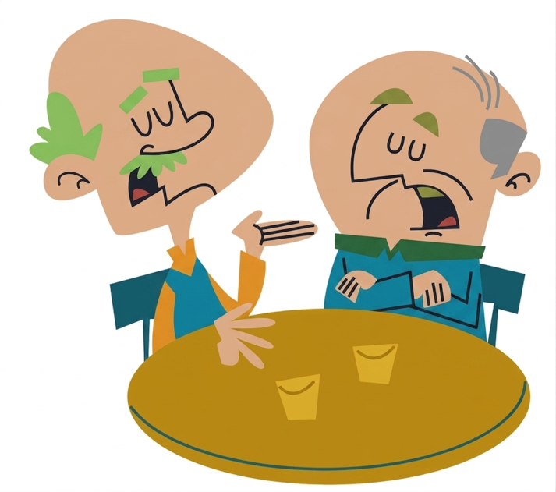
Why Communication Often Fails
Many hospitality sustainability messages land best when the communication is weak.
It may be:
vague
self-congratulatory
text-heavy
generic
hard to verify
disconnected from guest benefit
disconnected from local meaning
When that happens, guests may not feel inspired. They may feel sceptical. Strong sustainable experience communication does something different. It explains clearly, shows evidence, respects the guest’s attention, and links the message to both place and experience quality.
Say less. Show more. Mean it.
See also ›
C3 M2
- Digital Marketing for Sustainability

Slide 55

Storytelling and Sense of Place
A strong hospitality experience often creates emotional connection through place.
Storytelling can bring sustainability to life by connecting guests with:
local producers
seasonal rhythms
biodiversity
craft traditions
cultural identity
community contribution
This turns sustainability from an abstract claim into a specific story:
who made this
where it came from
why it matters here
how the guest is part of it
Stories create meaning.
Meaning strengthens memory.

Slide 56

Eco-Labels, Certifications and Proof
Certifications can help guests interpret sustainability claims more easily - but only if they are explained clearly.
A label should answer:
What does this certification mean?
Who verifies it?
What standards are covered?
How does it affect the guest experience?
Good communication explains the meaning behind the badge in guest-friendly language.
This matters because certification and standardisation influence trust. Booking.com’s 2024 sustainable travel research, summarised by GSTC, reported that 45% of travellers find it more appealing when accommodation is labelled as more sustainable, and 67% agree that booking sites should use the same sustainable certifications or labels.
See also ›
C3 M2
- Digital Marketing for Sustainability
https://green-forum.ec.europa.eu/green-business/emas/emas-sustainable-tourism/consumer-corner_en

Slide 57

Greenwashing and Credibility
Credibility Checklist:
specific claim
evidence available
clear scope
verifiable source
no overstatement
A sustainability message becomes risky when it is:
vague
unsupported
exaggerated
selective
visually misleading
disconnected from evidence
Guests increasingly make decisions through labels, booking platforms, websites, and quick impressions. The European Commission noted that many green claims are vague or unsupported, and newer EU rules are intended to ban vague environmental claims and unreliable sustainability logos. OECD work in 2025 also identifies misleading green claims as a growing consumer-protection issue.
https://environment.ec.europa.eu/topics/circular-economy-topics/green-claims_en
https://energy.ec.europa.eu/news/new-eu-rules-empower-consumers-green-transition-enter-force-2024-03-27_en
See also ›
C3 M2
- Digital Marketing for Sustainability

Slide 58

Digital Touchpoints, Reviews and Online Trust
Guest experience begins before arrival — often online.
Important digital touchpoints include:
website copy
booking platform descriptions
confirmation emails
pre-arrival guidance
app messages
QR-based information
review responses
Best Practice:
use simple, specific claims
explain benefits and options clearly
keep choice design clear and honest
keep language consistent across channels
answer guest questions in a warm and factual way
If sustainability language online feels confusing or over-claimed, guest trust weakens before arrival.
See also ›
C2 M1
- ·AI in Hospitality

Slide 59
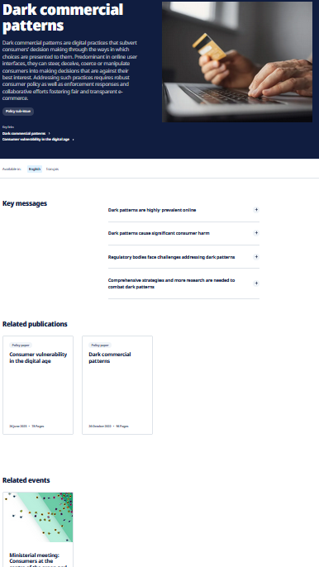
Further Reading:
OECD notes that digital interfaces and the way choices are presented can steer consumers; good design supports good decisions, while “dark commercial patterns” manipulate them.
Improving online disclosures with behavioural insights:
https://www.oecd.org/en/publications/improving-online-disclosures-with-behavioural-insights_39026ff4-en.html
Dark Commercial Patterns:
https://www.oecd.org/en/topics/sub-issues/dark-commercial-patterns.html
See also ›
C3 M2
- Digital Marketing for Sustainability

Slide 60
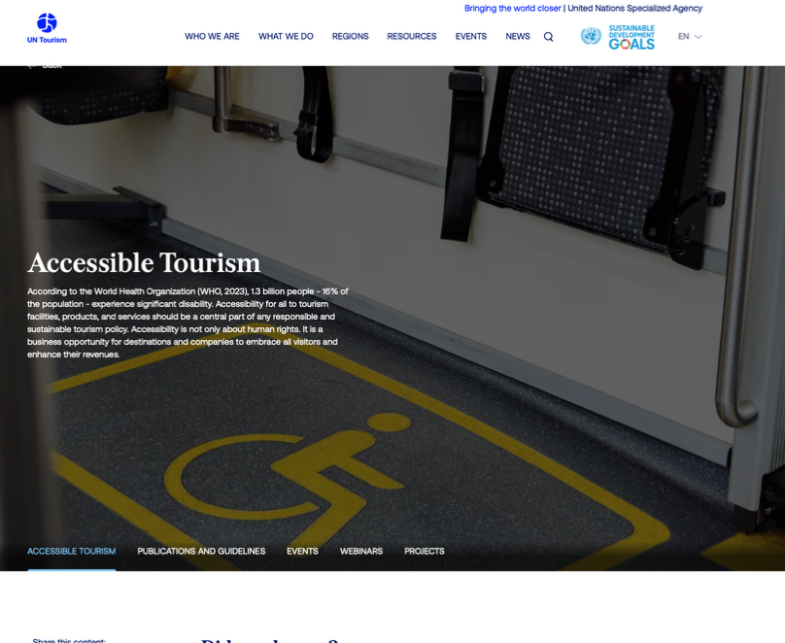
Accessible and Inclusive Communication
UN Tourism describes accessibility as a central part of responsible and sustainable tourism policy and also as a business opportunity for destinations and companies. It emphasises that accessible information across the whole value chain is essential for a seamless experience.
https://www.untourism.int/accessibility-tourism
CLICK TO VIEW

Slide 61

Accessible and Inclusive Communication
Inclusive hospitality communication makes more people feel confident, respected and able to participate.
This includes:
readable signage
plain language
multilingual support where needed
clear dietary and mobility information
digital and non-digital alternatives
visual clarity
cultural sensitivity
sensory awareness

Slide 62
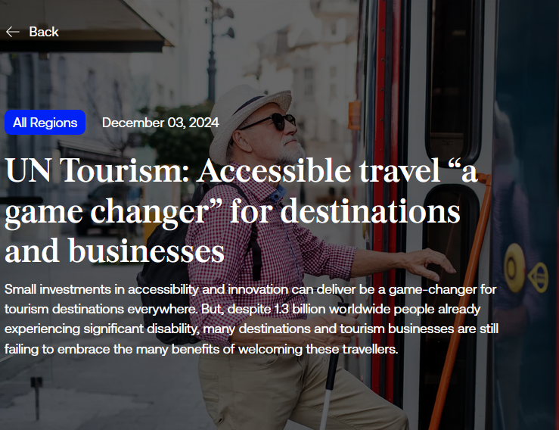
Further Reading:
UN Tourism: Accessible travel “a game changer” for destinations and businesses
Small investments in accessibility and innovation can deliver be a game-changer for tourism destinations everywhere. But, despite 1.3 billion worldwide people already experiencing significant disability, many destinations and tourism businesses are still failing to embrace the many benefits of welcoming these travellers.
https://www.untourism.int/news/un-tourism-accessible-travel-a-game-changer-for-destinations-and-businesses
CLICK TO VIEW

Slide 63
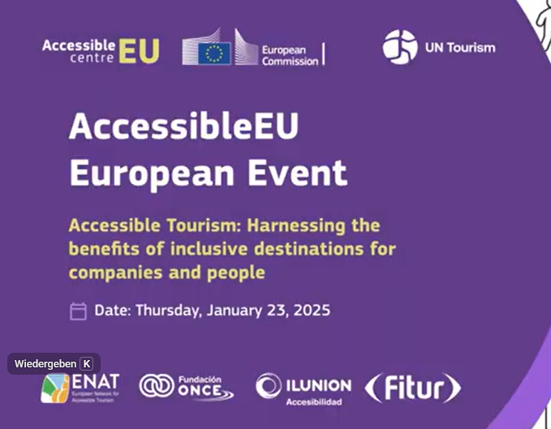
Further Reading:
Watch the AccessibleEU / UN Tourism seminar videos on
“Accessible Tourism: Harnessing the benefits of inclusive destinations for companies and people”. The videos are available here.
Watch For:
how accessibility improves service quality
why inclusion matters commercially as well as ethically
how universal design principles can improve tourism experiences for more people
Your task - Identify:
one barrier that could exist in a hotel or restaurant
one low-cost improvement
one communication change that would make the guest journey more inclusive

Slide 64
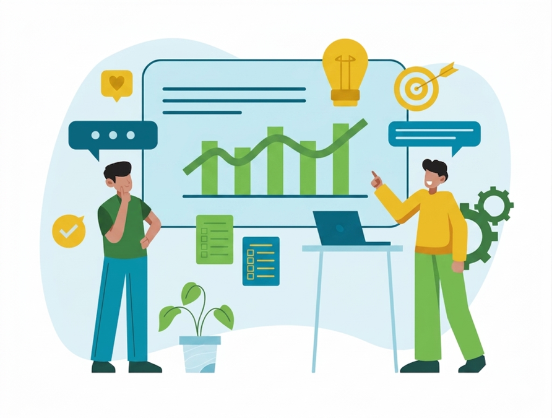
Reflection and Discussion
Review one guest-facing message, sign, menu note, app screen, or room card from your organisation or from a case study.
Ask:
Is it clear?
Is it warm?
Is it credible?
Is it inclusive?
Does it explain sustainability in a way the guest can
understand quickly?
Improve the message so that it becomes:
more guest-centred
more specific
more visually clear
more trustworthy
more aligned with the actual experience
Output:
Prepare a before/after comparison.
See also ›
C3 M1
- Leading Green and Digital Change

Slide 65
Key Takeways so far…
⁰¹
⁰⁴
Strong sustainable communication builds trust through clarity, evidence, and tone.
Greenwashing weakens guest trust and is increasingly under regulatory pressure.
⁰²
Storytelling can connect sustainability to place, culture, and memory.
⁰⁵
Inclusive communication improves the experience for more guests and strengthens hospitality quality.
⁰³
Certifications help most when their meaning is explained simply.
Key Takeways
Credible, human communication is part of sustainable design.

Slide 66
Applied Practice: Building a Conscious Guest Experience Concept
Turning guest journey insight into a practical hospitality design proposal. To apply the module by designing a guest experience concept that improves sustainability, inclusivity, communication, and guest satisfaction
05

Slide 67

Activity: Sustainable Guest Experience Challenge
Choose one setting:
rural guesthouse
boutique hotel
city hotel
B&B
restaurant with local sourcing
eco-conscious café
wellness or spa property
Your Task:
map the guest journey
identify 3 sustainability-enhancing touchpoints
propose 2 design improvements
create 1 guest communication element
explain how the concept improves both sustainability and customer satisfaction
Required Output:
guest journey map
two design ideas
one communication concept
short explanation of expected impact

Slide 68
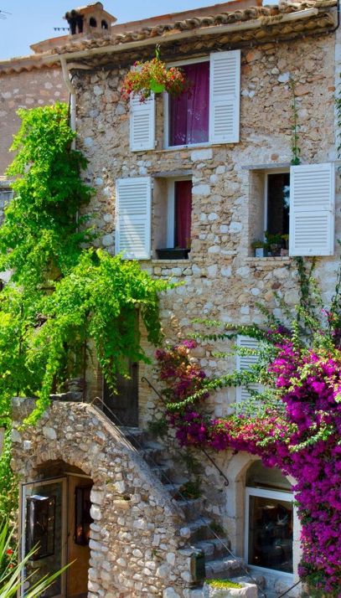
Worked Example: A Rural Guesthouse Experience Concept
Imagine a rural guesthouse that wants sustainability to feel warm, memorable and woven into the story. The pre-arrival email encourages train or shared-mobility travel and introduces nearby producers. At arrival, the guest receives a simple local map and a welcome note explaining the guesthouse’s seasonal food philosophy.
In the room, the housekeeping-frequency choice is presented as a comfort-and-impact option rather than a restriction. At breakfast, ingredients are linked to local farms through short story cards. At departure, guests are invited to share one local discovery and are thanked for supporting a lower-impact, community-connected stay.
This concept works because it combines:
clarity
local meaning
gentle behavioural design
visible but credible sustainability
guest participation that feels invited

Slide 69
Assessment Task
Prepare a short 3–5 slide concept presentation or one-page action sheet including:
A Guest Journey Map
>
Two Experience Design Ideas
>
One Guest Communication Output
>
Expected Benefits For Guests and the Business
Extension option: Pilot one change and report the early result.

Slide 70
C1 M3 · Case study pack
Download the full case studies
Every business featured in this module has a full case study.
Use the links below to open each one.
Hostal Grau – Barcelona, Spain (ULE)
Coco Hotel – Copenhagen, Denmark (EUEI)
Macrame do-not-disturb signs and visual cues; guest feedback loop protects the housekeeping experience.
Green Key, solar-powered, mobile-first check-in; Eden Reforestation offsets on every booking.
Download the full case study · {{CASE_URL_HOSTALGRAU}}
Download the full case study · {{CASE_URL_COCO}}
Aurora Courtyard – Tallinn (task)
Applied task: redesign a green guest experience so sustainability reads as quality, not cost-cutting.
Download the full case study · {{CASE_URL_AURORA}}
Download the full module pack (all cases in one file) {{CASE_PACK_URL_C1M3}}

Slide 71
Thank You for Engaging
We hope this module has enriched your knowledge and sharpened your practice.
Thank you for your commitment to hospitality that is intelligent, sustainable, and human centred.
Carry these insights into your work, lead with ethics and empathy, and let technology serve people with care.
www.ecosmartproject.eu

