Slide 1




C1 Sustainability and Green Innovation
Module 2:
Circular Economy & Resource Efficiency
www.ecosmartproject.eu
EcoSmart resources licensed under CC BY 4.0

Slide 2
Cluster 1 – Sustainability & Green Innovation | Module 2 - Circular Economy & Resource Efficiency
Why this module matters to your business
Circular economy is about getting more value from the resources you already use. For hospitality SMEs, it helps reduce waste, lower costs, extend product life, improve procurement decisions, and strengthen operational resilience.
01
02
03
See where value is lost
Keep resources working longer
Turn waste into operational value
Identify where food, water, energy, materials, packaging and equipment leave the system too early.
Apply practical approaches such as repair, reuse, refill, refurbishment and smarter purchasing.
Use circular thinking to improve efficiency, reduce costs and strengthen sustainability performance.
Meet the businesses you will learn from in this module
Jinny's Bakery (Ireland) Crolly Distillery (Ireland) Kar Tanesi Boutique Hotel (Türkiye) Hotel Bell Repos (Spain) Hotel GSH (Denmark) Hotel Luise (Germany) Lakeside Willow Lodge (Learner Challenge)

Slide 3

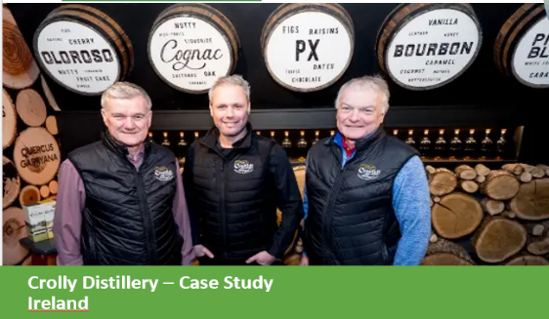
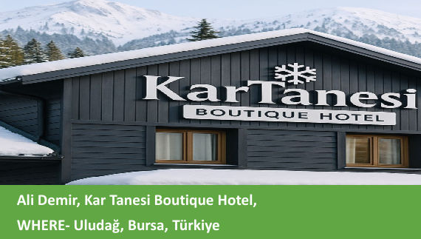
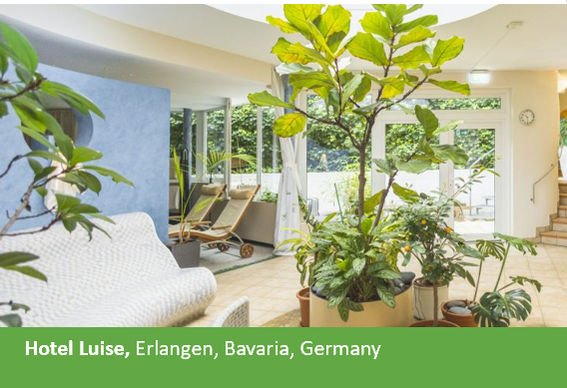

Cluster 1 – Sustainability & Green Innovation | Module 2 - Circular Economy & Resource Efficiency
Where this module fits
Role: Foundation module for circular economy thinking, resource efficiency, waste prevention, reuse, repair and regeneration in hospitality.
Comes after / assumes familiarity with
Comes after / assumes familiarity with
C1 M1 (Sustainability in Daily Hospitality Operations)
Extends or connects to
C1 M3 (Sustainable Customer Experience Design)
C2 M2 (Data Analytics in Hospitality)
C3 M1 (Leading Green & Digital Change)
C3 M2 (Digital Marketing for Sustainability)

Slide 4
Learning Objectives
By the end of this module, you will be able to:
explain what circular economy means in a hospitality SME context
distinguish between linear and circular ways of using resources
identify waste and resource hotspots across kitchen, housekeeping, maintenance and procurement
conduct a basic material flow assessment in one hospitality unit
create a checklist for identifying circular opportunities in daily operations
recommend practical interventions based on repair, reuse, refill, redesign and smarter purchasing
compare linear vs circular models in terms of environmental and financial outcomes for SMEs

Slide 5
Shared Glossary
Seven terms used across the programme. Same definitions in every module.
Term
Canonical definition
Full treatment in
Greenwashing
Making sustainability claims that are exaggerated, unverifiable, or unsupported – intentionally or by omission.
C3 M2
ESG
Environmental, Social & Governance – the three pillars used to assess a business's non-financial performance and its broader impact.
C3 M1
Nudge
A small change in how a choice is presented (a default, a reminder, the physical set-up) that shifts behaviour while keeping choice open.
C1 M3
Twin transition
Advancing digital transformation and the green transition together so that each reinforces the other in SMEs.
C3 M1
KPI
Key Performance Indicator – a measurable value that shows how effectively a business is achieving a defined objective.
C2 M2
Circular economy
An approach designed to keep materials and products in use for as long as possible through reducing, reusing, repairing, refurbishing and recycling – so that waste becomes a resource.
C1 M2
Guest journey
The full sequence of a guest's interactions with a business, from awareness through booking, stay and post-stay engagement – used to design sustainability and digital touchpoints coherently.
C1 M3
EcoSmart Hospitality – WP3 · Shared glossary · identical in all 7 modules

Slide 6
Contents
01
Circular Economy Basics for Hospitality SMEs
02
Mapping Resources and Waste Hotspots
03
Circular Interventions in Practice
04
Measuring Resource Efficiency and Value
05
Applied Practice: Building a Circular Opportunity Plan

Slide 7
Circular Economy Basics for Hospitality SMEs
To introduce the meaning of circular economy in hospitality and show how waste prevention, reuse, redesign and resource efficiency support both sustainability and business performance.
01

Slide 8
From “take–use–discard” to smarter resource systems
Circularity begins much earlier than
the recycling bin: in design, purchasing, use, maintenance and daily routines.
In hospitality, this means thinking differently about:
food
linen
guest amenities
furniture and fittings
packaging
water
cleaning products
purchasing decisions
A circular model asks a different question:
How can we keep materials, products and value in use for longer while reducing waste and pressure on new resources?
Take
Use
Discard
Circular
See also ›
C2 M2
- ·Data Analytics in Hospitality

Slide 9
Three Core Principles of the Circular Economy
A circular economy is based on three principles, all driven by design.
Eliminate Waste and Pollution
Circulate products and materials
Re-generate nature
Keep materials in use through maintenance, reuse, repair, refurbishment, refill and recycling.
Design products, services and routines so waste appears less often in the first place.
Choose systems that reduce harm and support healthier natural cycles over time.
Further Reading: https://www.ellenmacarthurfoundation.org/topics/circular-economy-introduction/overview?utm_source=chatgpt.com

Slide 10
The Waste Hierarchy
04 Disposal
The most effective circular strategy prevents waste before it appears.
prevent over-ordering before recycling packaging
repair or repurpose textiles before discarding them
redesign buffet and service routines before accepting food waste as normal
03 Recycling
02 Preparing for reuse
01 Prevention
Recycling matters, but prevention and reuse usually create greater value.

Slide 11
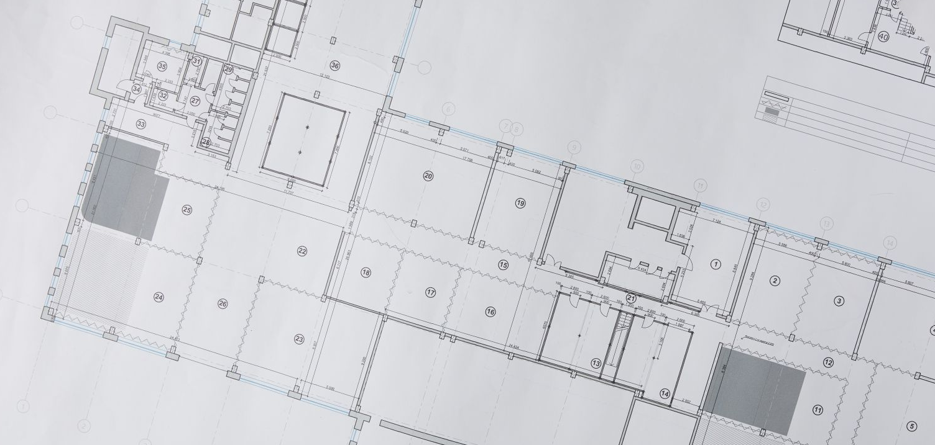
Where Circularity Matters in a Hospitality Business
See also ›
C1 M1
- Integrating Sustainability in Daily Operations
Storage & Back-of-House..
stock rotation, spoilage, over-ordering, damaged goods..
Kitchen & F&B ..
ingredients, prep waste, buffet surplus, packaging .
Procurement ..
delivery patterns, packaging, durability, supplier choice .
Housekeeping & Laundry ..
linen life, chemical use, single-use items .
Guest Rooms ..
amenities, dispensers, maintenance, replacement cycles .
Maintenance ..
Repair vs replace, fixture..
performance,.water and ..
energy efficiency .
Circularity is a cross-department operating logic.

Slide 12
Think in Flows, Beyond Bins
A circular business begins with the questions:
What comes in?
How is it stored?
How is it used?
Where is value lost?
What can be reused, repaired or redesigned?
What must still leave the system as waste?
Example
A food ingredient carries value throughout its flow. Value can be lost at purchasing, storage, trimming, preparation, buffet display and plate return.
To manage circularity well, we must understand the full life cycle of operational materials.
Reorder
Storage
Input
Loss
Use
Recovery

Slide 13

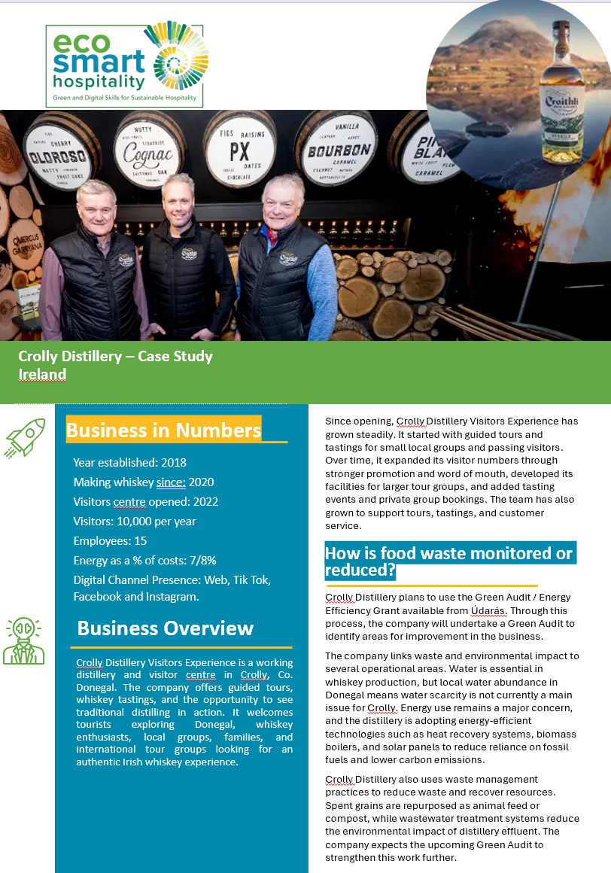
Crolly Distillery
Crolly Distillery demonstrates how circular thinking begins by looking at resource flows rather than waste streams. As production expanded, the business examined how energy, water, raw materials, and by-products moved through the operation and identified opportunities to recover value that would otherwise be lost.
The distillery introduced heat recovery systems, renewable energy technologies, and processes that give spent grain a productive second life rather than treating it as waste. By understanding what enters, moves through, and leaves the system, the business reduced resource loss while strengthening operational efficiency. The case illustrates a central principle of circular economy thinking: waste is often a sign that value is leaving the system too early. Mapping flows helps businesses identify where resources can be retained, reused, or recovered.
Key Learning: Circular businesses focus on how value moves through a system, not simply on what ends up in the bin.

Slide 14
Other EcoSmart Hospitality Examples
^{Resort Linen Reuse}
⁰¹
A resort repurposes worn-out linens into laundry bags or staff aprons.
What these examples show
circularity can be practical
circularity can reduce cost
circularity can improve design and process discipline
circularity can be applied in different departments
^{Water Efficiency Upgrade}
⁰²
Facilities teams audit water consumption in guest rooms and introduce low-flow fixtures.
^{Zero-waste Menu Design}
⁰³
Restaurant managers redesign menus around full-ingredient use.

Slide 15

Reflection and Discussion
Think about one hospitality setting you know well.
What is thrown away most often?
Which items are replaced too quickly?
Where is value lost before waste even appears?
Which routine feels most “linear”?
Discussion prompt - Which change would have the greatest effect:
buying differently
using differently
storing differently
repairing differently
communicating differently

Slide 16

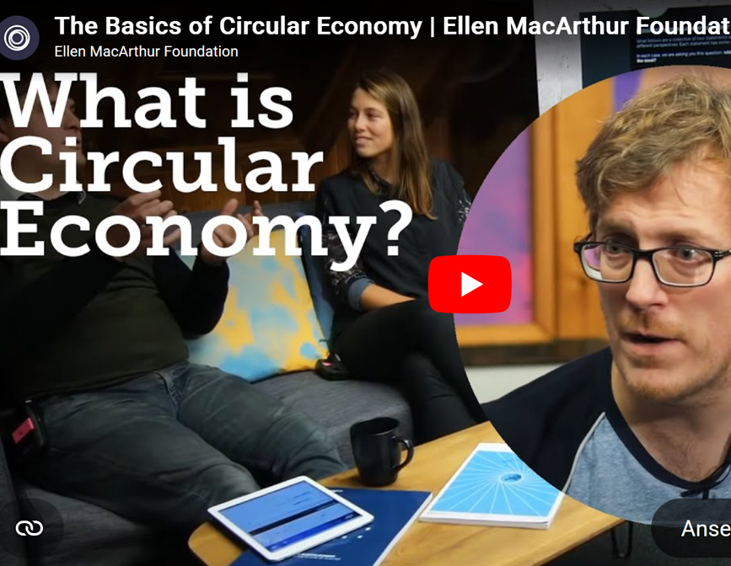
Watch and Reflect
As you watch, note:
one idea that changes how you think about waste
one principle that fits hospitality operations
one example you could translate into your own workplace
Reflection Question:
What would “circulating value” mean in a hotel, restaurant or café?

Slide 17
⁰¹
⁰⁴
Circular economy designs waste out from the start.
Systems thinking helps businesses understand where value is lost and where it can be retained.
⁰²
The most valuable strategies often happen before disposal: prevention, reuse, repair and redesign.
⁰³
Key Takeways
Hospitality operations contain many circular hotspots across food, linen, rooms, procurement and maintenance.
Circularity is practical when it is translated into everyday hospitality decisions.

Slide 18
Mapping Resources and Waste Hotspots
Seeing the operation as a flow system
To identify where materials, energy, water, packaging and products move through hospitality operations — and where waste, leakage and inefficiency occur.
02

Slide 19
Mapping Material Flows Across Property
Start
A material flow map helps teams see how resources move through the business.
For each department, ask:
what comes in?
where is it stored?
how is it used?
where does surplus, spoilage or damage occur?
what leaves as waste, recycling, laundry return or reuse?
What this reveals
duplication
over-ordering
hidden waste
lost reusable value
weak handover between teams
Start
Process
Process
Yes
Process
Process
Process
Decision
Process
No
See also ›
C1 M1
- Integrating Sustainability in Daily Operations

Slide 20


Kitchen & F&B
Common circularity hotspots in food operations include:
overproduction
poor stock rotation
excessive trimming
buffet overfill
avoidable plate waste
single-use service items
supplier packaging
poor use of edible surplus
Circular questions
Can menu design use ingredients more fully?
Can buffet presentation reduce excess exposure?
Can prep and service batches be smaller or more adaptive?
Can packaging be reduced at source?
See also ›
C1 M1
- Integrating Sustainability in Daily Operations

Slide 21
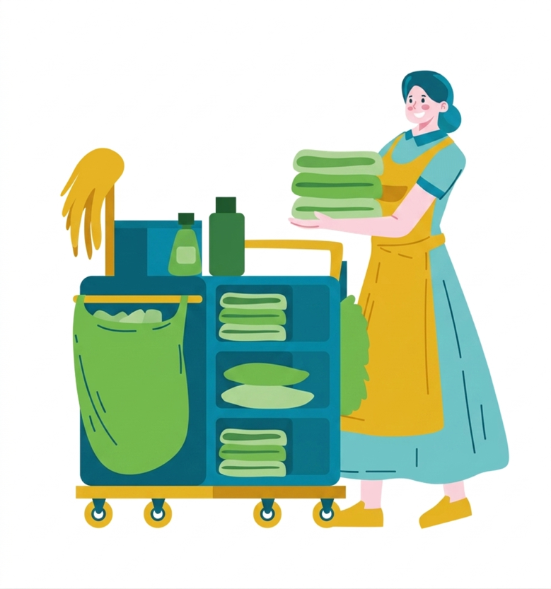
Housekeeping & Laundry Hotspots
Housekeeping and laundry are major circularity zones because they affect:
linen replacement cycles
textile wear and damage
chemical use
water demand
packaging from amenities and supplies
disposal of partially used products
Circular opportunities
longer textile life through correct care
repair before replacement
refill systems in place of disposables
accurate chemical dosing
more selective replacement of worn items
See also ›
C1 M1
- Integrating Sustainability in Daily Operations

Slide 22

Guest Rooms & Amenities Hotspots
Guest rooms generate circularity questions around:
disposable toiletries
miniature product packaging
amenity replacement frequency
furniture and fitting replacement
maintenance response time
waste separation in rooms
housekeeping frequency choices
Operational lesson:
Small repeated guest-room decisions can create large material and waste impacts over time.
See also ›
C1 M3
- Sustainable Customer Experience Design

Slide 23

Maintenance, Water & Equipment Hotspots
Circularity also depends on technical systems.
Look For:
leaks and poor fixture performance
short equipment life due to weak maintenance
replacement routines where repair could work instead
inefficient controls or settings
missed refurbishment opportunities
untracked spare parts and consumables
Circular Principle:
Maintenance protects value by extending product life and preventing avoidable resource loss.
See also ›
C2 M1
- AI in Hospitality

Slide 24


Procurement & Packaging Hotspots
Procurement decisions often decide circular performance before the product arrives.
Look At:
purchase volume and order frequency
single-use vs refill or bulk formats
packaging intensity
durability and repairability
availability of spare parts
supplier take-back or reuse schemes
local/regional sourcing opportunities
Key Lesson:
A waste problem at the back door is often a purchasing decision made much earlier.
See also ›
C1 M1
- Integrating Sustainability in Daily Operations

Slide 25
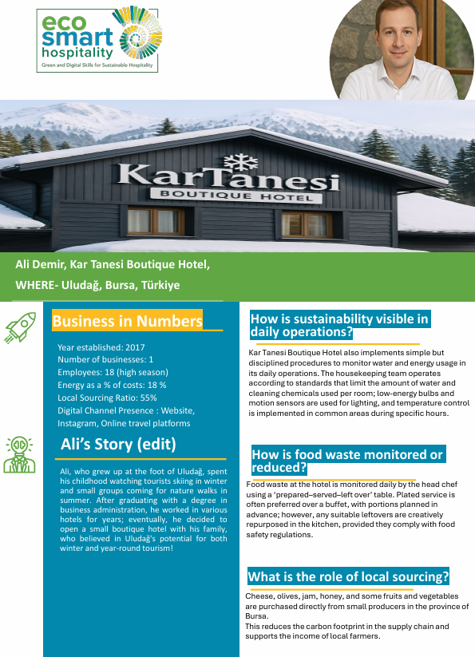
Kar Tanesi Boutique Hotel
Kar Tanesi Boutique Hotel demonstrates how circular economy principles can be embedded into everyday hospitality operations. The business has developed consistent procedures for water use, energy management, local sourcing, composting, and material reuse across multiple departments.
Rather than relying on individual sustainability projects, circularity is built into daily routines and operational decisions. Staff follow standardised procedures that help reduce waste, use resources more efficiently, and extend the useful life of products and materials.
These practices support environmental performance while maintaining service quality and operational consistency.
The case shows that circularity becomes most effective when it is translated into repeatable routines that staff can apply every day.
Key Learning: Circular economy succeeds when sustainable resource management becomes part of normal operational practice rather than an occasional initiative.

Slide 26
Activity: Build a Material Flow Map
Choose one unit:
breakfast service
housekeeping trolley system
guest-room amenities
laundry
bar service
maintenance stores
Map the flow
Inputs / Storage / Use / Loss / Recovery / Reorder
Output - Identify:
two major waste points
one hidden cost
one circular opportunity
Reorder
Storage
Input
Loss
Use
Recovery

Slide 27
Reflection and Discussion
Where does value leak out most often in your chosen process?
before service?
during service?
during cleaning or reset?
through replacement habits?
through supplier packaging?
Prompt:
Which losses are obvious — and which ones stay invisible because they feel “normal”?

Slide 28
⁰¹
⁰⁴
Circularity improves when teams understand flows alongside waste bins.
Material flow mapping helps teams see where circular opportunities are most practical.
⁰²
Food, linen, amenities, packaging and equipment all move through systems.
⁰³
Key Takeways
You cannot redesign what you have not yet mapped.
Different departments create different forms of loss.

Slide 29
Circular Interventions in Practice
How hospitality businesses can reduce inputs, extend product life and create circular value
To explore concrete circular strategies that can be applied across hospitality operations, procurement and service design.
03

Slide 30

Design Out Waste Before It Appears
The most effective circular intervention is a better design decision.
Design Questions
Can the product be used for longer?
Can the format reduce packaging?
Can the service be right-sized?
Can the menu or offering reduce leftover materials?
Can one item serve multiple purposes?
Hospitality Examples
refill dispensers in place of miniatures
smaller, smarter buffet refill containers
durable serviceware in place of single-use defaults
modular furniture and fittings that can be repaired

Slide 31

Design Out Waste Before It Appears
Repair: Extend product life through maintenance and simple fixes.
Reuse: Use the same item multiple times in its original function.
Repurpose: Use a product or material in a different function.
Refurbish: Restore value through renewal, replacement parts or upgrading.
Hospitality Examples
Repairing chairs as the default
Reusing dispensers and durable containers
Repurposing worn linen for internal operations
Refurbishing fixtures as the default

Slide 32
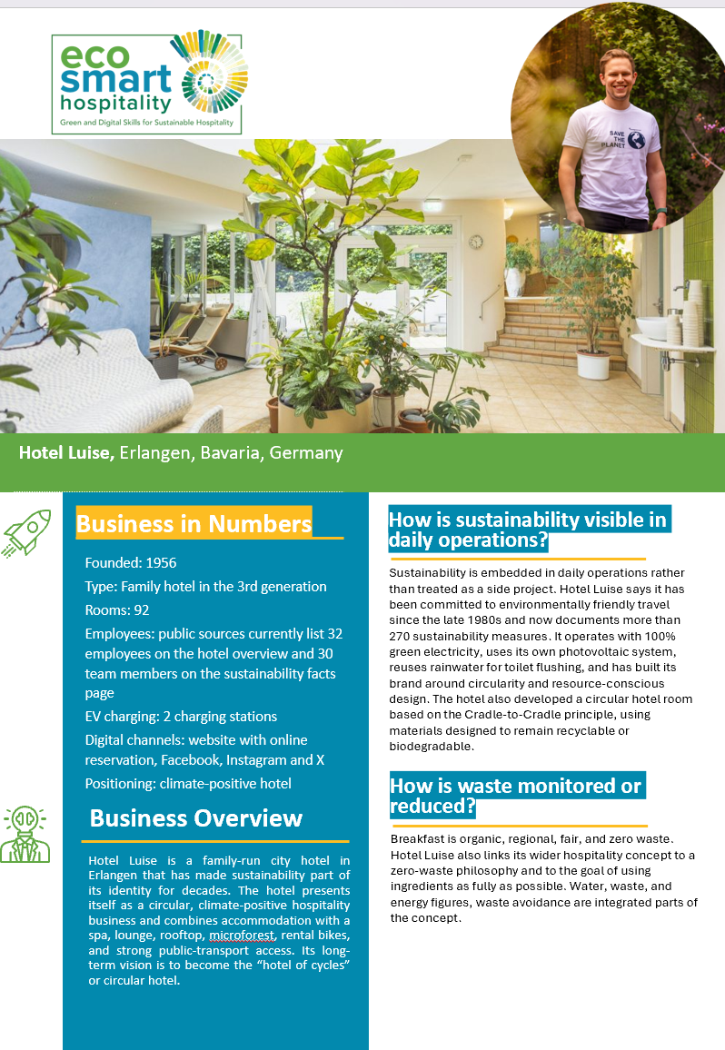
Hotel Luise
Hotel Luise demonstrates how circular economy thinking can influence purchasing, refurbishment, and investment decisions. The hotel is recognised for its circular hotel room concept, where materials, furnishings, and products are selected with their full life cycle in mind.
Rather than focusing only on purchase price, the business considers durability, repairability, reuse potential, environmental impact, and end-of-life recovery. This approach supports longer product life, reduces unnecessary replacement, and lowers the environmental footprint of refurbishment and renovation projects.
The case highlights an important circular economy principle: many waste problems are created long before products enter daily operations. Better purchasing decisions often create the greatest long-term circular benefits.
Key Learning: The most effective circular intervention is often a smarter purchasing or design decision made before waste exists.

Slide 33

Circular Food Systems
and Zero-Waste Menus
Further Reading: UNEP’s Food Waste Index 2024 underlines that measurement is the basis for effective food waste reduction.
https://www.unep.org/resources/publication/food-waste-index-report-2024
Circular food thinking aims to keep edible value high and waste low.
Practical Strategies
full-ingredient use
better forecasting
smaller batch cooking
cross-utilisation between menu items
adaptive buffet refill
clear storage and labelling routines
surplus prevention before disposal or composting
Operational Lesson:
A circular kitchen is usually a more disciplined and more profitable kitchen.
See also ›
C1 M3
- Sustainable Customer Experience Design

Slide 34

Water Efficiency as Circular Resource Management
Circular resource efficiency also means reducing avoidable water use while maintaining guest comfort and hygiene standards.
Examples:
low-flow fixtures
faster leak reporting
selective housekeeping frequency
efficient laundry loads
irrigation review in resort settings
better monitoring of unusually high-use rooms or zones
Key lesson:
Water efficiency is part of using resources more intelligently.

Slide 35


Water Efficiency as Circular Resource Management
A circular purchasing decision asks more than:
“What is cheapest offer?” It also asks:
How long will it last?
Can it be repaired, reused or refilled?
How much packaging does it generate?
What maintenance does it require?
What is the disposal cost?
Is there a lower-impact or local alternative?
Procurement lesson:
A lower purchase price can still create a higher total cost over time.
The European Commission’s Buying green! handbook explicitly highlights life-cycle costing and environmental criteria in purchasing decisions: https://op.europa.eu/en/publication-detail/-/publication/8c2da441-f63c-11e5-8529-01aa75ed71a1/language-en (available in all EU-Languages)
See also ›
C2 M2
- Data Analytics in Hospitality

Slide 36
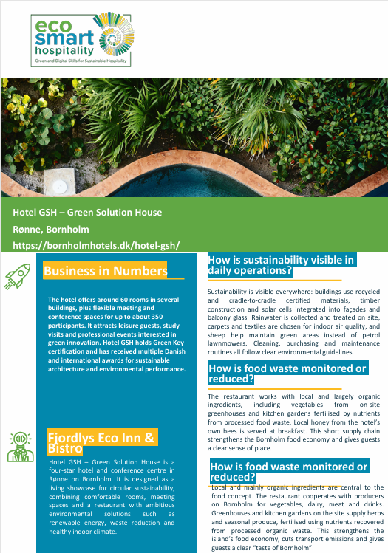
Hotel GSH
Hotel GSH demonstrates how circular economy can extend beyond waste reduction into a broader approach to regenerative hospitality. The hotel integrates circular design principles through building materials, rainwater harvesting, on-site food production, resource recovery systems, and long-term environmental planning.
Circularity is visible across both operations and guest experience. Resources are managed as part of interconnected systems where water, materials, food production, energy, and maintenance decisions support one another. The result is a hospitality model that focuses on retaining value, reducing resource pressure, and strengthening environmental performance over time. The case shows how circular economy is not only about managing waste more effectively. It is about designing systems that keep resources productive for as long as possible while supporting healthier environmental outcomes.
Key Learning: The strongest circular systems are designed to retain value, regenerate resources, and reduce waste before it is created.

Slide 37
Certifications, Standards and Credible Claims
Certifications help structure improvement; real operational change remains the foundation.
Good Practice
use standards to organise action
document evidence
train staff
communicate clearly with guests
use specific, measured claims
Critical Question:
Does the label support real practice, or only appearance?
Example of a well established standard is: ISO 14001:2015 Environmental management systems - Requirements with guidance for use. Further reading: https://www.iso.org/home/insights-news/resources/iso-14001-explained.html
See also ›
C3 M2
- ·Digital Marketing for Sustainability

Slide 38
Hospitality Examples (I/II)
Learning Prompt:
Which of these changes is:
easiest to pilot
fastest to measure
most visible to staff
most visible to guests
⁰¹
⁰³
Case A: Linen Repurposing
Worn textiles are repurposed for internal use.
Case C: Refillable Guest Amenities
Dispensers reduce packaging and replacement waste.
Case B: Zero-Waste Menu Design
Ingredients are selected and combined for fuller use across dishes.
Case D: Low-Flow Water Retrofits
Small technical changes reduce long-term resource use.
⁰²
⁰⁴

Slide 39
Hospitality Examples (II/II)
For each intervention now, rate it on:
Impact
Cost
Ease of implementation
Staff acceptance
Speed of visible results
⁰¹
⁰³
Case A: Linen Repurposing
Worn textiles are repurposed for internal use.
Case C: Refillable Guest Amenities
Dispensers reduce packaging and replacement waste.
Case B: Zero-Waste Menu Design
Ingredients are selected and combined for fuller use across dishes.
Case D: Low-Flow Water Retrofits
Small technical changes reduce long-term resource use.
⁰²
⁰⁴

Slide 40
Reflection and Discussion
Discussion Prompt
Why do some good circular ideas fail in practice?
What is your approach to prevent your next circular idea from failing?

Slide 41
⁰¹
⁰⁴
Circular interventions should begin with prevention and redesign.
Good circular practice combines environmental logic with operational realism.
⁰²
Repair, reuse, refill and refurbishment help retain value.
⁰³
Food, water, procurement and product life are all circularity topics.
Key Takeways
Circularity works best when it improves both resource use and decision quality.

Slide 42
Measuring Resource Efficiency and Value
From circular ideas to visible performance
To show how hospitality SMEs can use simple indicators to monitor circularity, compare options, and build the business case for change.
04

Slide 43
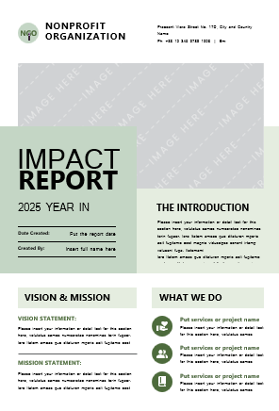
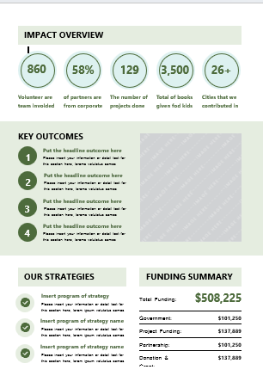
Why Measurement Matters
Measuring circularity turns a good intention
into a management practice.
Measurement Helps Teams:
see hidden waste
compare current and improved practice
identify cost-saving opportunities
justify investment decisions
show progress to managers, staff and guests
SME Reality:
Simple tracking is often enough to support better decisions.
See also ›
C2 M2
- Data Analytics in Hospitality

Slide 44
Simple Circularity KPIs for Hospitality SMEs
Laundry loads per occupied room
Amenity packaging use per stay
Repair vs replace rate
Packaging units per delivery
01
02
03
04
05
06
07
08
Food waste per cover
Water use in high-demand zones
Share of refill/bulk purchases
Packaging units per delivery
Practical Tip: Choose a small number of indicators that teams can actually record and review.
See also ›
C2 M2
- Data Analytics in Hospitality

Slide 45

KPI Focus: Food Waste per Cover
One practical way to make food waste visible is to relate it to activity.
Basic Logic
Food waste per cover = total food waste from a service or day ÷ number of covers served
This helps teams:
compare services fairly
track improvement over time
test whether forecasting, buffet redesign or batch changes are working
link waste reduction to operational decisions
Key Lesson:
A ratio is often more useful than an isolated waste total.
Further Reading: UNEP’s Food Waste Index 2024 underlines that measurement is the basis for effective food waste reduction. https://www.unep.org/resources/publication/food-waste-index-report-2024

Slide 46

Building a Simple Circularity Dashboard
A smart hospitality dashboard could track:
food waste per cover
laundry loads per occupied room
guest-room amenity use
packaging units received
repairs completed
leaks identified and closed
share of purchases in refill/bulk format
Review Rhythm:
daily: operational exceptions
weekly: trends
monthly: decisions and priorities
Key Lesson:
A useful dashboard is short, visible and regularly discussed.
See also ›
C2 M21
- AI in a Hospitality

Slide 47
Direct Cost, Hidden Cost and Retained Value
Direct Cost
purchase price
utilities
disposal fees
⁰¹
Circular decisions are both environmental and financial — they affect cost in several ways.
Hidden Cost
storage pressure
breakage
over-ordering
staff time
spoilage
frequent replacement
⁰²
Circularity improves when teams see value retained alongside waste removed.
⁰³
Retained Value
longer product life
lower purchasing volume
fewer disposables
lower waste handling
stronger process discipline
See also ›
C2 M2
- Data Analytics in Hospitality

Slide 48
From One-Off Action to a Management System
Improve
⁰⁴
⁰¹
Plan
One successful intervention is useful.
A repeatable management system
is more powerful.
A stronger circularity approach includes:
clear responsibilities
documented routines
staff awareness and training
simple indicators
review meetings
corrective action
continual improvement
The goal is a better operating system — built to last beyond a single campaign.
Management
Cycle
⁰²
Implement
Review
⁰³
See also ›
C3 M1
- Leading Green and Digital Change

Slide 49
Reflection Activity: Choose Your Indicators
^{Select & Choose:}
⁰¹
Select one department and choose three indicators you would begin with.
^{For each indicator, define:}
⁰²
what will be measured
how it will be measured
who is responsible
how often it will be reviewed
what action might follow
⁰³
^{Output}
A one-page mini monitoring plan for one hospitality unit.

Slide 50
⁰¹
⁰⁴
Circularity becomes stronger when it is measured.
Long-term progress depends on routines, roles and regular review.
⁰²
Simple KPIs are often enough for SMEs – especially to start with.
⁰³
Key Takeways
Circular value becomes visible when teams learn how to track it.
Ratios such as food waste per cover can reveal trends more clearly than totals alone.

Slide 51
Applied Practice: Building a Circular Opportunity Plan
Turning analysis into action in a real hospitality workflow
To apply the module by auditing one unit, identifying circular opportunities, prioritising actions, and presenting the environmental and business case for change.
05

Slide 52

Applied Practice Brief
Choose One Unit or Process:
breakfast
buffetroom
Amenities
housekeeping trolley system
linen managementbar service
maintenance stores
supplier deliveries
Your Task:
map the current flow
identify waste and value-loss points
propose 3 circular improvements
choose 1 quick win and 1 strategic change
define 2 indicators to review progress
Output:
A short circular opportunity plan for management or team discussion.

Slide 53
Current Challenges
Worked Example: Breakfast Buffet Redesign
⁰¹
overproduction late in service
large display quantities
repeated trimming waste
unclear use of edible surplus
weak tracking of leftovers
A real hospitality case example: Winnow reports that the Lisbon Marriott Hotel achieved a 50% food waste reduction in nine months after combining clearer waste data with operational changes.
Circular Redesign
⁰²
smaller refill containers after peak demand
tighter forecasting by day pattern
more cross-use of ingredients
clearer separation of edible surplus and unavoidable waste
daily food waste review linked to covers served
⁰³
Expected Gains
Further Reading: https://www.winnowsolutions.com/lisbon-marriott-cuts-food-waste-by-50-with-winnows-ai-system
lower waste
lower purchasing pressure
better stock control
clearer management decisions

Slide 54


Presenting the Business and Environmental Case
A strong circular proposal
should explain:
the current problem
where value is being lost
the proposed intervention
the environmental benefit
the operational or financial benefit
the likely staff barriers
how progress will be measured
Operational Value
Environmental Value
Circularity is a process, cost, resilience and environmental argument.
See also ›
C3 M2
- ·Digital Marketing for Sustainability

Slide 55
Assessment Task and Rubric
Prepare a short 3–5 slide presentation or one-page action plan showing your circular opportunity proposal.
Clear understanding of the current process
>
Accurate identification
of waste or resource-loss points
>
Realistic circular interventions
>
Practical indicators for follow-up
>
Clear
business & environmental reasoning
>
Professional communication and feasibility
Extension option: Pilot one change and report the early result.

Slide 56
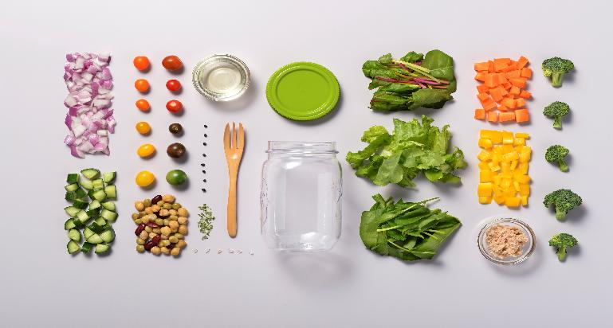
C1 M2 · Case study pack
Download the full case studies
Every business featured in this module has a full case study. Use the links below to open each one.
Crolly Distillery – Ireland
Udaras Green Audit; heat recovery, biomass, solar; spent grains reused; visitor experience.
Download the full case study · {{CASE_URL_CROLLY}}
Kar Tanesi Boutique Hotel - Türkiye (BUU)
Standardised water and energy procedures per room; local sourcing; compost and reuse flows.
Download the full case study · {{CASE_URL_KARTANESI}}
Hotel GSH (Green Solution House) – Bornholm, Denmark (EUEI)
Hotel Luise – Erlangen, Germany (TVW)
Cradle-to-cradle materials, rainwater harvest, on-site greenhouses, sheep for grounds-keeping.
Climate-positive positioning, circular hotel room (Cradle-to-Cradle), 270+ sustainability measures.
Download the full case study · {{CASE_URL_GSH}}
Download the full case study · {{CASE_URL_LUISE}}

Slide 57
Thank You for Engaging
We hope this module has enriched your knowledge and sharpened your practice.
Thank you for your commitment to hospitality that is intelligent, sustainable, and human centred. Carry these insights into your work, lead with ethics and empathy, and let technology serve people with care.
www.ecosmartproject.eu

