Slide 1
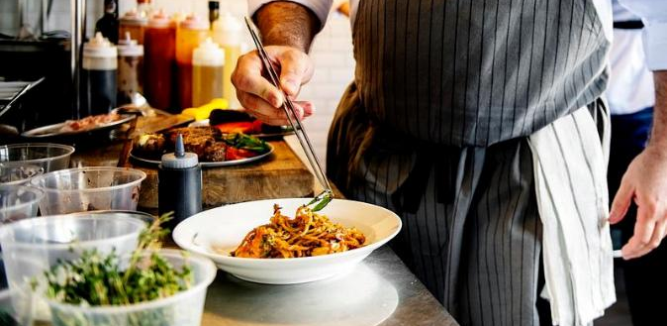



C1 Sustainability and Green Innovation
Module 1:
Sustainability in Daily Hospitality Operations
www.ecosmartproject.eu
EcoSmart resources licensed under CC BY 4.0

Slide 2
Cluster 1 – Sustainability & Green Innovation | Module 1 - Sustainability in Daily Hospitality Operations
Why this module matters to your business
Practical, everyday sustainability for hospitality SMEs, built around real decisions in front office, housekeeping, kitchens and procurement.
01
02
03
Spot the impact in a normal shift
Redesign one routine well
Bring your team with you
See where energy, water, waste and sourcing decisions already live in your daily routine — and which small changes pay back fastest.
Choose a real routine, room turnover, breakfast close-down, preparation, and redesign it, so guest service stays strong and impact drops.
Build sustainable habits through simple briefings, shared checklists and visible leadership so good practice holds shift after shift.
Meet the businesses you will learn from in this module
Adrede (Madrid, Spain) · Heritage Flavours (Bursa, Türkiye) · Hotel Lücke (Rheine, Germany) · Casa Verde Bistro (Portugal — learner task)

Slide 3





Cluster 1 – Sustainability & Green Innovation | Module 1 - Sustainability in Daily Hospitality Operations
Where this module fits
Role: Foundation module for sustainable daily practice across hospitality operations, teams and service delivery.
Extends or connects to
C1 M2 (Circular Economy & Resource Efficiency)
C1 M3 (Sustainable Customer Experience Design)
C2 M2 (Data Analytics in Hospitality)
C3 M1 (Leading Green & Digital Change)
C3 M2 (Digital Marketing for Sustainability)

Slide 4
Why This Module Matters-For Your Business, Your Team & Your Guests
Sustainability in hospitality lives in the small decisions teams make every day. It is shaped by the small decisions teams make every day in front office, housekeeping, kitchens, maintenance, purchasing and guest communication.
For hospitality SMEs, sustainable daily operations help to:
Reduce avoidable costs through better use of energy, water and materials
Strengthen resilience by lowering exposure to rising utility prices and supply disruption
Build team responsibility through shared routines and practical habits
Improve operational quality by making processes more consistent and intentional
Respond to guest expectations with visible, credible and responsible hospitality practice

Slide 5
Learning Objectives
By the end of this module, you will be able to:
Explain what sustainable daily operations mean in a hospitality context
Recognise how energy, water, waste and sourcing decisions appear in everyday work
Identify sustainable actions relevant to e.G. Front office, housekeeping and kitchen operations
Apply principles of energy efficiency, water conservation, ethical sourcing and carbon awareness in routine decisions
Design a staff shift routine with sustainability checkpoints such as energy shut-off, recycling and waste monitoring
Evaluate the short- and long-term environmental impact of daily operational routines
Recommend one realistic improvement for a hospitality workflow or department

Slide 6
Shared Glossary
Seven terms used across the programme. Same definitions in every module.
Term
Canonical definition
Full treatment in
Greenwashing
Making sustainability claims that are exaggerated, unverifiable, or unsupported – intentionally or by omission.
C3 M2
ESG
Environmental, Social & Governance – the three pillars used to assess a business's non-financial performance and its broader impact.
C3 M1
Nudge
A small change in how a choice is presented (a default, a reminder, the physical set-up) that shifts behaviour while keeping choice open.
C1 M3
Twin transition
Advancing digital transformation and the green transition together so that each reinforces the other in SMEs.
C3 M1
KPI
Key Performance Indicator – a measurable value that shows how effectively a business is achieving a defined objective.
C2 M2
Circular economy
An approach designed to keep materials and products in use for as long as possible through reducing, reusing, repairing, refurbishing and recycling – so that waste becomes a resource.
C1 M2
Guest journey
The full sequence of a guest's interactions with a business, from awareness through booking, stay and post-stay engagement – used to design sustainability and digital touchpoints coherently.
C1 M3

Slide 7
Contents
01
Why Sustainability Belongs in Daily Operations
02
Sustainable Routines by Department
03
Monitoring Resource Use and Everyday Performance
04
Team Behaviour, Responsibility and Culture
05
Applied Practice: Redesigning One Daily Routine

Slide 8
Why Sustainability Belongs in Daily Operations
Foundations for practical sustainability in hotels, restaurants and guest services. To introduce the operational role of sustainability and examine how daily routines can reduce waste, improve efficiency, strengthen resilience and support responsible hospitality practice.
01

Slide 9
What sustainable daily operations look like in practice
Common misconceptions
to watch for
Sustainable daily operations are:
One-off symbolic actions
Practical decisions built into normal work
Sustainability becomes real in hospitality when it is part of the daily routine.
Only a manager’s responsibility
Resource-aware ways of delivering service without reducing quality
A trade-off against guest comfort or professionalism
Visible in habits, standards and checklists

Slide 10
Why Daily Routines Matter
^{For the business}
⁰¹
Lower avoidable costs
Stronger resilience
Better process discipline
Well-designed sustainable routines support both service quality and operational performance.
^{For the team}
⁰²
Clearer expectations
Shared responsibility
More consistent working habits
^{For guests}
⁰³
More credible sustainable practice
Clearer choices
Stronger trust in the business

Slide 11

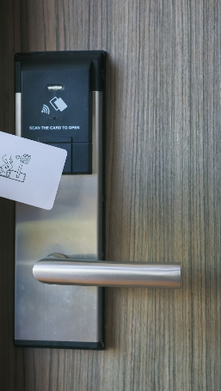
Where Impact Happens in Hospitality
In a typical hospitality business, sustainability hotspots appear across the whole operation:
Front office: guest information, printing, transport advice, partner recommendations
Housekeeping: linen cycles, cleaning chemicals, amenities, room shut-off checks
Kitchen & F&B: food waste, storage, energy use, water use, packaging
Maintenance: heating, cooling, leaks, equipment settings, preventive maintenance
Procurement: supplier choice, delivery patterns, packaging, durability, local sourcing
Environmental impact sits across the whole guest and staff journey.
See also ›
C1 M3
· Sustainable Customer Experience Design

Slide 12
Examples in Practice
Case 3:
Heritage Flavours,
Bursa
Case 1:
Boutique Hotel Amenities
Case 2:
Green Restaurant, Bursa
A boutique hotel replaces disposable plastic toiletry containers with bulk dispensers to reduce plastic waste.
Sustainability has become a natural part of daily operations
A front office team promotes local transport options and green-certified partner businesses.
What these examples show: sustainability can be operational, actions can
be measured, guest-facing teams also shape environmental outcomes

Slide 13
Simple EcoSmart Hospitality Examples in Practice
^{Energy Efficiency}
^{Water Conservation}
.
^{Waste Prevention}
Switch-off routines, correct settings, equipment awareness, avoiding unnecessary use.
Leak reporting, mindful cleaning, laundry discipline, efficient use of fixtures.
Reduce overproduction, separate correctly, choose reusables where practical.
Small actions repeated consistently create meaningful change over time.
^{Ethical And Local Sourcing}
^{Carbon Awareness}
Prefer durable, lower-impact, responsibly sourced and locally relevant options.
Recognise that transport, food, procurement and energy choices all shape environmental impact.

Slide 14
Reflection and Discussion
What is one low-cost change that could be introduced tomorrow?
Operational Lens
Where is energy used unnecessarily?
Where is water lost or overused?
Where does waste appear before service is even complete?
Operational Lens
Team Lens
Which habits are strong?
Which routines depend too much on memory or goodwill?
Think about one normal shift in your workplace.
Team Lens
Guest Lens
Where could sustainability be visible in a way that still feels professional and welcoming?
Guest Lens

Slide 15
3-Step Group Activity:
Map a Shift
^{Choose One Role}
⁰¹
E.g. receptionist, room attendant, kitchen porter, line cook, shift supervisor
^{Map The Routine}
⁰²
List the main steps in one normal shift.
Identify Five Sustainable Actions
⁰³
Mark where the role could reduce waste, save resources or improve sourcing choices.

Slide 16
3-Step Group Activity:
Map a Shift
Evidence Of Learning
Present:
the current routine
five sustainable actions
one quick win
one longer-term improvement
Measure Success
How will you know the change is working?

Slide 17
⁰¹
⁰⁴
Sustainability in hospitality begins in routine, not in slogans.
Small actions become powerful when they
are repeated consistently.
⁰²
Daily decisions shape energy use, water use, waste levels and sourcing quality.
⁰⁵
Sustainable daily operations support cost control, resilience and service quality.
⁰³
Key Takeways
Every department contributes to environmental impact.

Slide 18
Further Reading: GreenComp and Practical Hospitality Sustainability
The GreenComp framework supports sustainability learning through four broad competence areas:
Embodying Sustainability Values
Embracing Complexity in Sustainability
Envisioning Sustainable Futures
Acting for Sustainability
In hospitality, this helps professionals strengthen:
sustainable business thinking
resource efficiency
environmentally responsible decision-making
Reflection task
Write 100–150 words:
Which GreenComp idea is already visible in your workplace?
Which one still needs to become part of daily operations?
01
02
03
You can download GreenComp here

Slide 19
Sustainable Routines by Department
Role-specific action across front office, housekeeping, kitchen, maintenance and procurement. To explore how each department can translate sustainability into repeatable routines, responsibilities and service standards.
02

Slide 20


Front Office: Sustainable Guest-Facing Routines
Front office is a key sustainability touchpoint because it shapes guest information, expectations and choices.
Good and simple daily routines include:
promoting public transport, walking routes and lower-impact local mobility
reducing unnecessary printing where digital confirmation is suitable
explaining towel and linen options clearly and positively
recommending local producers and green-certified partner businesses
escalating maintenance issues such as temperature complaints or leaks quickly
Service Principle:
Support guest choice with warm, plain-language signals.
See also ›
C1 M3
- Sustainable Customer Experience Design

Slide 21
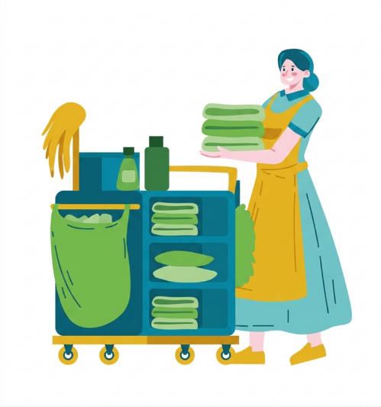
Housekeeping:
Low-Impact Room Care
Housekeeping strongly influences water use, laundry volume, cleaning chemical use and amenity waste.
Key Routines:
apply linen change policy consistently
use correct chemical dosing
switch off lights or systems in empty serviced rooms where policy allows
refill bulk amenities hygienically and accurately
sort waste correctly and safely
report leaks, faulty flushes and damaged seals immediately
Service Principle:
Low-impact housekeeping should feel organised, hygienic, high-quality and just as attentive.
See also ›
C1 M2
- Circular Economy and Resource Efficiency

Slide 22

Kitchen & F&B: Waste-Aware Service Preparation
Kitchen sustainability begins before service and continues after it.
Key Routines:
forecast prep volumes carefully
separate edible surplus from unavoidable waste
store food correctly to extend usable life
use lids, correct heat levels and full loads where possible
reduce unnecessary single-use items in prep and service
record repeated waste patterns to inform menu and purchasing decisions
Operational Principle:
Waste prevention starts with disciplined preparation, storage and service planning.
See also ›
C1 M2
- Circular Economy and Resource Efficiency

Slide 23

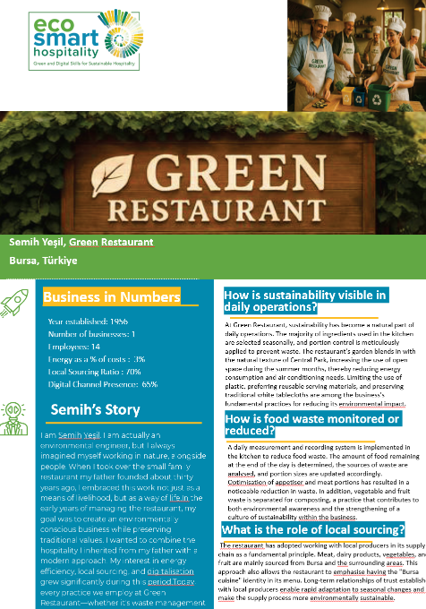
Green Restaurant, Bursa
Green Restaurant demonstrates how sustainability can become part of normal daily operations through consistent routines and measurement. The restaurant applies portion control, monitors food waste daily, separates organic waste for composting, and works closely with local producers throughout the year.
Rather than relying on large-scale initiatives, the business focuses on small operational decisions repeated consistently. Kitchen teams record waste levels, analyse recurring causes of waste, and adjust preparation volumes accordingly. Seasonal sourcing, reusable service materials, and waste separation are integrated into everyday practice rather than treated as occasional projects.
The case demonstrates how sustainability becomes more effective when it is built into routine workflows, staff habits, and operational decision-making.
Key Learning: Small operational improvements become powerful when they are measured, repeated consistently, and embedded into everyday work practices.

Slide 24


Procurement & Local Sourcing
Purchasing decisions shape waste, durability, packaging and local value creation.
Good Routines Include:
favouring reusable, refillable or bulk solutions where practical
comparing product life alongside purchase price
choosing local or regional suppliers when quality and reliability fit
checking certifications, safety standards and labour considerations where relevant
avoiding duplicate stock and unnecessary packaging
Decision Rule:
Buy less, buy better, and think about the full life cycle of what you purchase.
See also ›
C1 M2
- Circular Economy and Resource Efficiency

Slide 25
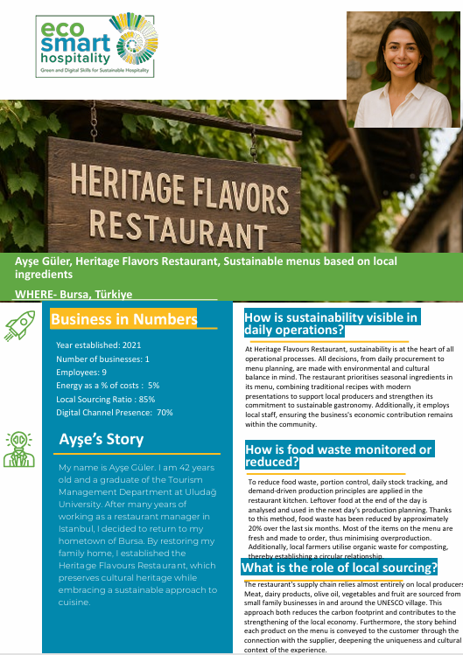
Heritage Flavors, Bursa
Heritage Flavours demonstrates how sustainability can become part of everyday purchasing decisions rather than a separate environmental initiative. Operating from a restored family home in Bursa, the restaurant builds its menu around seasonal ingredients and long-standing relationships with local producers.
By aligning menu planning with what is available locally and in season, the business reduces transport impacts, supports regional food networks, and creates a stronger sense of place for guests. Procurement is treated as both an operational decision and a hospitality experience, helping guests connect food choices with local culture and identity.
This approach illustrates how sustainable sourcing can strengthen resilience, reduce unnecessary complexity, and create experiences that feel authentic and rooted in place.
Key Learning: Procurement decisions shape environmental impact, local value creation, operational resilience, and the guest experience at the same time.

Slide 26
Building a Sustainable Shift Routine: Example
A sustainability-aware shift routine can be built into five checkpoints:
⁰¹
Start of shift - Equipment check, stock check, role reminders
⁰²
During service Reduce - overproduction, support guest choices, reduce avoidable waste
⁰³
Changeover - Switch-off checks, refill control, waste separation
⁰⁴
End of shift - Record spoilage, unusual waste, leaks or guest feedback
⁰⁵
Weekly review - Identify one improvement and assign responsibility
Sustainability becomes reliable when it is visible, routine and shared.

Slide 27

Reflection
and Discussion
Which department in your organisation has:
the greatest sustainability impact?
the easiest quick wins?
the biggest barrier to routine change?
Discuss:
Where does responsibility feel unclear?
Where do time pressures block good practice?
Which routine would improve most through a
simple checklist?
Small-group prompt
Choose one department and identify:
one routine to stop
one routine to improve
one routine to standardise

Slide 28
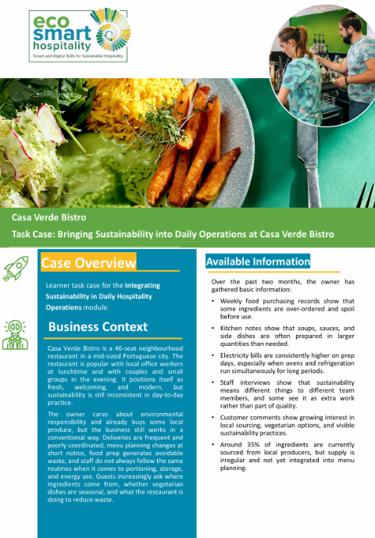
Casa Verde Bistro
Applied Practice Challenge
Casa Verde Bistro is a 46-seat neighbourhood restaurant that wants sustainability to become a visible and consistent part of daily operations.
All the information you need is in the case study
Your Challenge
Which daily routines would you review first?
Which operational issues create the greatest environmental impact?
What information would you monitor more closely?
Which improvements could be implemented quickly?
How could staff become more involved in sustainability decisions?
What would success look like after six months?
Key Learning
Monitoring helps reveal where sustainability challenges exist. Lasting improvement happens when operational routines, team behaviours, and management decisions work together to address them.

Slide 29
⁰¹
⁰⁴
Different departments create different kinds of environmental impact.
Maintenance and procurement determine long-term efficiency and cost.
⁰²
Front office influences information, guest behaviour and partner choice.
⁰⁵
Sustainable hospitality needs role clarity, repeatable routines and shared accountability.
⁰³
Key Takeways
Housekeeping and kitchen routines shape water, chemical, food and amenity use.
Each department needs its own standard, shaped for the work it does.

Slide 30
Exploration: Photo Audit
of One Department
Using a phone or tablet, capture up to five sustainability hotspots in one department.
Possible examples:
unnecessary lighting
unclear waste separation
excess packaging
duplicated cleaning materials
poorly positioned refill stations
unclear guest signage
For each image, add:
What is happening?
Why does it matter?
What should change?
Output:
Create a simple visual audit board for class or team discussion.

Slide 31
Monitoring Resource Use and Everyday Performance
Simple tools for tracking energy, water, waste and material use in hospitality SMEs. To introduce practical ways of measuring daily performance so teams can move from good intentions to informed action.
03

Slide 32

Why Monitoring Matters
- You improve what you notice
Monitoring helps hospitality teams:
see patterns in daily work
spot leaks, overuse and waste early
compare current practice with improved practice
make sustainability part of normal management
In SMEs, monitoring works with simple tools.
A clipboard, a simple spreadsheet or a short weekly dashboard can already improve decisions.
Monitoring exists to sharpen operational judgment.

Slide 33


Monitoring Routines (examples)
Daily Checks
Weekly Checks
Unusual food waste
Lights or equipment left on
Amenity and chemical use
Leaks or abnormal water use
Spoilage, breakage or returns
Laundry volume
Energy meter patterns
Water consumption trends
Use of disposables versus reusables
Guest comments related to comfort or sustainability
See also ›
C2 M2
· Data Analytics in Hospitality

Slide 34
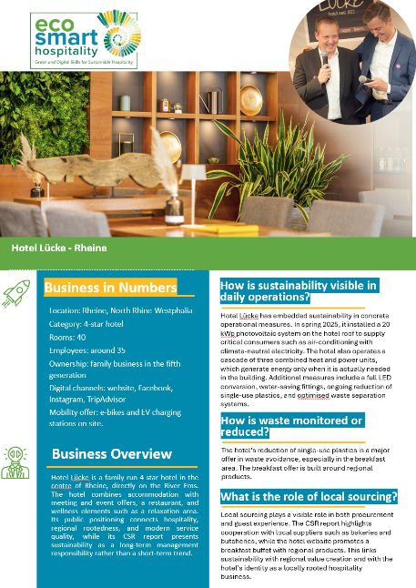
Hotel Lücke, Germany
Hotel Lücke demonstrates how sustainability can be strengthened through monitoring, measurement, and long-term operational planning. The hotel combines practical sustainability measures with clear performance indicators, helping management connect environmental goals with daily decision-making.
Its sustainability approach includes photovoltaic energy generation, combined heat and power systems, water-saving technologies, reduced single-use plastics, and improved waste separation. Progress is tracked through indicators such as energy use, carbon emissions, recycling rates, water consumption, and guest satisfaction.
By linking sustainability actions to measurable outcomes, the hotel creates a culture of continuous improvement and informed management rather than relying on assumptions or good intentions alone.
Key Learning: Monitoring turns sustainability from an aspiration into a management practice by making performance visible, measurable, and actionable.

Slide 35

Simple KPIs for Sustainable Operations (Examples)
Useful SME-friendly indicators include:
Food waste per service or per cover
Laundry loads per occupied room
Cleaning product use by floor or department
Guest uptake of towel or linen reuse options
Number of maintenance issues reported and resolved
Share of local or lower-impact supplier spend
These indicators give part of the picture.
They help make hidden patterns visible and easier to discuss.

Slide 36

Logs, Dashboards and Clear Responsibility
A simple monitoring system needs only three things:
A clear owner - Who records the information?
A simple format - Checklist, log sheet or spreadsheet
A review point - Daily briefing or weekly operations meeting
Avoid these common problems
collecting too much data
recording data nobody uses
measuring and then parking the data
⁰¹
⁰²
⁰³
Good monitoring supports staff judgment. It should not feel like surveillance.
See also ›
C2 M1
- AI in Hospitality

Slide 37
Exercise: Turning Data into Action
What the team tracked for four weeks
occupied rooms
laundry loads
guest uptake of reuse signage
housekeeping time per room
What they discovered
Reuse signage was unclear and applied inconsistently.
Action taken
clearer guest wording
short staff refresher briefing
end-of-shift linen check
What to review next
Laundry volume per occupied room and guest comments on room care.
Problem - Laundry costs were rising and room turnover felt inconsistent.
See also ›
C2 M2
- Data Analytics in Hospitality

Slide 38

Reflection and Discussion
Think of one resource your workplace uses every day.
Do you currently track it?
Is the data reliable enough to help a decision?
Who sees the information?
Wat would change if the data clearly showed overuse?
Discussion prompt:
What is the difference between measuring for blame and measuring for improvement?

Slide 39
⁰¹
⁰⁴
Monitoring turns sustainability into a management practice.
The goal is better decisions - good-enough measurement is enough.
⁰²
⁰⁵
Simple indicators are often enough for SMEs.
Data fuels learning and improvement.
⁰³
Key Takeways
Measure what matters, review it regularly, and act on what you learn.
Data becomes useful when roles, formats and review points are clear.

Slide 40
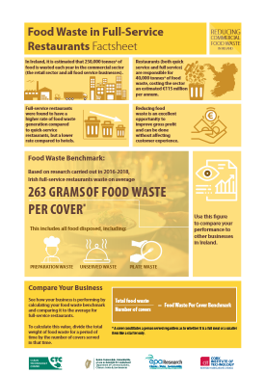
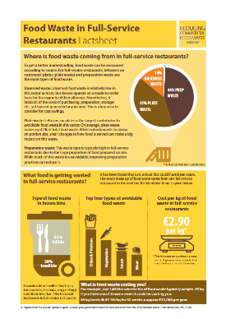
Further Reading and Challenge
A useful example for hospitality monitoring is food waste per cover. Measuring it helps reduce waste when you:
measure regularly
review the results
adjust menus, forecasting and service practice
Create a worksheet
We want to monitor…
We will measure it by…
The responsible person is…
We will review it every…
Source: https://www.epa.ie/media/epa-2020/monitoring-amp-assessment/circular-economy/Food-waste-in-Full-Service-Restaurants-v3.pdf

Slide 41
Team Behaviour, Responsibility and Culture
How habits, leadership and communication shape sustainable operations. To explore how hospitality teams build lasting sustainability practice through role modelling, clear expectations and shared responsibility.
04

Slide 42

Why Behaviour and Culture Matter
Many sustainability failures come from habits, supervision and handovers — awareness alone rarely fixes them.
They happen because of:
habits under time pressure
unclear expectations
inconsistent supervision
weak handover between shifts
the feeling that sustainability belongs to “someone else”
Culture becomes visible in small moments:
Does the team report waste?
Does anyone challenge overproduction?
Are switch-off checks normal or optional?
Good culture and involvement make the right actions easier.
See also ›
C3 M1
- Leading Green and Digital Change

Slide 43
What Drives or Blocks Sustainable Habits
Drivers and blockers or sustainable
habits
mixed messages
unrealistic workloads
confusing procedures
poor shift handover
no visible follow-up
simple routines
visible leadership
the right tools in the right place
regular reinforcement
shared goals and feedback
See also ›
C3 M1
- Leading Green and Digital Change

Slide 44

Role of Managers and Supervisors
Leaders shape sustainability culture by what they notice, ask about and repeat.
Managers and supervisors should:
explain why the routine matters
model the behaviour themselves
check standards respectfully and consistently
link sustainability to quality, cost and ethics together
run short feedback loops, shift by shift
Consistency builds sustainability culture, one shift at a time.
See also ›
C3 M1
- Leading Green and Digital Change

Slide 45

Staff Engagement Tools and Behavioural Nudges
Simple engagement tools include:
shift-start reminders
visible signage near equipment and waste stations
team challenges for waste reduction
sustainability champions or ambassadors
“win of the week” recognition
Examples of practical nudges
clearer default towel-reuse wording
colour-coded waste stations
refill points positioned for ease
short prompts at key equipment points
Nudges work best when they fit the real workflow.
See also ›
C3 M1
- Leading Green and Digital Change

Slide 46
Running a 5-Minute Green Team Briefing
⁰¹
Today’s focus
“Please watch unnecessary food waste during preparation.”
What success looks like - “Fewer full waste bins and better stock use by the end of service.”
⁰⁴
⁰²
Why it matters
“This supports both cost control and our sustainability goals.”
Close - “Raise any barrier now so we can solve it together.”
⁰⁵
Keep sustainability briefings practical, short and role-specific.
⁰³
What to do -“Use the prep waste bin, label open items clearly, and report overproduction.”
See also ›
C3 M1
- Leading Green and Digital Change

Slide 47
Reflection and Discussion
In small groups, discuss:
Which sustainable behaviour already feels normal in your workplace?
Which one still depends on one motivated person?
Where do staff feel tension between speed, service and sustainability?
Activity: Write three team norms
Examples:
“We report leaks immediately.”
“We avoid overproduction where possible.”
“We leave spaces ready for the next shift.”
Output:
Agree one team norm you would introduce first.
Follow up!

Slide 48
⁰¹
⁰⁴
Sustainable operations depend on people as much as procedures.
Positive team norms make good practice more stable under pressure.
⁰²
Habits improve when routines are simple, visible and reinforced.
⁰³
Shared responsibility is part of professional hospitality identity
Key Takeways
Managers build culture through consistency, not occasional messaging.

Slide 49
Applied Practice: Redesigning One Daily Routine
From concept to action in a real hospitality workflow. To apply the module by auditing one routine, identifying hotspots, proposing improvements, and presenting the operational and environmental case for change.
05

Slide 50

How to Audit the Routine
Your Tastks:
Choose one daily routine from your workplace or a case scenario:
guest room turnover
breakfast buffet close-down
prep and storage
end-of-shift cleaning
front desk guest information
waste station management
⁰¹
Map the current routine
⁰²
Identify resource-use and waste hotspots
⁰³
Redesign the routine with sustainability checkpoints
⁰⁴
Explain who does what and how success will be measured

Slide 51
01. Applied Practice Brief
Helpful question: Where does this routine create environmental impact that adds little guest value?
⁰¹
⁰³
⁰⁵
Define the routine clearly.
Mark the points where waste, overuse or inconsistency happen.
Propose:
one quick win
one process change
one team behaviour changez
List the materials, energy, water, time and people involved.
Define two indicators to review after implementation.
⁰²
⁰⁴
See also ›
C1 M2
- ·Circular Economy and Resource Efficiency

Slide 52
02. Example: Guest Room Turnover
Current Issues
lights and HVAC left on after departure
partially used amenities discarded
unnecessary linen replacement
duplicated cleaning steps
Current Issues
Redesigned Routine
entry check for lights, windows and thermostat
refill or bulk amenity system
policy-based linen replacement
standardised trolley setup to reduce duplicate movement
final room check for waste separation and shut-off compliance
Nredesigned Routine
Expected Gains
Expected Gains
lower energy use
lower amenity waste
more consistent room standards

Slide 53
03. Building a Business and Environmental Case
A strong sustainability proposal explains both impact and practicality
The Expected Environmental Benefit
Likely Staff Barriers
The Problem
The Proposed Change
The Expected Operational Benefit
How The Results Will Be Reviewed
See also ›
C3 M1
- Leading Green and Digital Change

Slide 54

04. Learner Task and Assessment
Assessment task
Prepare a short 3–5 slide mini-presentation or a one-page action sheet showing your redesigned routine.
Assessment criteria
clear description of the current routine
accurate identification of sustainability hotspots
realistic and role-appropriate improvements
clear sustainability checkpoints
practical indicators for follow-up
professional communication and feasibility
Optional extension
Pilot the new routine for one week and report back on early results.

Slide 55

C1 M1 · Case study pack
Download the full case studies
Every business featured in this module has a full case study. Use the links below to open each one.
Heritage Flavours - Bursa, Türkiye
Seasonal menus built on local producers in a restored family home.
Download the full case study · {{CASE_URL_HERFLA}}
Green Restaurant (GreenRes) - Türkiye
Environmental engineer-owner threads waste management, local sourcing and digital tools through daily routines.
Download the full case study · {{CASE_URL_GREENRES}}
Hotel Luecke - Rheine, Germany (TVW)
Casa Verde Bistro - Portugal (task)
CHP cascade, PV, single-use plastic reduction; CSR reporting as long-term management.
Applied task: bring sustainability into daily operations at a 46-seat neighbourhood restaurant.
Download the full case study · {{CASE_URL_LUECKE}}
Download the full case study · {{CASE_URL_CASAVERDE}}

Slide 56
Thank You for Engaging
We hope this module has enriched your knowledge and sharpened your practice.
Thank you for your commitment to hospitality that is intelligent, sustainable, and human centred. Carry these insights into your work, lead with ethics and empathy, and let technology serve people with care.
www.ecosmartproject.eu

